Slide 1




Artificial Intelligence for All
Letizia Jaccheri
Tromsø 02.10.2025

Slide 2
Position
I feel privileged for the opportunities I have had and continue to have, even if at times I have experienced moments of discrimination due to sexism

Slide 3
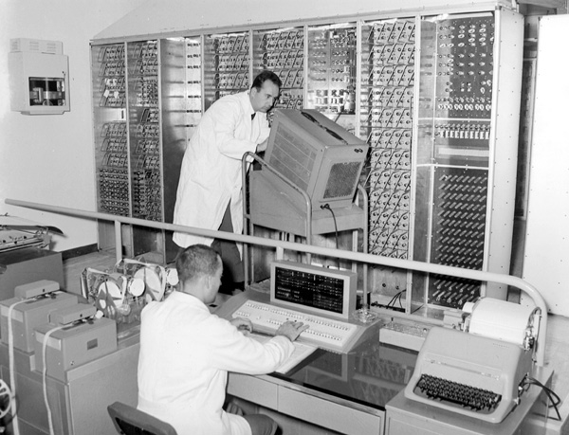
1960
Notes:
It's the 1960s. In Pisa, in November 1961, the large electronic calculator for scientific research developed by the University of Pisa's Research Center was inaugurated at the University of Pisa's Institute of Physics, in the presence of the President of the Republic and the Rectors of all the Italian universities, who had gathered in Pisa for the opening of the new academic year.
The initiative immediately attracted the interest of the Olivetti company of Ivrea, which had already begun electronics studies and designs in connection with its own production programs. Under an agreement with the University of Pisa, Olivetti guaranteed financial support and the collaboration of its specialized personnel.
I, too, was born in the mid-1960s.

Slide 4
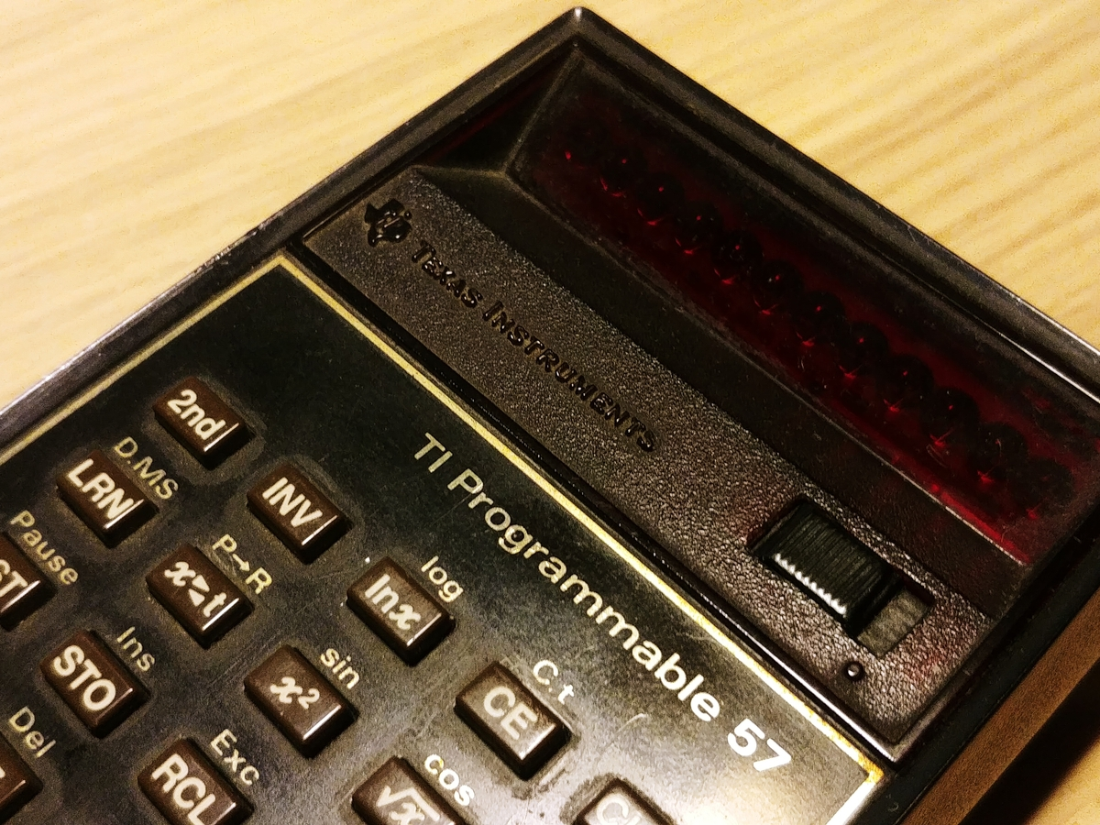
1970
Notes:
In high school, we had two hours of math a week. Our math teacher, Annamaria Bastianoni, taught us how to program the Texas T57 calculator. She had worked as a temporary researcher at the National Research Center when she was young. She was a math teacher at a high school, but she was a pioneer. While the calculator was doing calculations, the teacher would respectfully address the calculator and say, "Think about it."
Math was easy for me, but Greek translations, on the other hand, were becoming increasingly difficult.

Slide 5
1980
Notes:
It is the decade in which I made the most important choices: Computer science, then software engineering and Norway.

Slide 6
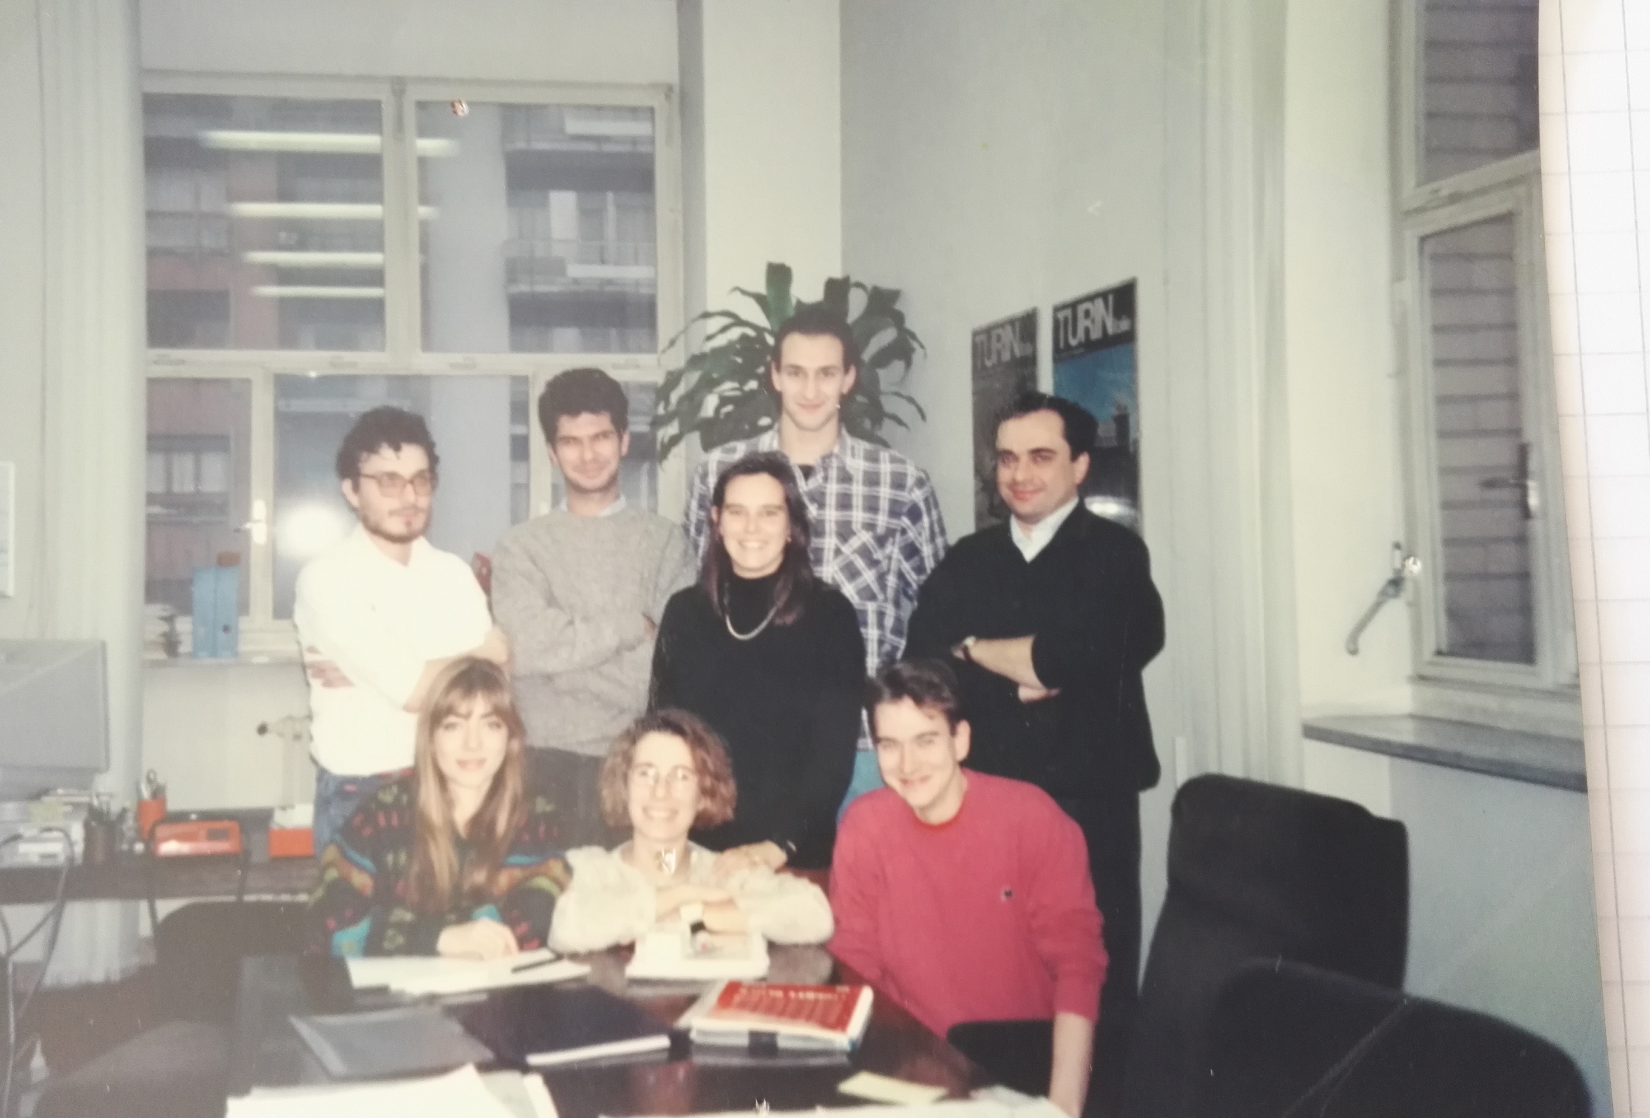
1990
Jaccheri, M. L., & Conradi, R. 1993. Techniques for process model evolution in EPOS. IEEE Transactions on Software Engineering, 19(12), 1145-1156.
Notes:
I came back to Italy and I lived 5 years in Torino. I published my first journal paper with my Norwegian professor Reidar Conradi.

Slide 7

2000
Software engineering issues in interactive installation artA Trifonova, L Jaccheri, K Bergaust International Journal of Arts and Technology 1 (1), 43-65
Notes:
In 2000 I had two children under 2 years, I wrote my book Kjærlighet og Computer and I discovered the world of interdisciplinarity.

Slide 8
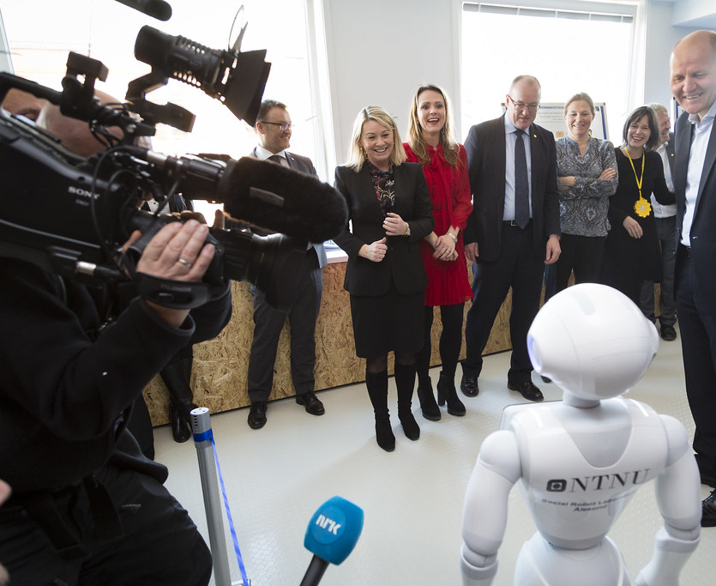
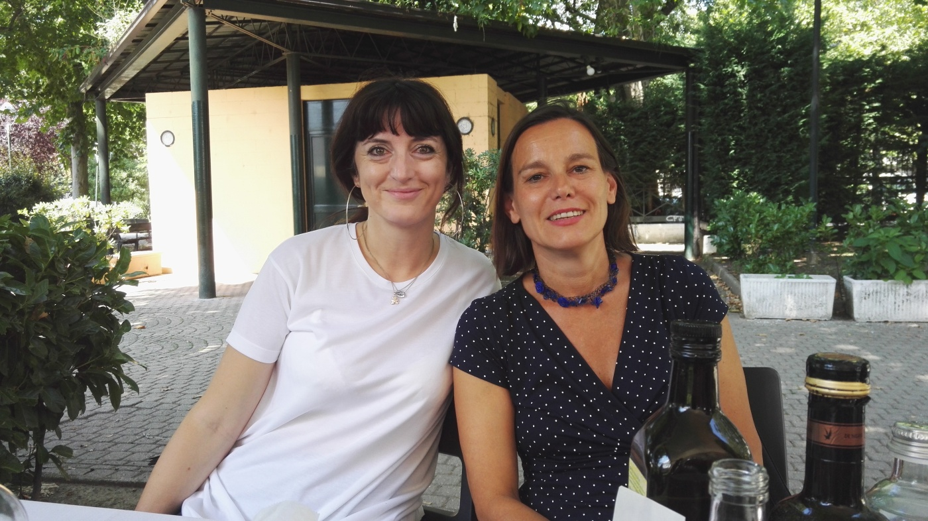
2010
A checklist for integrating student empirical studies with research and teaching goalsJC Carver, L Jaccheri, S Morasca, F Shull Empirical Software Engineering 15 (1), 35-59
Notes:
I became department head. Together with Telenor we started the NTNU AI lab. In this pictures I am together with very important people but I understood that I like to be with students. This paper tells about my struggles on how to combine research and education.

Slide 9
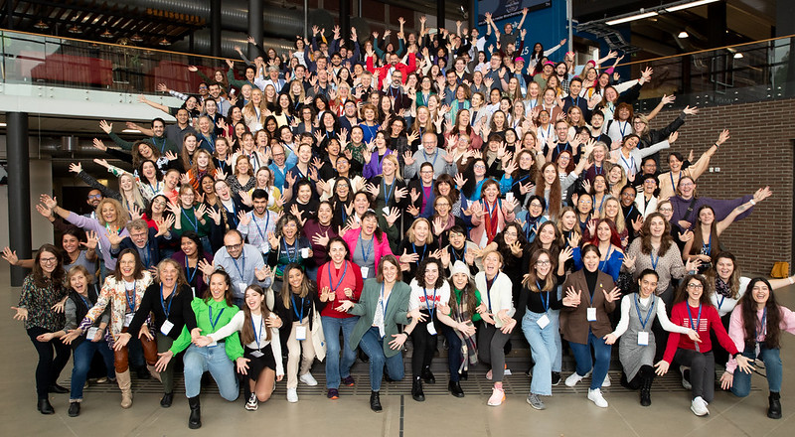
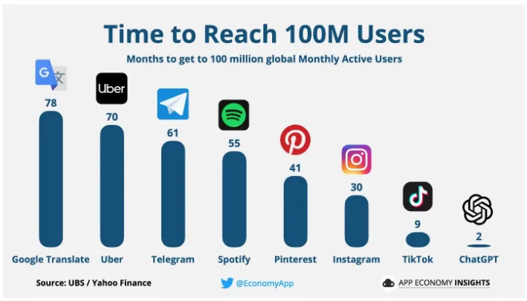
2020
Developing software for motivating individuals with intellectual disabilities to do outdoor physical activity, Juan C. Torrado, Ida Wold, Letizia Jaccheri, Susanna Pelagatti, Stefano Chessa, Javier Gomez, Gunnar Hartvigsen, Henriette MichalsenAuthors Info & Claims, ICSE-SEIS '20: Proceedings of the ACM/IEEE 42nd International Conference on Software Engineering: Software Engineering in Society
Notes:
60 years have passed since the first program in computer science was started in Pisa

Slide 10
Learning/reflection objectives for this lecture
Develop AI - Use AI?
AI for all – AI against one or several groups?
Who has developed and is developing AI?
What do you want to do with AI?

Slide 11



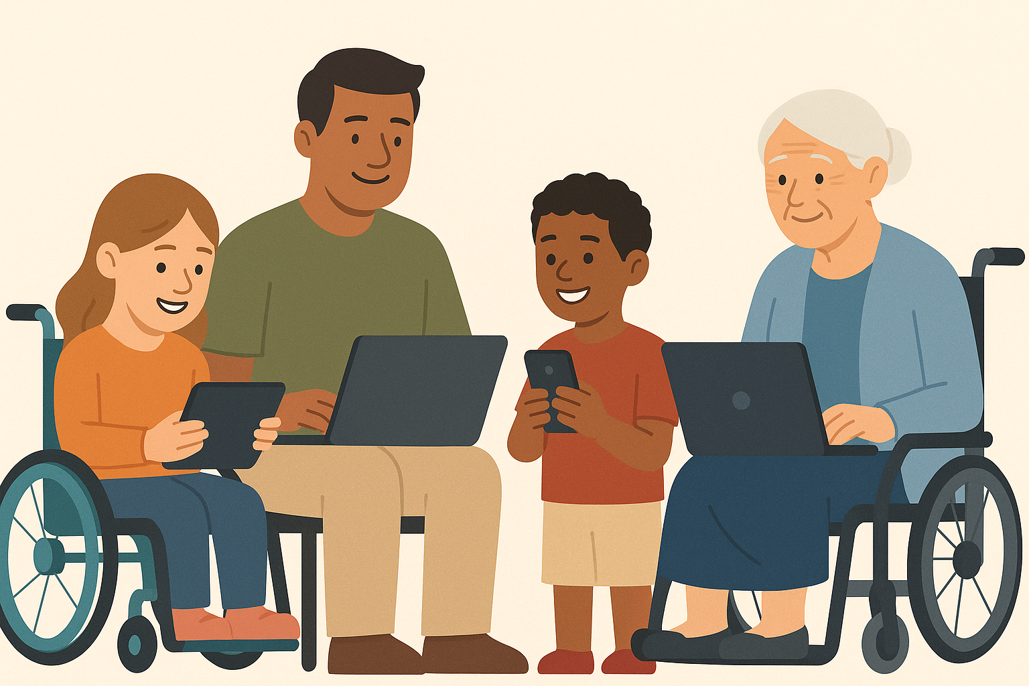


Software Engineering
Notes:
CS started in early 60’s. the subfields are inter-related and discoveries and innovations in one field can bring challenges, discoveries and innovations in other field. My own field software engineering is very inter related with AI as we use AI tools to develop software AND we use software engineering techniques and processes to develop AI systems.

Slide 12

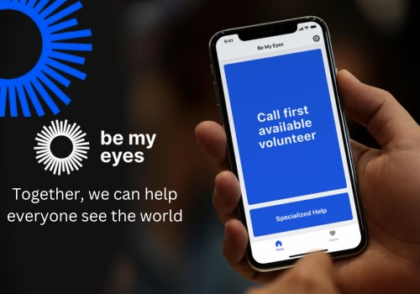






10 apps for people with disabilities
Be My Eyes
VoiceOver
Wheelmap
Avaz Pro (non verbal)
SoundAlert
Aira
Proloquo2Go
TapToTalk
Medisafe
Dragon Anywhere
Notes:
https://medium.com/@rana.adnanali/top-10-mobile-apps-that-make-life-easier-for-people-with-disabilities-681a5fedf3ef
1. Be My Eyes
Connecting visually impaired users with volunteers through video calls, this app provides real-time assistance for tasks that require sight, such as identifying objects or reading labels.
2. VoiceOver
Apple’s built-in screen reader enhances device accessibility for blind and visually impaired users by narrating what’s on the screen, enabling independent device usage.
3. Wheelmap
Promoting inclusivity, this app crowd-sources information about wheelchair-accessible places, allowing users to navigate urban environments confidently.
4. Avaz Pro
Catering to non-verbal individuals, this communication app employs customizable picture-based communication to foster expression and connection.
5. SoundAlert
Enhancing safety for users with hearing impairments, this app alerts them to important sounds in their environment, providing awareness and security.
6. Aira
By combining wearable technology and human agents, Aira assists blind and low-vision users with navigation, reading, and other daily tasks.
7. Proloquo2Go
This symbol-based communication app aids those with speech and language difficulties, enabling effective expression and communication.
8. TapToTalk
Focusing on language development and communication for users with autism, this app employs picture-based communication to foster interaction and learning.
9. Medisafe
Managing medication schedules is made easier with this app, particularly for users with cognitive impairments, promoting adherence and well-being.
10. Dragon Anywhere
Providing a hands-free control option for those with mobility impairments, this dictation app enables users to navigate mobile devices without physical input.

Slide 13
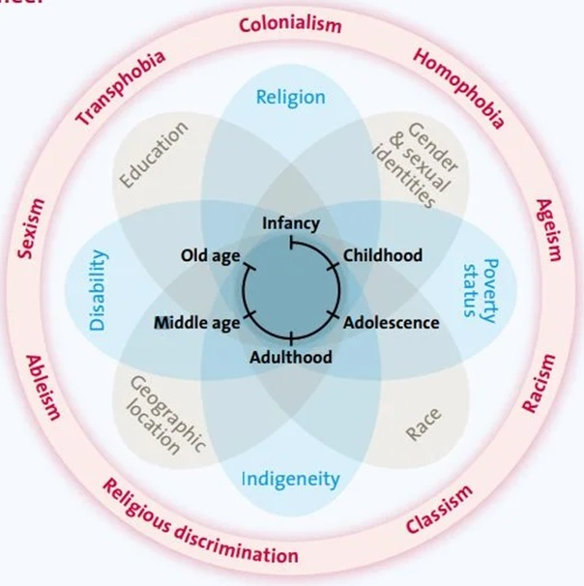
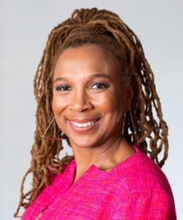
Intersectionality
Bias
Kimberlé Crenshaw 1989
Notes:
https://www.unwomen.org/sites/default/files/2022-01/Intersectionality-resource-guide-and-toolkit-en.pdf Intersectionality Resource Guide and Tool Kit
https://youtu.be/akOe5-UsQ2o?si=GSxI73Yif1dw8y7c TEK talk 2 millions play 2016
Intersectionality is an analytical framework used to understand how different social identity categories, such as gender, race, class, sexuality, disability, and more, interact in complex ways and create unique experiences of discrimination or privilege for individuals.
The term was first introduced by American lawyer and academic Kimberlé Crenshaw in the late 1980s. She wanted to explain how black women experienced discrimination in a way that was different from both white women and black men, because they faced both gender and racial discrimination at the same time. Intersectionality therefore looks at how different forms of power and oppression overlap and influence each other.
For example, a black, disabled, lesbian woman may experience discrimination based on all of these identity aspects at the same time, giving her a different experience than someone who only experiences discrimination based on one of these identity categories.
Intersectionality is important for understanding that social problems and injustice cannot be solved by looking at each identity category in isolation. It requires a holistic approach that takes into account the different layers of identity and how they influence each oth

Slide 14
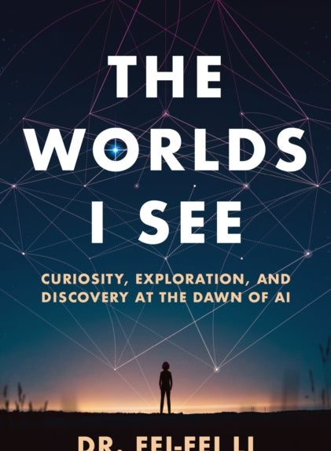
AI – Women
Female roles in AI
Siri voice
Avatar
AI for/against women
For – Menstruation Apps, Designing Software to Prevent Child Marriage Globally, Tappetina
Against - automatic processing of CVs
Women creating AI
Fei Fei Li
Francesca Rossi
Notes:
Kvinner er et eksempel
The Top 10 women in the world of AI in 2023 https://aimagazine.com/top10/the-top-10-women-in-the-world-of-ai-in-2023
Paper https://dl.acm.org/doi/abs/10.1145/3311927.3325322

Slide 15
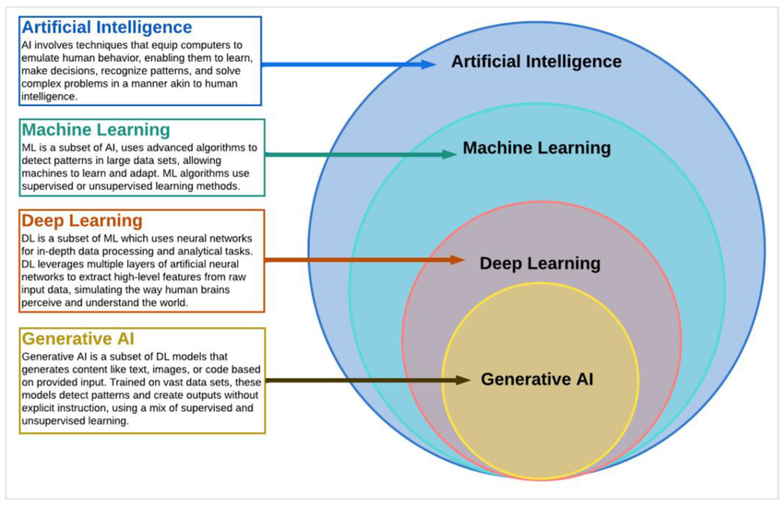
AI Definitions
AI is a field of study (and research field) within computer science that develops and studies intelligent machines
AI stands for a computer system that performs tasks that typically require human intelligence, such as recognizing speech, making decisions and identifying patterns
Generatively create new content (sound, code, images, text, video)
Notes:
AI has become a catchall term for applications that perform complex tasks that once required human input, such as communicating with customers online or playing chess. The term is often used interchangeably with its subfields, which include machine learning (ML) and deep learning.
There are differences, however. For example, machine learning is focused on building systems that learn or improve their performance based on the data they consume. It’s important to note that although all machine learning is AI, not all AI is machine learning.
To get the full value from AI, many companies are making significant investments in data science teams. Data science combines statistics, computer science, and business knowledge to extract value from various data sources.

Slide 16
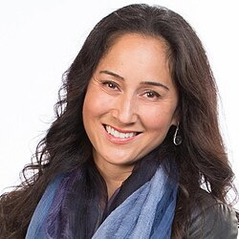
AI
1950 Alan Turing “Computer Machinery and Intelligence”
1956 John McCarthy - academic discipline and first AI programs (LISP)
1959 Arthur Samuel created the term machine learning
1965 Edward Feigenbaum and Joshua Lederberg first expert system
1966 Joseph Weizenbaum first chatbot ELIZA
1968 Alexey Ivakhnenko Deep Learning
1980 Geoffrey Hinton Neural networks
1997 Deep Blue (developed by IBM) beat Gary Kasparov
2000 Cynthia Breazeal developed the first robot that could simulate human emotions
2006 Companies such as Twitter, Facebook, and Netflix started utilizing AI as a part of their advertising and user experience (UX) algorithms
2011 Apple released Siri, the first popular virtual assistant.
2022 (30 November) Open AI CHATGPT available
2024
  Nobel Prize in Physics John J. Hopfield and Geoffrey E. Hinton - enable machine learning with artificial neural networks.
  Nobel Prize in Chemistry David Baker, Demis Hassabis, and John M. Jumper for developing AI algorithms that solved the 50-year protein structure prediction challenge
Notes:
https://dorik.com/blog/history-of-ai
The 1956 Dartmouth workshop was the moment that AI gained its name
URL
The history of AI
1950s: The first AI programs were written to run on the Ferranti Mark 1 machine of the University of Manchester: a checkers-playing program written by Christopher Strachey and a chess-playing program written by Dietrich Prinz.
1960s: The Dartmouth Conference was organized by John McCarthy, Marvin Minsky, Nathaniel Rochester, and Claude Shannon to discuss the possibility of thinking machines and artificial intelligence.
1970s: The first expert systems were developed.
1980s: The first neural networks were developed.
1990s: The first autonomous robots were developed.
2000s: The first self-driving cars were developed.google translator came in 2006 based on statistical methods.
2010s: The first AI-powered virtual assistants were developed. Deep learning revolution, AlexNet 2012
2020s: AI continues to advance and is being used in a wide range of applications, from healthcare to finance to transportation 1.

Slide 17
Why now?
Hardware – software – data
GPT – Generativ Pretrained Transformer autumn 2022

Slide 18
Hardware
From Kilobyte til Petabyte 10¹⁵
Notes:
It is a big misconception that you need to be very intelligent and preferably a man to understand computers, algorithms and AI. I have been working with data since the early 80s, it was kind of by chance. And I think it is as difficult to figure out a knitting pattern as it is to understand algorithms.
We need the past to have a language to talk about the present and the past
K = 1000
Giga = 1000000000
104 = 10000
1017 = 100,000,000,000,000,000
Memory 36 Kbyte
Speed ​​104 flops
Floating point operation per second
– now 8 Giga
– now 1017

Slide 19
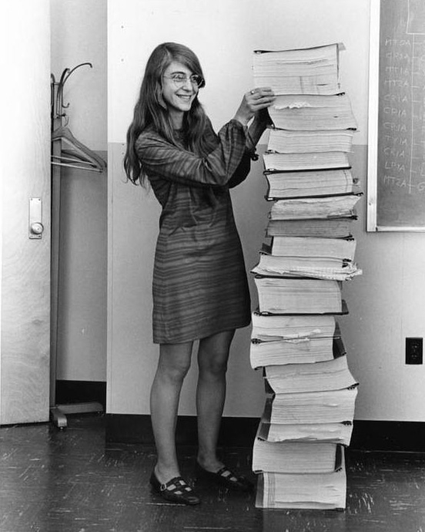
Software
Apollo 145,000 lines of code
Now millions of lines of code
Notes:
Margaret Hamilton (who I met once!), the first person to coin the term software engineering and who wrote the software for the Apollo expedition in the 60s is a woman (Apollo first man on the moon)
Margaret Hamilton (who I met once!), the first person to coin the term software engineering and who wrote the software for the Apollo expedition in the 60s is a woman
Apollo 145,000 lines of code
Now millions of lines of code

Slide 20
Data
CHAT GPT 4 has been trained on almost all text ever written
10¹³
Notes:
According to https://www.youtube.com/watch?v=_6R7Ym6Vy_I&t=2220s
All human written text = 10¹³
CHAT GPT 4 = 300 x 10¹²

Slide 21

Economy/power
- GPT-3 has an estimated training time of 355-GPU-years and an estimated training cost of $4.6 million.
- If we trained GPT-3 at IDUN, it would take 355/36 = 10 years
Notes:
NodeType#CPUsProcessor#CoresRAM[GB]#GPUsGPU type
How can we compare to the system on which Open AI trains its models to give an idea
https://lambdalabs.com/blog/demystifying-gpt-3
CHAT GPT4 – it costed 1 M Dollars to pre train According to https://www.youtube.com/watch?v=_6R7Ym6Vy_I&t=2220s
https://www.hpc.ntnu.no/idun/

Slide 22

Women in ICT
2012: 17%
2023: 19,4%
Which are the numbers for your stakeholder group?
Notes:
Some numbers about ICT specialists in Europe and World and who are the ICT specialists
In 2022, 9.4 million people in the EU worked as ICT specialists
In the world 55.3 million in 2020
3 out of 4 companies have problems finding specialists with the right skills
And how many ICT specialists are women?
2% in 10 years
How many years will it take if we continue like this?
eurostat
https://ec.europa.eu/eurostat/statistics-explained/index.php?title=ICT_specialists_in_employment
In 2023, 80.6 % of men were employed as ICT specialists in the EU against 19.4 % of women.

Slide 23
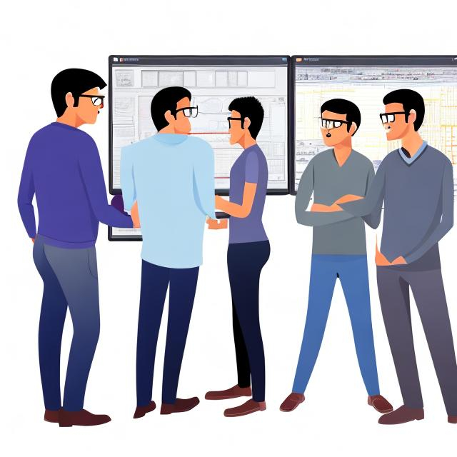
I asked OpenArt
During Autumn 2023, I asked OpenArt to draw four software engineers

Slide 24

I asked again in 2025

Slide 25
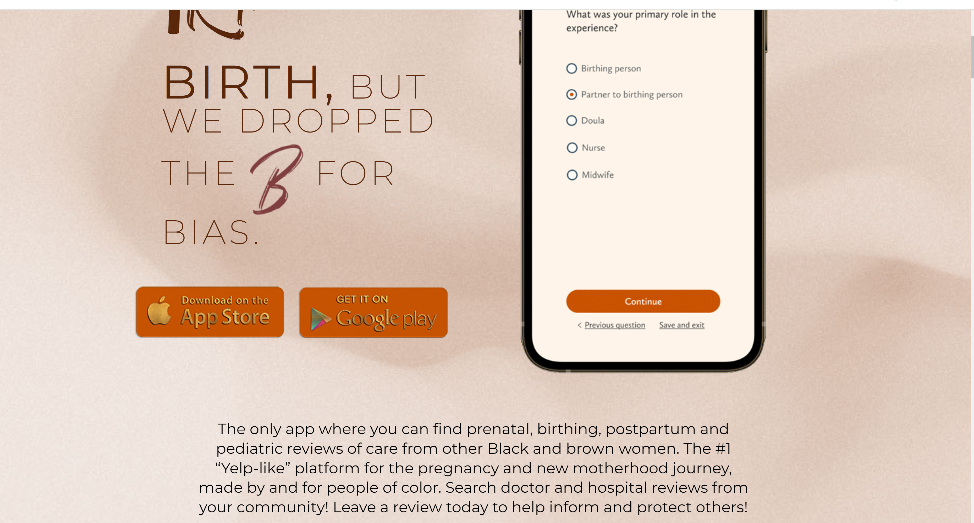
AI for all
We cannot change old networks, we can make new ones around AI
AI for women https://irthapp.com/
EmpowHerAI
AI for your stakeholder group?

Slide 26
AI ACT
While the Act does not explicitly mention individuals with disabilities, it emphasizes the importance of ensuring that AI systems are accessible and do not discriminate against any group.
Notes:
Risiko nivå
Vi har allerede regler som regulerer diskriminering i Norge og i Europa

Slide 27
Learning/reflection objectives for this lecture
Develop AI - Use AI?
AI for all – AI against one or several groups?
Who has developed and is developing AI?
What do you want to do with AI?
you do not know how much we are using chatgpt

Slide 28



More References
Crenshaw, K. W. (2013). Mapping the margins: Intersectionality, identity politics, and violence against women of color. In M. A. Fineman & R. Mykitiuk (Eds.), *The public nature of private violence* (pp. 93–118). Routledge.
Hagen, M. H., Hartvigsen, G., Jaccheri, L., & Papavlasopoulou, S. (2024). Digital psychosocial follow-up for childhood critical illness survivors: A qualitative interview study on health professionals’ perspectives. *Scandinavian Journal of Child and Adolescent Psychiatry and Psychology, 12*(1), 50–62.
El Shemy, I., Jaccheri, L., Giannakos, M., & Vulchanova, M. (2024). Participatory design of augmented reality games for word learning in autistic children: The parental perspective. In *Proceedings of IFIP ICEC ’24*.
Cutrupi, C. M., Zanardi, I., & Jaccheri, L. (2024). Draw a software engineer test: Preliminary attempts to investigate university students’ perceptions of software engineering professions. In *Proceedings of the 5th ACM/IEEE Workshop on Gender Equality, Diversity, and Inclusion in Software Engineering*.
Cutrupi, C. M., Jaccheri, L., & Serebrenik, A. (2026). Gender diversity interventions in software engineering: A comprehensive review of existing practices. *Computer Science Review, 59,* 100812.
Cutrupi, C. M., Jaccheri, L., & Papavlasopoulou, S. (2025). Women’s participation in student software development teams: A cross-sectional study on role distribution. *IEEE Transactions on Software Engineering.*
Takaoka, A. J. W., Cutrupi, C. M., & Jaccheri, L. (2025). Intersectional software engineering as a field. *Software, 4*(3), 18.

Slide 29







Norwegian and European best Practices
ADA – 1997 - ongoing
Kodeløypa – 14 - ongoing
IDUN – 19 - 22
EUGAIN – 20 – 24
Horizon CRAFT – 21 – 25
Erasmus + Women Stem Up 22-25
ACM WomENcourage 23
Abelia Tech Kvinner 17 – ongoing
Erasmus + TECHLARP 25-27
ACM Trondheim Chapter
Notes:
But why?
What are the challenges?
And in our projects we are trying to combat these challenges,
Examples from EUGAIN
Calling the applicants, Welcome day, March 8 - Women's Day, Network lunches, Programming courses, social activities such as Mountain hiking, PhD party, Invite high school girls from all over the country, Presentations and workshops, Personal meeting with role models, Break down stereotypes and bias, hire women role models
This is answer to question about what works
Explain briefly what these projects have done and achieved since 1997
Measures such as
Information
Mentoring
Network
Anti bias training

