Slide 1




Soft(ware) Stories: Tecnologia, Identità e Giustizia di genere nel mondo digitale
Letizia Jaccheri (letiziajaccheri.org)
AI for All
We Should All Be Feminists in Software Engineering
Notes:
https://speakers.acm.org/speakers/jaccheri_10303

Slide 2

The Distinguished Speakers Program
is made possible by
For additional information, please visit http://dsp.acm.org/

Slide 3
About ACM
ACM, the Association for Computing Machinery (www.acm.org), is the premier global community of computing professionals and students with nearly 100,000 members in more than 170 countries interacting with more than 2 million computing professionals worldwide.
OUR MISSION: We help computing professionals to be their best and most creative. We connect them to their peers, to what the latest developments, and inspire them to advance the profession and make a positive impact on society.
OUR VISION: We see a world where computing helps solve tomorrow’s problems – where we use our knowledge and skills to advance the computing profession and make a positive social impact throughout the world.
I am proud to be an ACM Member.

Slide 4







Norwegian and European best Practices
ADA – 1997 - ongoing
Kodeløypa – 14 - ongoing
IDUN – 19 - 22
EUGAIN – 20 – 24
Horizon CRAFT – 21 – 25
Erasmus + Women Stem Up 22-25
ACM WomENcourage 23
Abelia Tech Kvinner 17 – ongoing
Erasmus + TECHLARP 25-27
ACM Trondheim Chapter
Notes:
But why?
What are the challenges?
And in our projects we are trying to combat these challenges,
Examples from EUGAIN
Calling the applicants, Welcome day, March 8 - Women's Day, Network lunches, Programming courses, social activities such as Mountain hiking, PhD party, Invite high school girls from all over the country, Presentations and workshops, Personal meeting with role models, Break down stereotypes and bias, hire women role models
This is answer to question about what works
Explain briefly what these projects have done and achieved since 1997
Measures such as
Information
Mentoring
Network
Anti bias training

Slide 5
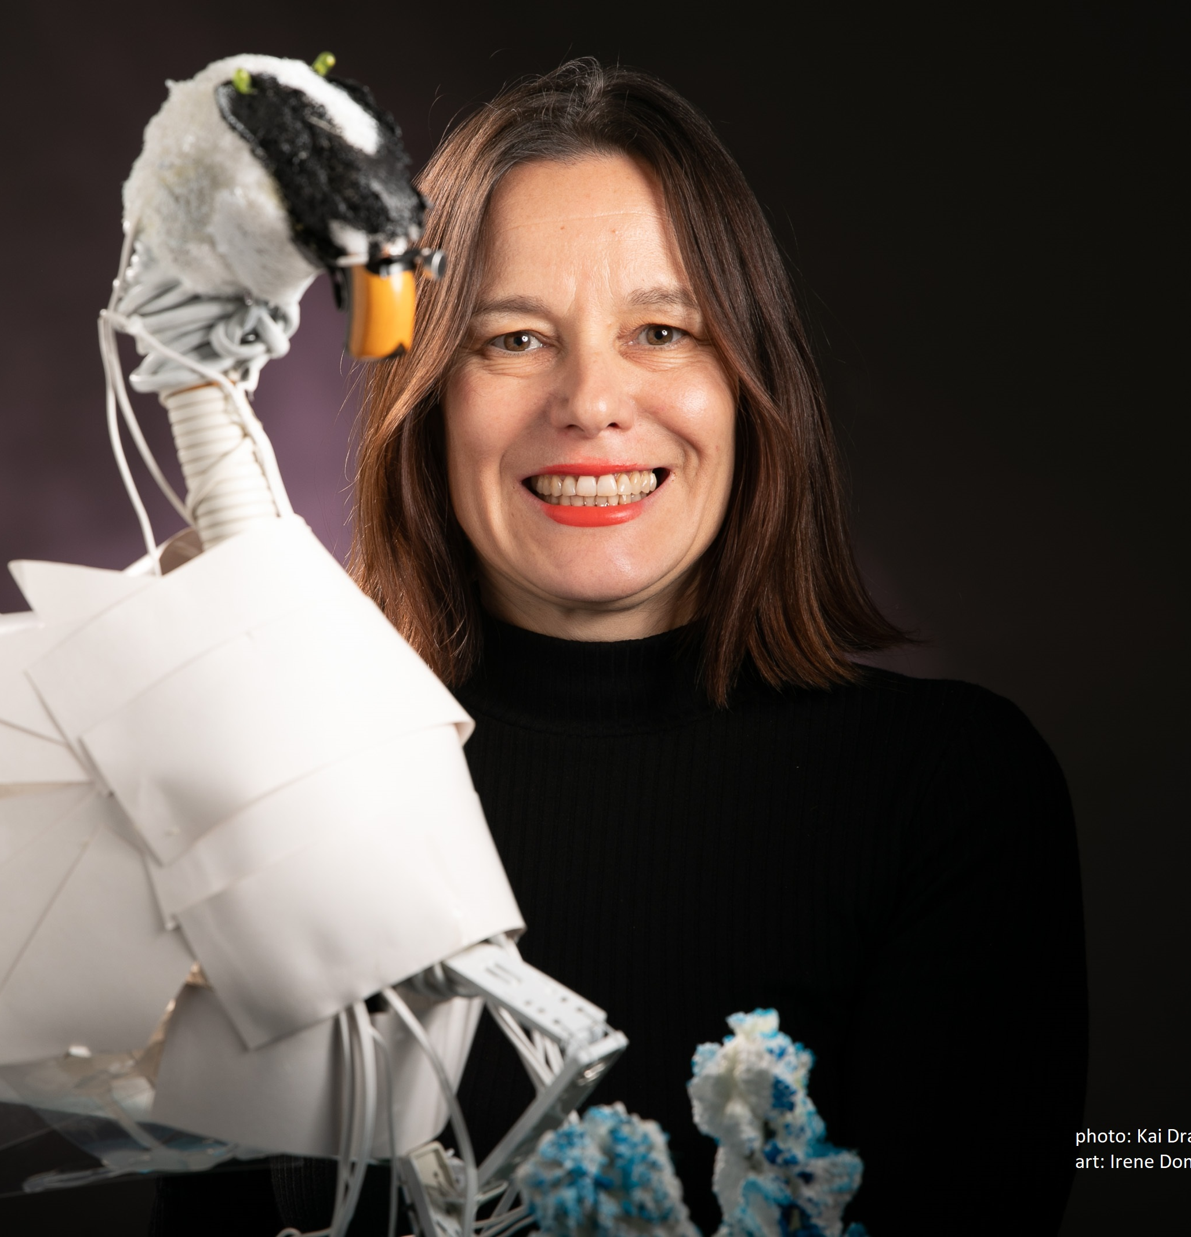
About you
Intervention: An intentional action or program designed to promote gender equality in computer science, such as mentoring, workshops, or policy changes.
Research study: A systematic investigation that analyzes data to understand barriers, outcomes, and effective strategies for achieving gender equality in computer science.

Slide 6

Stakeholders
Status quo
Goal
Type of Intervention
Risks
Plan your own Intervention
Letizia Jaccheri, NTNU, October 2025
Notes:
Q: Do you know about any interventions/techniques for improving balance and eliminating biases?

Slide 7
Research question
Research method
Data collection
Data analysis
Where to publish
Plan your own Research Study
Letizia Jaccheri, NTNU, October 2025

Slide 8
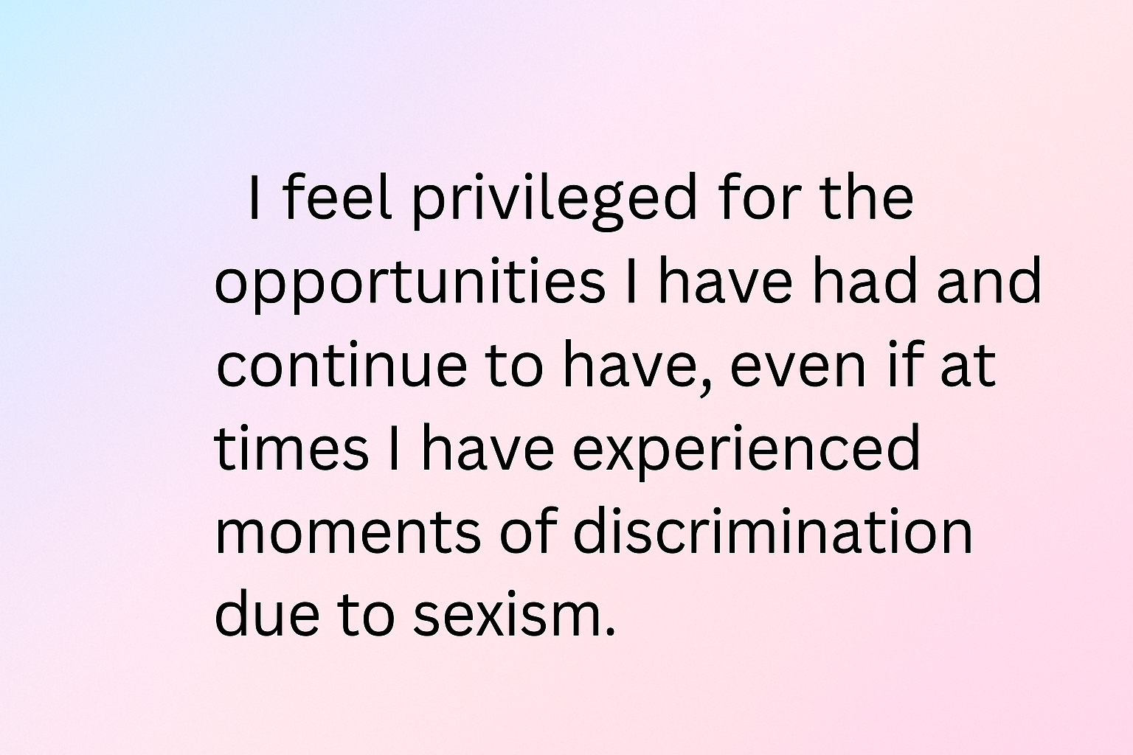
Position
Notes:
mi sento privilegiata per le opportunità che ho avuto e ho, anche se a volte, ho vissuto momenti di discriminazione a causa del sessismo

Slide 9
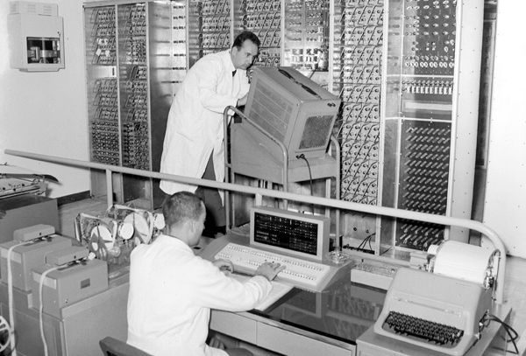
1960
Notes:
It's the 1960s. In Pisa, in November 1961, the large electronic calculator for scientific research developed by the University of Pisa's Research Center was inaugurated at the University of Pisa's Institute of Physics, in the presence of the President of the Republic and the Rectors of all the Italian universities, who had gathered in Pisa for the opening of the new academic year.
The initiative immediately attracted the interest of the Olivetti company of Ivrea, which had already begun electronics studies and designs in connection with its own production programs. Under an agreement with the University of Pisa, Olivetti guaranteed financial support and the collaboration of its specialized personnel.
I, too, was born in the mid-1960s.

Slide 10
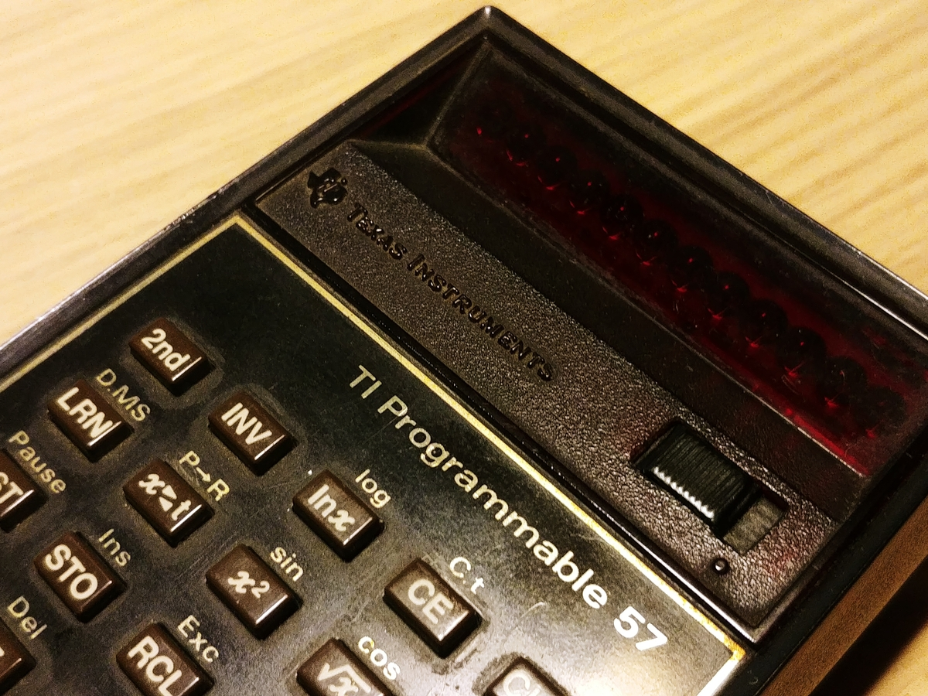
1970
Notes:
In high school, we had two hours of math a week. Our math teacher, Annamaria Bastianoni, taught us how to program the Texas T57 calculator. She had worked as a temporary researcher at the National Research Center when she was young. She was a math teacher at a high school, but she was a pioneer. While the calculator was doing calculations, the teacher would respectfully address the calculator and say, "Think about it."
Math was easy for me, but Greek translations, on the other hand, were becoming increasingly difficult.

Slide 11
1980
Notes:
It is the decade in which I made the most important choices: Computer science, then software engineering and Norway.

Slide 12
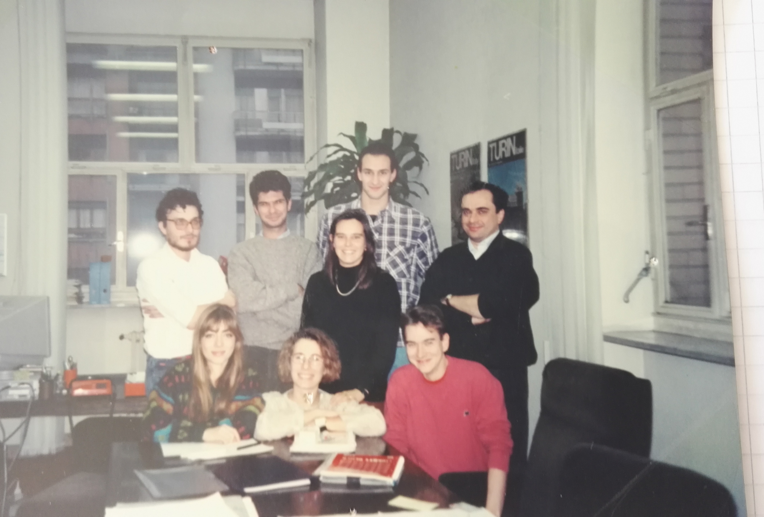
1990
Jaccheri, M. L., & Conradi, R. 1993. Techniques for process model evolution in EPOS. IEEE Transactions on Software Engineering, 19(12), 1145-1156.
Notes:
I came back to Italy and I lived 5 years in Torino. I published my first journal paper with my Norwegian professor Reidar Conradi.

Slide 13

2000
Software engineering issues in interactive installation artA Trifonova, L Jaccheri, K Bergaust International Journal of Arts and Technology 1 (1), 43-65
Notes:
In 2000 I had two children under 2 years, I wrote my book Kjærlighet og Computer and I discovered the world of interdisciplinarity.

Slide 14
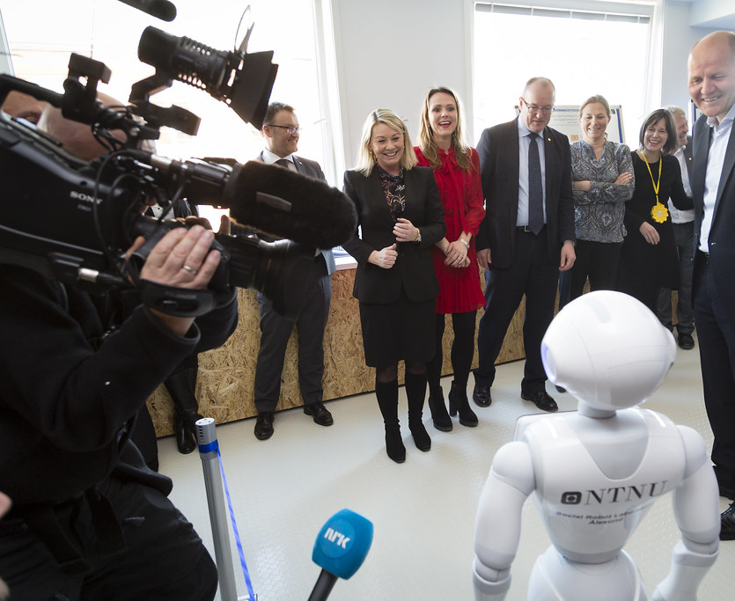
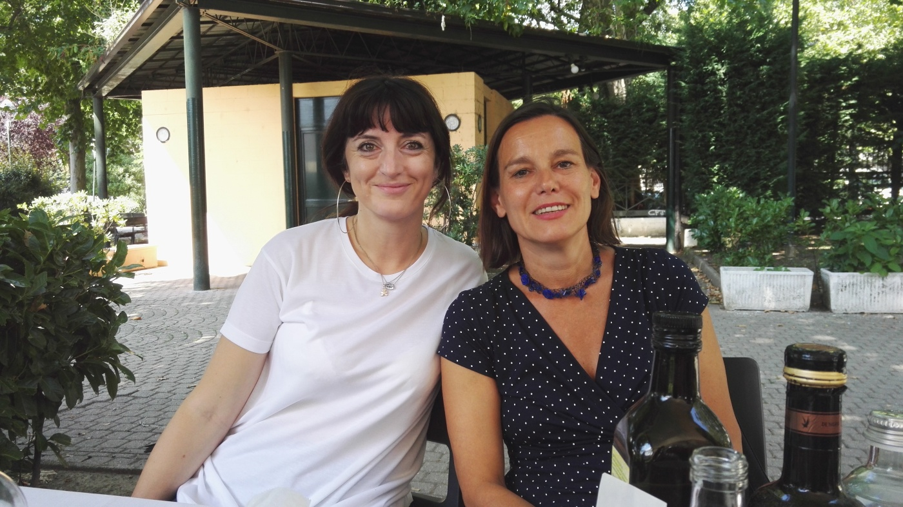
2010
A checklist for integrating student empirical studies with research and teaching goals JC Carver, L Jaccheri, S Morasca, F Shull Empirical Software Engineering 15 (1), 35-59
Notes:
I became department head. Together with Telenor we started the NTNU AI lab. In this pictures I am together with very important people but I understood that I like to be with students. This paper tells about my struggles on how to combine research and education.

Slide 15
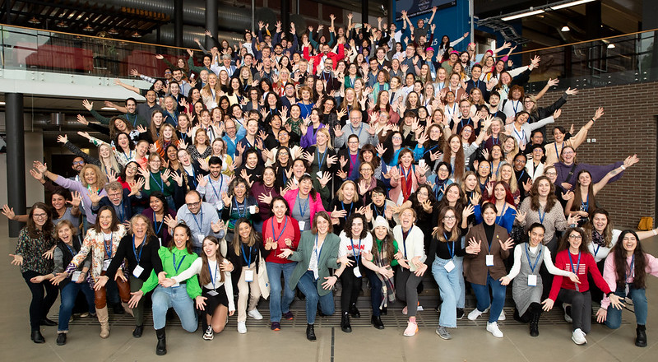
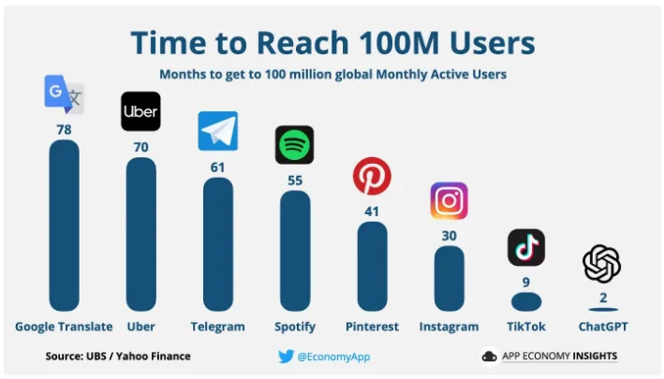
2020
Gender Diversity Interventions in Software Engineering: A Comprehensive Review of Existing Practices, CM Cutrupi, L Jaccheri, A Serebrenik, Computer Science Review 59, 100812
2026
Women’s Participation in Student Software Development Teams: A Cross-Sectional Study on Role Distribution, CM Cutrupi, L Jaccheri, S Papavlasopoulou, IEEE Transactions on Software Engineering
Notes:
60 years have passed since the first program in computer science was started in Pisa

Slide 16
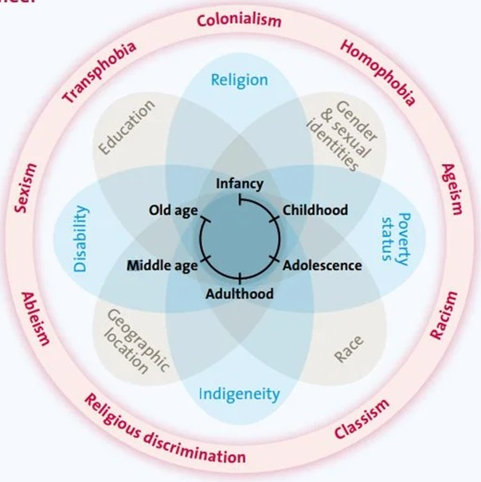
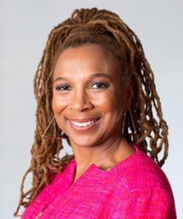
Intersectionality
Bias
Kimberlé Crenshaw 1989
Notes:
https://www.unwomen.org/sites/default/files/2022-01/Intersectionality-resource-guide-and-toolkit-en.pdf Intersectionality Resource Guide and Tool Kit
https://youtu.be/akOe5-UsQ2o?si=GSxI73Yif1dw8y7c TEK talk 2 millions play 2016
Intersectionality is an analytical framework used to understand how different social identity categories, such as gender, race, class, sexuality, disability, and more, interact in complex ways and create unique experiences of discrimination or privilege for individuals.
The term was first introduced by American lawyer and academic Kimberlé Crenshaw in the late 1980s. She wanted to explain how black women experienced discrimination in a way that was different from both white women and black men, because they faced both gender and racial discrimination at the same time. Intersectionality therefore looks at how different forms of power and oppression overlap and influence each other.
For example, a black, disabled, lesbian woman may experience discrimination based on all of these identity aspects at the same time, giving her a different experience than someone who only experiences discrimination based on one of these identity categories.
Intersectionality is important for understanding that social problems and injustice cannot be solved by looking at each identity category in isolation. It requires a holistic approach that takes into account the different layers of identity and how they influence each oth

Slide 17
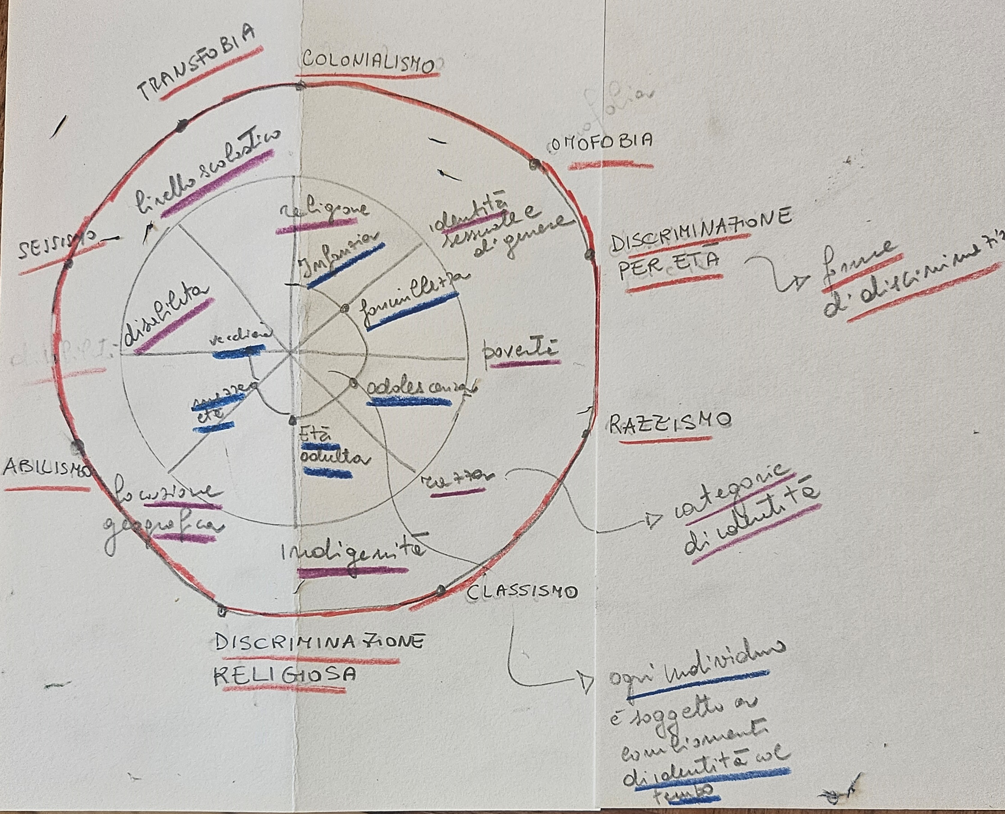

Slide 18
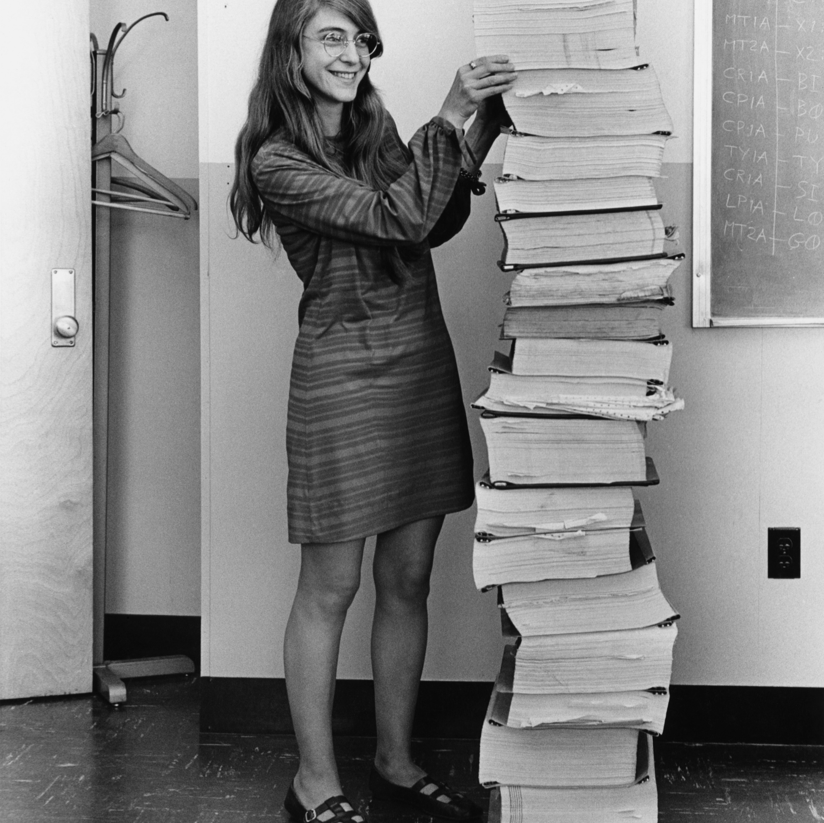
The Software Engineering (SE) concept was coined by a woman, Margaret Hamilton. Born 1936, she is an American computer scientist who directed the developed of the onboard flight software for NASA’s Apollo program

Slide 19
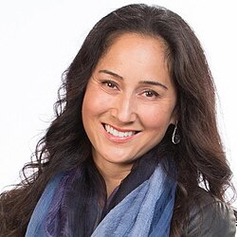
AI
1950 Alan Turing “Computer Machinery and Intelligence”
1956 John McCarthy - academic discipline and first AI programs (LISP)
1959 Arthur Samuel created the term machine learning
1965 Edward Feigenbaum and Joshua Lederberg first expert system
1966 Joseph Weizenbaum first chatbot ELIZA
1968 Alexey Ivakhnenko Deep Learning
1980 Geoffrey Hinton Neural networks
1997 Deep Blue (developed by IBM) beat Gary Kasparov
2000 Cynthia Breazeal developed the first robot that could simulate human emotions
2006 Companies such as Twitter, Facebook, and Netflix started utilizing AI as a part of their advertising and user experience (UX) algorithms
2011 Apple released Siri, the first popular virtual assistant.
2022 (30 November) Open AI CHATGPT available
2024
  Nobel Prize in Physics John J. Hopfield and Geoffrey E. Hinton - enable machine learning with artificial neural networks.
  Nobel Prize in Chemistry David Baker, Demis Hassabis, and John M. Jumper for developing AI algorithms that solved the 50-year protein structure prediction challenge
Notes:
https://dorik.com/blog/history-of-ai
The 1956 Dartmouth workshop was the moment that AI gained its name
URL
The history of AI
1950s: The first AI programs were written to run on the Ferranti Mark 1 machine of the University of Manchester: a checkers-playing program written by Christopher Strachey and a chess-playing program written by Dietrich Prinz.
1960s: The Dartmouth Conference was organized by John McCarthy, Marvin Minsky, Nathaniel Rochester, and Claude Shannon to discuss the possibility of thinking machines and artificial intelligence.
1970s: The first expert systems were developed.
1980s: The first neural networks were developed.
1990s: The first autonomous robots were developed.
2000s: The first self-driving cars were developed.google translator came in 2006 based on statistical methods.
2010s: The first AI-powered virtual assistants were developed. Deep learning revolution, AlexNet 2012
2020s: AI continues to advance and is being used in a wide range of applications, from healthcare to finance to transportation 1.

Slide 20
How to set up an intervention

Slide 21
What do we want?
Equal rights
Diversity of thoughts
Economic reasons

Slide 22
The European Commission report Women active in the ICT sector concludes that including more women in the digital economy could create an annual GDP boost in the EU of EUR 9 billion.
Notes:
https://www.itu.int/en/ITU-D/Digital-Inclusion/Women-and-Girls/Girls-in-ICT-Portal/Documents/women_active_in_ict.pdf

Slide 23

curb cut
Notes:
The Curb-Cut Effect is a vibrant illustration of how laws and programs designed to benefit vulnerable groups, such as the disabled or people of color, often end up benefiting all.

Slide 24

Women in ICT
2012: 17%
2023: 19,4%
Which are the numbers for your stakeholder group?
Notes:
Some numbers about ICT specialists in Europe and World and who are the ICT specialists
In 2022, 9.4 million people in the EU worked as ICT specialists
In the world 55.3 million in 2020
3 out of 4 companies have problems finding specialists with the right skills
And how many ICT specialists are women?
2% in 10 years
How many years will it take if we continue like this?
eurostat
https://ec.europa.eu/eurostat/statistics-explained/index.php?title=ICT_specialists_in_employment
In 2023, 80.6 % of men were employed as ICT specialists in the EU against 19.4 % of women.

Slide 25
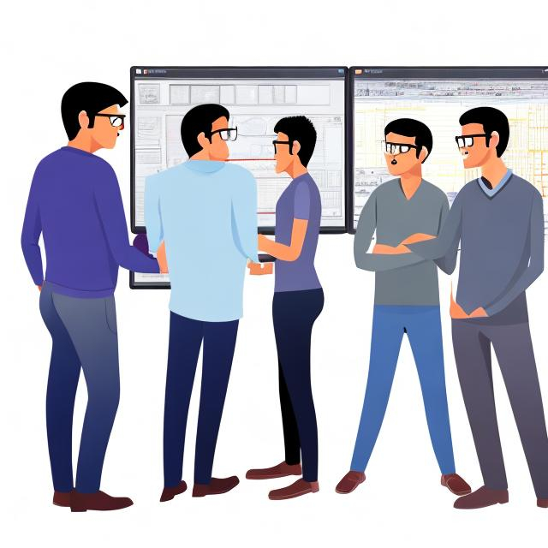
I asked OpenArt
During Autumn 2023, I asked OpenArt to draw four software engineers

Slide 26

I asked again in 2025

Slide 27
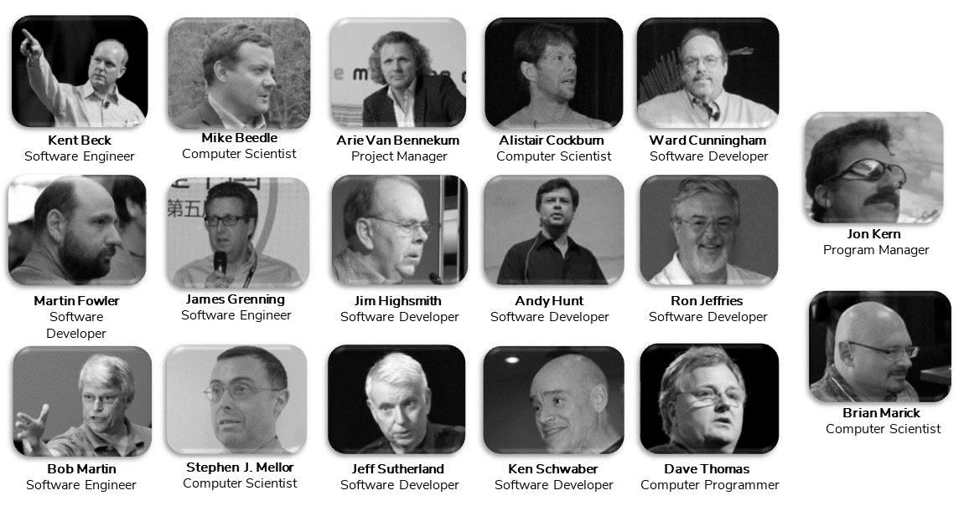
17 MEN CREATED
THE AGILE MANIFESTO
Notes:
Who developed the agile manifesto?

Slide 28
Software Engineering
Gender
Analysis and Design | Empirical software engineering | Software quality | Architecture | Processes | AI and SE | Human factors in SE
Gender and sex | Non-binary | LGBT+ rights | #metoo 2017 | Same-sex marriage 2001 | Intersectionality – triply | feminism
Notes:
Quality of the process and quality of the software
How do we understand gender and SE?
gender as a social construction (as opposed to sex, which is by birth) (it: genere, sesso – no:
gender as a non-binary term (as opposed to what it used to be: binary male vs female) - recent steps (correlated)
in the women's rights movement #metoo started in 2017
as well as the LGBTQ rights movement, while the first gay movement started more than 100 years ago, The Netherlands was the first country to allow same-sex marriage in 2001.
defining one's pronouns has become trendy (she/her)
non-binary acceptance of gender
intersectionality, that is, that our identities have several layers and they influence one another --> people who are not only women, but also LGBTQ and of color, are triply underprivileged and left out of rights not only in everyday life but in digital services as well.
gender equality charts in the EU or over the world and Gender Gap Index
education + social stereotypes --> girls' barriers to get into IT and CS
due to women's lack, and the lack of diversity, in IT teams --> bias in designing products due to a lack of diversity, for ex. HCI, AI, etc.
this creates usability problems, tech issues, discrimination, the spread of bias, etc. It is crucial to underline that taking gender into account in tech is not only a human rights issue, but an economic and technological need.

Slide 29
Why?
Stereotypes
Insufficient Knowledge of jobs
Job adv oriented towards men
Social expectations
Notes:
But why?
What are the challenges?
And in our projects we are trying to combat these challenges,

Slide 30
Define the problem
How do you say bias in your language?
Discuss one example of bias that intersect with SE

Slide 31
Interventions
Information
Network
Anti bias training
Mentoring
Notes:
Examples from ADA
Calling the applicants, Welcome day, March 8 - Women's Day, Network lunches, Programming courses, social activities such as Mountain hiking, PhD party, Invite high school girls from all over the country, Presentations and workshops, Personal meeting with role models, Break down stereotypes and bias, hire women role models
This is answer to question about what works
Explain briefly what these projects have done and achieved since 1997
Measures such as
https://www.ntnu.no/ada
https://www.ntnu.edu/idun
Eugain.eu
https://www.ntnu.edu/smartcities/craft
https://liu.se/en/news-item/erasmus-projektet-women-stem-up-tilldelas-4-1-miljoner-kronor
https://womencourage.acm.org/2023/
https://www.abelia.no/50techkvinner/

Slide 32
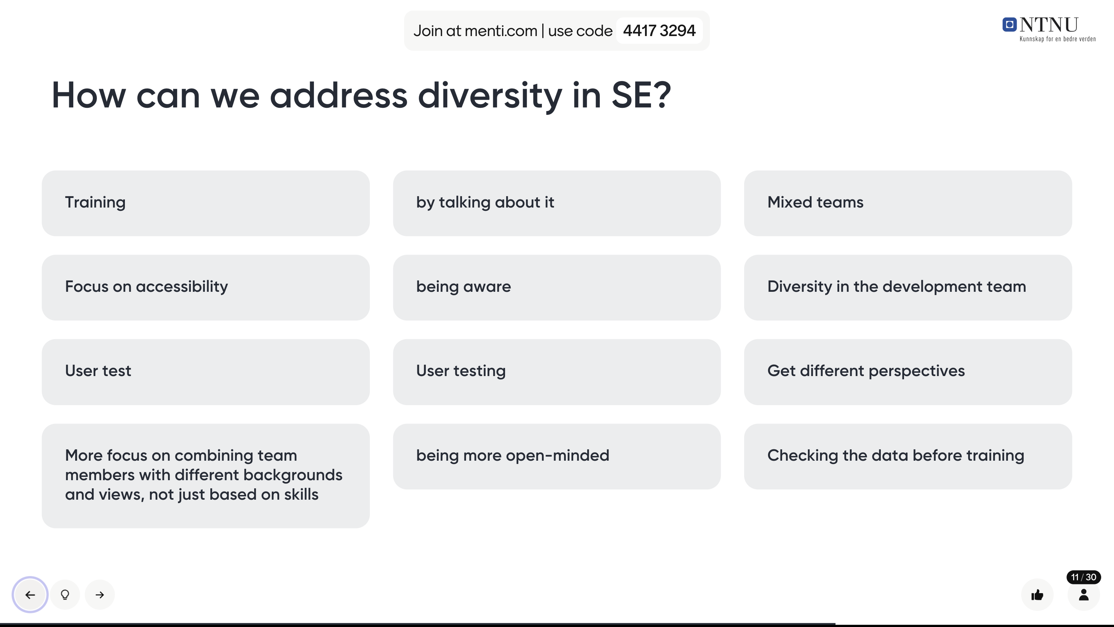

Slide 33

Female ICT students in 2021
20%
29%
Notes:
Numbers for bachelor master phd – in Norway we are doing a bit better 29%

Slide 34
Feminism is a movement advocating for women's rights and gender equality and it is a field of study. It began in the late 18th century calling for women's education and equal rights.
in the 19th and early 20th centuries, focused on legal issues like suffrage, culminating in women gaining the right to vote in many countries Norway 1913 – Italy 1945 - Switzerland 1971 (1991) - Afghanistan under Taliban control – Tuscany ++
from the 1960s to the 1980s, addressed broader social issues like reproductive rights, workplace discrimination, and sexuality.
The third wave, starting in the 1990s, challenged gender norms and embraced diversity, addressing issues of race, class, and LGBTQ+ rights.
Today, feminism continues to evolve, focusing on intersectionality and global gender inequalities.
Notes:
during the Enlightenment, with thinkers like Mary Wollstonecraft

Slide 35

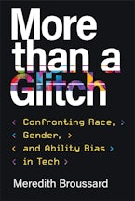
(some) biases in SE
Cultural/Social bias: These biases are often unconscious and can lead to discrimination, unfair treatment, and exclusion of certain groups in areas like hiring, healthcare, and legal proceedings.

Slide 36
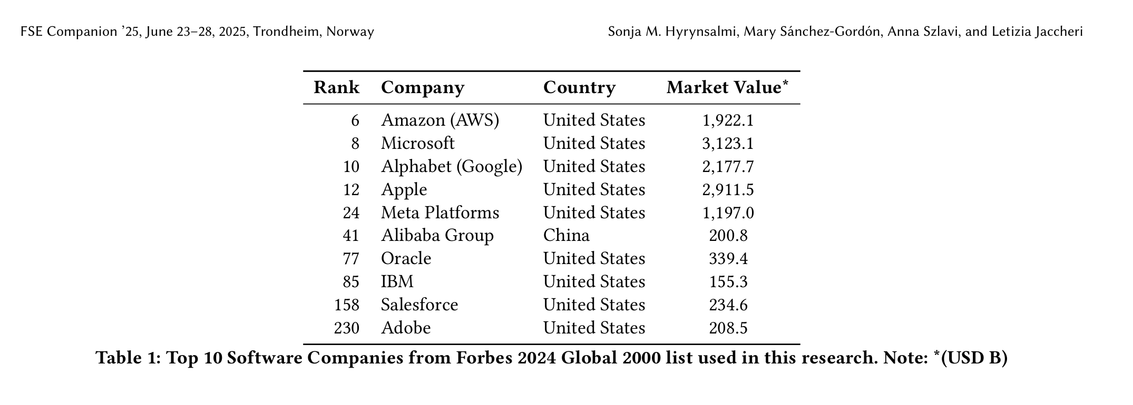
Corporate defunding DEI programs
Big tech companies are rethinking their strategy, either by reducing, increasing, or renaming their DEI initiatives.
Some companies keep on with their DEI strategy, at least so far, despite the challenging political climate.
Hyrynsalmi, Sonja, et al. "The Tech DEI Backlash-The Changing Landscape of Diversity, Equity, and Inclusion in Software Engineering." Proceedings of the 33rd ACM International Conference on the Foundations of Software Engineering. 2025. https://dl.acm.org/doi/abs/10.1145/3696630.3728695

Slide 37
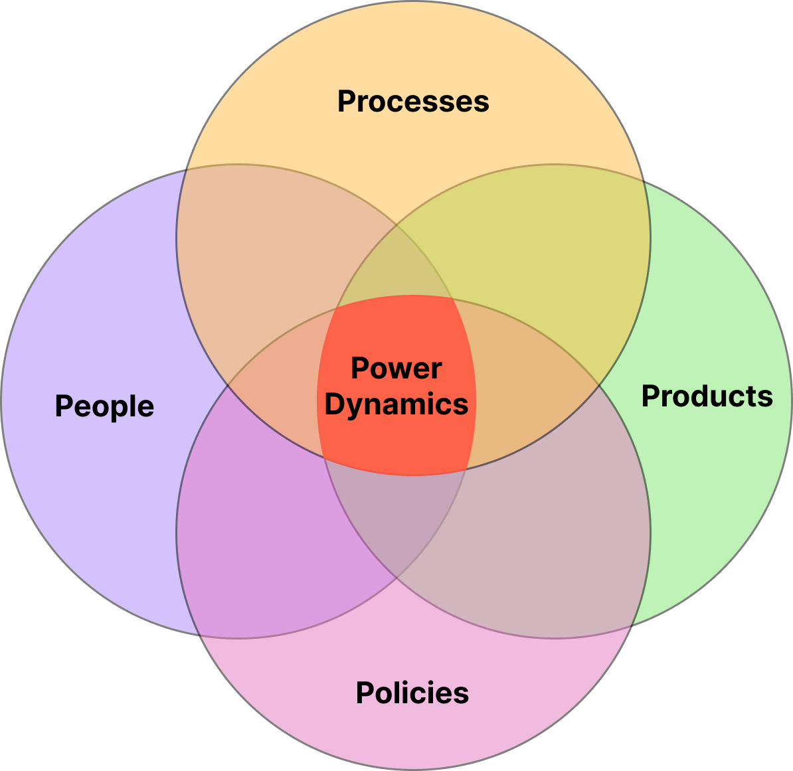
Intersectional Software Engineering (ISE)
ISE is defined as a field of study in software engineering that acquires knowledge about power dynamics in specific domains (e.g., education, industry, non-governmental organizations) and environments (e.g., classroom, workplace) using gender-forward intersectionality or intersectionality as a framework
Takaoka, Alicia Julia Wilson, Claudia Maria Cutrupi, and Letizia Jaccheri. "Intersectional Software Engineering as a Field." Software 4.3 (2025): 18. https://www.mdpi.com/2674-113X/4/3/18
Notes:
When we think how intersectionality can impact SE, we can define four power dynamics: in this paper we aimed to define ISE as a field of study.
ISE highlights the importance of recognizing and evaluating power imbalances through four fundamental dimensions
People: group dynamics, stereotypes, implicit bias
Processes: fundamental design errors, lack of user cetered participation
Products: exclusions from testing, developing
Policies: gender equity plans

Slide 38
Diversity TDT4290 Customer Driven Project
Group division based on diversity factors (gender, background, nationality)
Update compendium, modified evaluation criteria
Introducing the concept of diversity in reports
Implementing rotation system for non Agile roles
Holding a lecture about diversity
Introducing inclusive language in compendium
Conducting final survey
Observing diversity in customers and teaching staff
Studies to observe perceptions on diversity

Slide 39
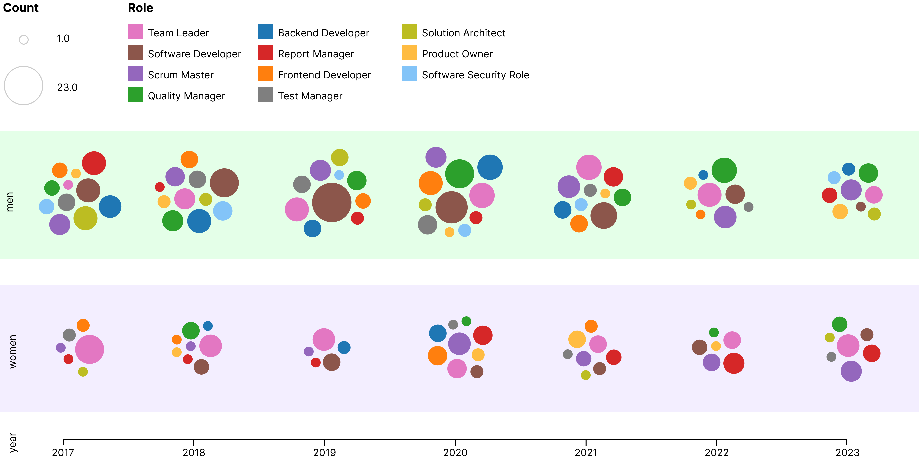
Diversity in software development teams
Cutrupi, C. M., Jaccheri, L., & Papavlasopoulou, S. (2025). Women’s Participation in Student Software Development Teams: A Cross-Sectional Study on Role Distribution. IEEE Transactions on Software Engineering. https://ieeexplore.ieee.org/abstract/document/11175036

Slide 40
What you can do in your project
The teams should reflect how diversity dimension(s) is perceived in their project, how diversity impacts the product realized, how diverse are users involved in the process.
The teams should reflect how diversity dimension(s) impact the team dynamics: what aspects of diversity you encounter, how you manage differences between members, criteria used to assign roles, how you address diversity topics during the course, self reflection on the impact of diversity.
From Compendium, paragraph 3.12, page 23

Slide 41



More References
Crenshaw, K. W. (2013). Mapping the margins: Intersectionality, identity politics, and violence against women of color. In M. A. Fineman & R. Mykitiuk (Eds.), *The public nature of private violence* (pp. 93–118). Routledge.
Hagen, M. H., Hartvigsen, G., Jaccheri, L., & Papavlasopoulou, S. (2024). Digital psychosocial follow-up for childhood critical illness survivors: A qualitative interview study on health professionals’ perspectives. *Scandinavian Journal of Child and Adolescent Psychiatry and Psychology, 12*(1), 50–62.
El Shemy, I., Jaccheri, L., Giannakos, M., & Vulchanova, M. (2024). Participatory design of augmented reality games for word learning in autistic children: The parental perspective. In *Proceedings of IFIP ICEC ’24*.
Cutrupi, C. M., Zanardi, I., & Jaccheri, L. (2024). Draw a software engineer test: Preliminary attempts to investigate university students’ perceptions of software engineering professions. In *Proceedings of the 5th ACM/IEEE Workshop on Gender Equality, Diversity, and Inclusion in Software Engineering*.
Cutrupi, C. M., Jaccheri, L., & Serebrenik, A. (2026). Gender diversity interventions in software engineering: A comprehensive review of existing practices. *Computer Science Review, 59,* 100812.
Cutrupi, C. M., Jaccheri, L., & Papavlasopoulou, S. (2025). Women’s participation in student software development teams: A cross-sectional study on role distribution. *IEEE Transactions on Software Engineering.*
Takaoka, A. J. W., Cutrupi, C. M., & Jaccheri, L. (2025). Intersectional software engineering as a field. *Software, 4*(3), 18.

