Slide 1


From Software through Art to Social Entrepreneurship
Letizia Jaccheri
letiziajaccheri.org
Lugano Universita’ della Svizzera Italiana
October 2019
Notes:
Welcome to my lecture, my name is letizia jaccheri, I work at the Norwegian university of science and technology in Norway and I am honored to give this speech. It is like a dream to be here in this beautiful country in this town I have never visited before
For my presentation I use an interactive software and I kindly ask each of you to open this open page and to give me a feedback when you are online.

Slide 2
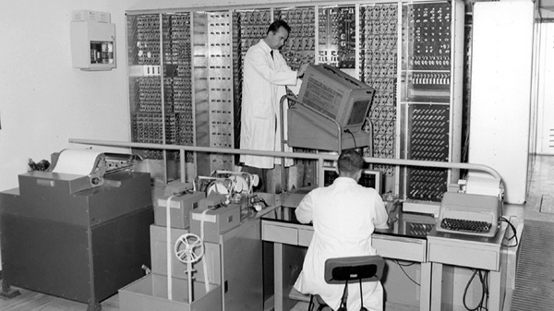
Pisa, Italy, 1960’s
The first Italian computer is build
Notes:
I was born in the 1960’s in Pisa Tuscany Ital. At that time in Pisa a group of researchers supported by the Italian Company Olivetti were developing the first Italian computer, called CEP. CEP was developed 500 meters from my house and that project attracted to Pisa many intelligent talents from all over Italy and the rest of the world. Not least that project inspired many people to start studying computer science. Personally I wrote my first program on a spectrum in 1982 and started computer science in 1983 we were 1300 students who started all together from many different places in Italy. It was the beginning of a big adventure.

Slide 3
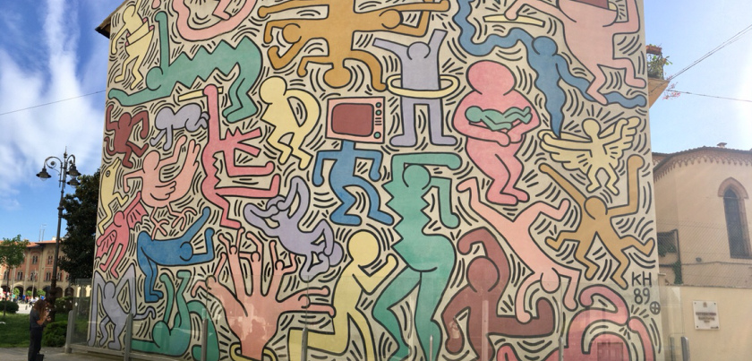
1988 Pisa Keith Haring Mural
Notes:
I graduated with a master in software engineering in 1988, the same time this mural was painted in Pisa. It was the first time I saw a computer depicted in a piece of art. Many of us had an intuition that computers and software were going to change everything.
Progress in software engineering has been remarkable over my professional lifetime. Our societies could not function without large, professional software systems. For building business systems, there are ecosystems of technologies that support the development and deployment of large enterprise applications. National utilities and infrastructure like energy, communications, and transport—all rely on complex computer systems. Software has allowed us to explore space and to create the World Wide Web, the most significant information system in the history of mankind. Humanity is now faced with a new set of challenges—climate change and extreme weather, declining natural resources, an increasing world population to be fed and housed, international terrorism, and the need to help elderly people lead satisfying and fulfilled lives. We need new technologies to help us address these problems and, for sure, software will play a central role in these technologies. Software engineering is, therefore, a critically important technology for the future of mankind.
Computer technology has never flop in the last 35 years since I started to study cs. The studies in computer science have never been as popular as now.

Slide 4
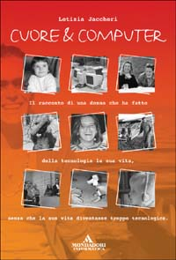
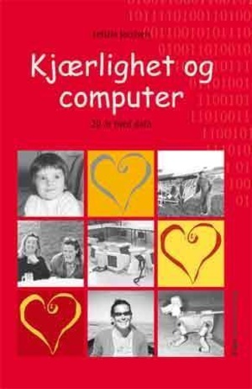
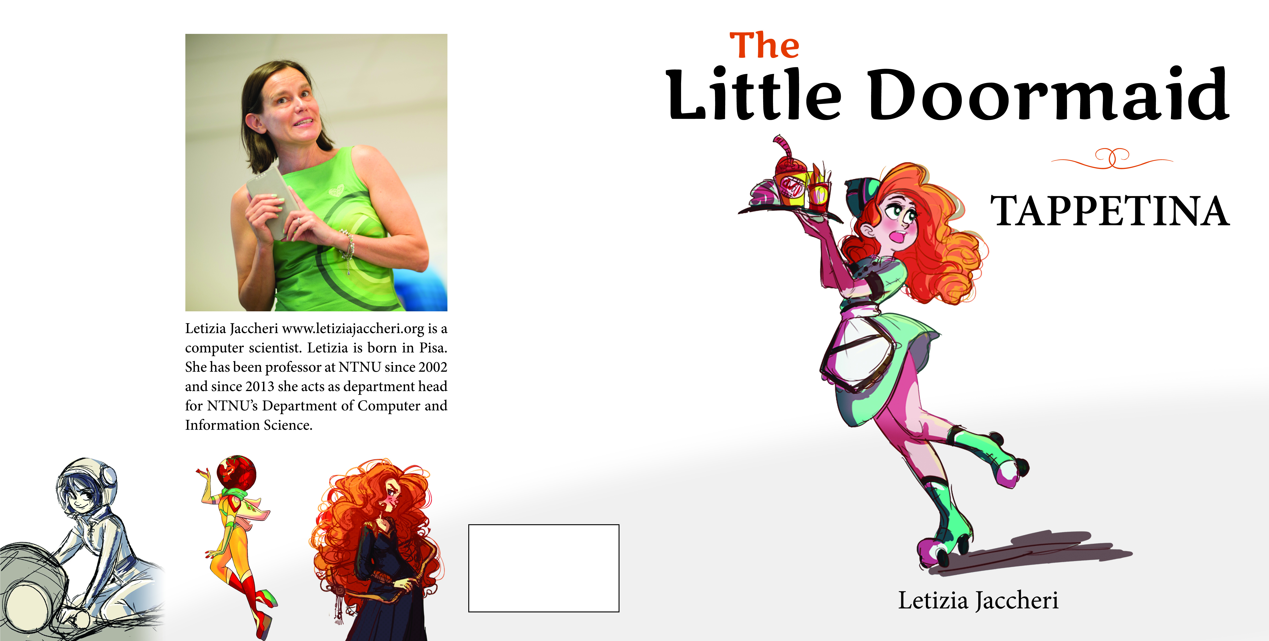
tappetina.com
Understand the relationship between art and software
Notes:
When I look back and when I look forward, I see that the goal that has motivated my research is the will to understand the relation between art and software. Art is the same as life, and communication between human beings. Software is the language to communicate between human beings and computers.
Art and science have in common a goal of trying to do something newer and unexplored with respect of what we have done before.
Art and science are very different in that the subject in science should be as distint as possible from the researcher while the artist uses herself and her feelings as a medium and as a message
I am not sure if I am an artist or a scientist but I do not care to be defined.
During the years I have being writing several scientific papers, teaching several courses, supervising students. I also love to write for the popular dissemination, expecially for children and young ones. You find most of what I have written on my blog. Most of the information is in English, something in Italian, or Norwegian. The Doormaid books is also translated to other languages, like Chinese, it is not translated into German nor French, if anybody is interested, you should contact me, it would be fun.

Slide 5
Menti – three questions about the audience

Slide 6

Structure
Research
software
art
social
Notes:
The presentation will be organized in 3 parts, software, art, social good
I do not need to define Software for this audience. You in this room are experts in AI, deep learning, machine learning, web intelligence. You work with fundamental questions in Natural Language Systems: tools, theories, and case studies
Most of you are well acquainted with Software Engineering principles, practices and applications. You work with Data Analysis: Big data analytics, text analytics, web analytics, data mining, business intelligence. Some of you are dealing with decision Support Systems in various domains, such as Health systems, sales optimization, agriculture estimation.
You are researching Social Media Analytics: Text mining, opinion mining, sentiment analysis.
Software is the ground for your and my research.
Each of you has one or several definitions of art in your mind. For me art is about life, communication between human beings, it is like research an attempt to achieve something higher than we have achieved before.
Social innovations are new ideas that meet social needs, create social relationships and form new collaborations. These innovations can be products, services or models addressing unmet needs more effectively.

Slide 7
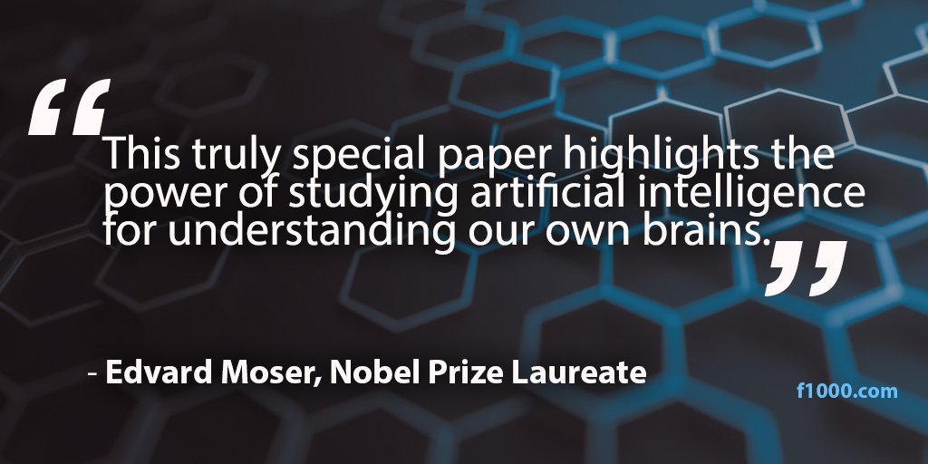
On the importance of good research goals
Notes:
Before going inside the three subthemes (software, art, social) I would like to stop for a while and reflect about the importance of good research and good research goals.
In 2014 two researchers at NTNU get the Nobel prize in medicine.
This is how one of them describes one of his paper
Studying artificial intelligence for understanding our own brains.

Slide 8
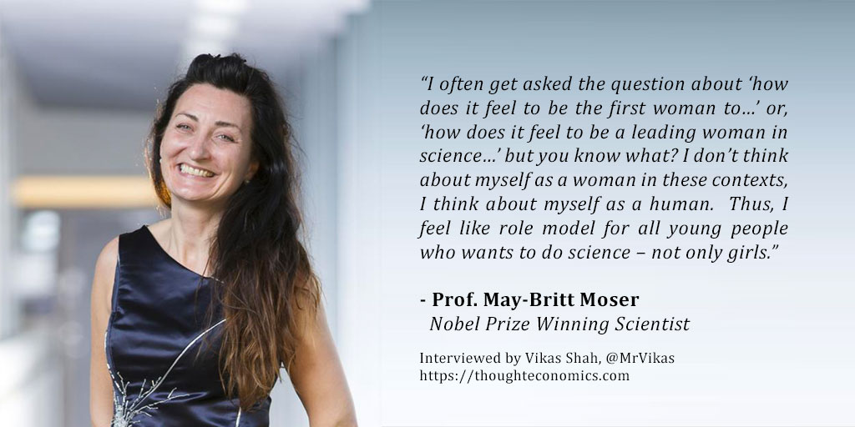
On the importance of good role models
Notes:
They soon became role models for all of us at NTNU who want to establish research projects guided by meaningful and powerful research goals.
Before I og ahead I would like to stop and ask you to reflect one minute about what I have said until now. My slides are available. Do you have questions?

Slide 9
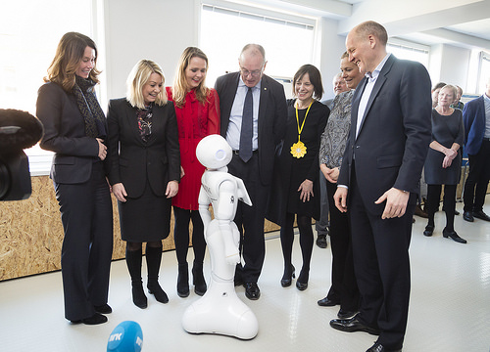
Video Telenor-NTNU AI-Lab on Vimeo
https://www.youtube.com/watch?v=avag7C4vKic
Notes:
Recently NTNU has established an open AI Lab financed by the Norwegian industry. The notion of Artificial Intelligence was invented in 1956, even before software engineering. Deep learning was introduced as a rebranding of AI in 2006 and AI started its new wave with Big Data Powerful computing
https://vimeo.com/tydelig/review/290972766/392840506c
The Norwegian Open Ai Lab
In our AI lab at NTNU, several social innovation projects are carried out.
Alexandra Bech Gjørv, Research Director, SINTEF
Norwegian Minister of Trade and Industry Monica Mæland, Norwegian Minister of Culture Linda Hofstad Helleland, SINTEF CEO Alexandra Bech Gjørv, and Telenor CEO Sigve Brekke, Hege Skryseth, Executive Vice President, KONGSBERG

Slide 10
software
Notes:
When I was developing this presentation, I realized that I have been working with software research for more than 30 years and that software engineering is 49 years old. The name ‘software engineering’ was proposed in 1969 at a NATO conference to discuss software development problems—large software systems were late , did not deliver the functionality needed by their users, cost more than expected, and were unreliable.
Software engineering research has focused on understanding software and how humans can develop good software.

Slide 11
Notes:
It does not make sense to talk about software without talking about data. In order to say something about the most popular software applications (facebook, google, youtube, twitter, netflix) we can say something about the data they generate. It has been estimated that for each minute 375.000 apps are downloaded from app store and google store, that almost half millions twits are sent, 36 millions of whatsup messages, a quarter of millions of hours are watched, and 3,7 millions of queries are run. We also note that all the apps in this figure are made in US. I wonder which are the most popular apps in this Swtizerland and in this particular part of S..

Slide 12
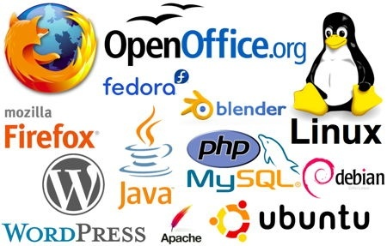
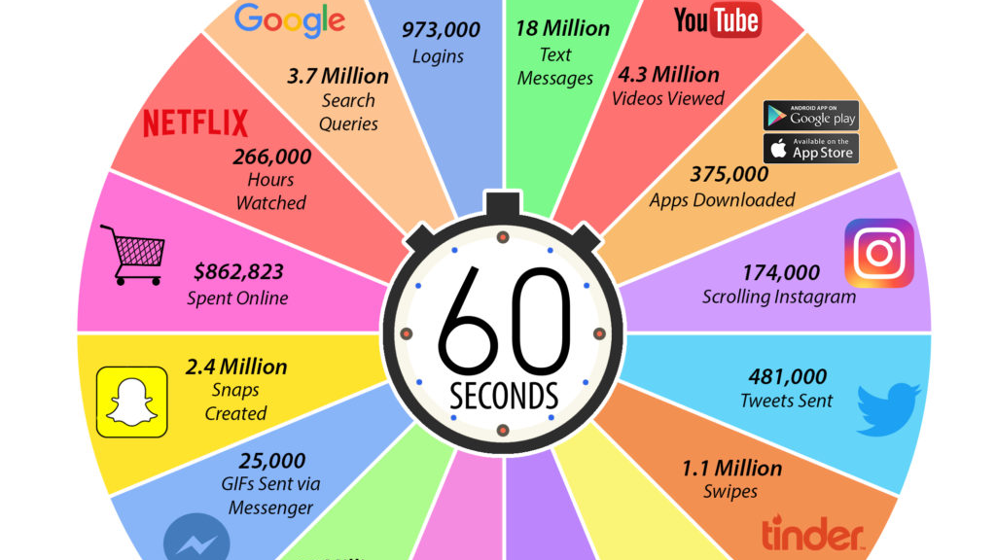
Carver, Jeffrey C; Jaccheri, Letizia; Morasca, Sandro; Shull, Forrest; ,
A checklist for integrating student empirical studies with research
and teaching goals, 2010
Jaccheri, Letizia; Osterlie, Thomas; Open source software:
A source of possibilities for software engineering education
and empirical software engineering, 2007.
Notes:
For many years we have studied open source software
and its implication for education and innovation. OSS is central to understand software engineering. Open source projects can be regarded as interesting sources for software engineering education and research. By participating in open source projects students can improve their programming and design capabilities. By reflecting on own participation by means of an established research method and plan, master’s students can in addition contribute to increase knowledge concerning research questions. In this work we report on a concrete study in the context of the Netbeans open source project. The research method used is a modification of action research.

Slide 13
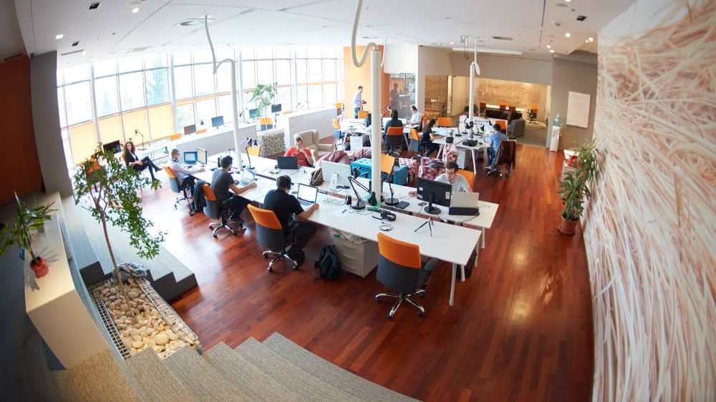
Berg, V., Birkeland, J., Nguyen-Duc, A., Pappas, I., & Jaccheri, L. (2018).
Software Startup Engineering: A Systematic Mapping Study.
Notes:
Our ongoing research in software engineering is on Software startups. Software startups are newly created companies producing cutting-edge software technology, they are an important source of software innovation even in academia.
Software startups have long been a significant driver in economic growth and innovation. However, the on-going failure of the major number of startups calls for a better understanding of state-of-the-practice of startup activities. We have run a systematic mapping study on 74 primary papers from 1994 to 2017. The study answers the main question «How has software startup research changed over time in terms of focused knowledge areas?”
We have also identified how startups that develop products with both software and hardware parts can generate value from data analytics and what challenges they face towards this direction. To this end, we performed a multiple-case study with early-stage startups and employed qualitative analysis on a dataset from 13 startups. Through semi-structured interviews, we examine how these companies use data analytics. The findings show that although the benefits from data analytics are clear, multiple barriers and challenges exist for the startups to be able to create value from them. The major ones are about their resources, including human skills, economical resources, as well as time management and privacy issues.

Slide 14
Menti – three questions about software

Slide 15
art
Notes:
I wonder now if you have any questions about the software part of my presentation.

Slide 16
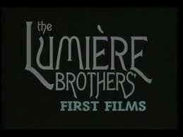
Art and Technology have been in contact for centuries
Between 1800 and 1900:
camera, film, and telephone
Romanticism (Goethe and Beethoven)
After 1900 Modernism
Filippo Tommaso Marinetti Futurist
Duchamp
Video The Lumiere Brothers' - First films (1895) on youtube
Notes:
Technological progress and evolution in art, has always gone hand in hand. Between 1800 and 1900 humanity assisted to inventions like camera, film, and telephone and artist movements like Romanticism (with artists such as Goethe and Beethoven) focused on feelings and targeted middle-class audiences rather than kings and patrons.
After 1900 Modernist art brought the author and the audience more closer to each other by letting the artwork represent everyday life, including technology. The Italian writer Filippo Tommaso Marinetti launched the Futurist movement, an art movement inspired by technological inventions such as film, air planes, and fast trains. Duchamp explored the role of the audience’s interaction with works of art. Artists became free to express them self on any issue, through any medium.

Slide 17
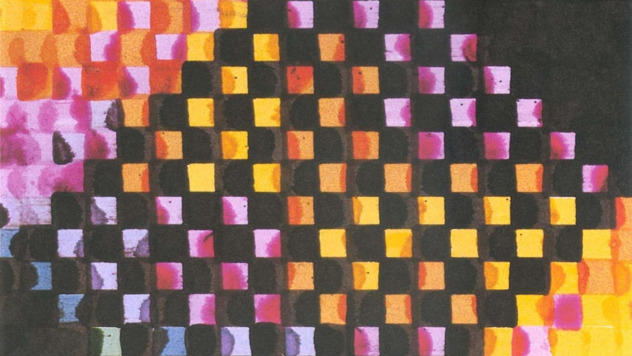
1965 First Computer Art Exhibition
Trifonova, Anna; Jaccheri, Letizia; Bergaust, Kristin;
Software engineering issues in interactive installation art,
2008
Notes:
ENIAC (Electronic Numerical Integrator and Computer) was introduced at the University of Pennsylvania in 1946. In 1951 the first UNIVAC became commercially available. In 1965 American A. Michael Noll and German Frieder Nake experiment with computer art and in the same year the first computer art exhibition is held.
In 1974 Vinton G. Cerf developed the TCP/ Internet Protocol. The Free Software Foundation published a single license usable for all software in 1989, called the GNU General Public License (GPL). This formalized the concept of copy left as opposite to copy right. Artists began to exploit the new technology offered by the web (Internet art) from the very beginning, developing new forms of interaction with the audience and shared authorship.
Photoshop 1.0 was released in 1990 as a tool for digital photography. In the following years, digital cameras appeared on the market. Pictures could now be uploaded to computers and then manipulated. The first multimedia PC was released in 1991, its defining components being the CD-ROM drive and the sound card. The performance of micro processor-based computers reached the point that real-time generation of computer music using more general programs and algorithms became possible. In 1991, the first Web server was installed at the Stanford Linear Accelerator Center in California. In 1992, the portable browser was released by CERN as freeware, and the world had approximately 50 Web servers.

Slide 18
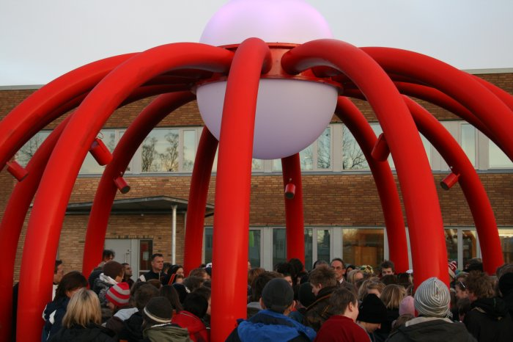
How can we improve the development process
of software
dependent artworks and projects,
in terms of software development,
maintenance, upgrade and usability of the artwork?
Ahmed, Salah Uddin; Jaccheri, Letizia; M’kadmi, Samir; Sonic onyx: Case study of an interactive artwork, 2009
Notes:
In this project that we carried out in Trondheim from 2007 to 2011, the research questions explore the interplay between artwork, technology, artist, and audience
How can we improve the development process of software dependent artworks and projects, in terms of software development, maintenance, upgrade and usability of the artwork? This permanent installation in the school yard of a school in Trondheim, enables the pupils to play with technology and music, while being outside and together.

Slide 19
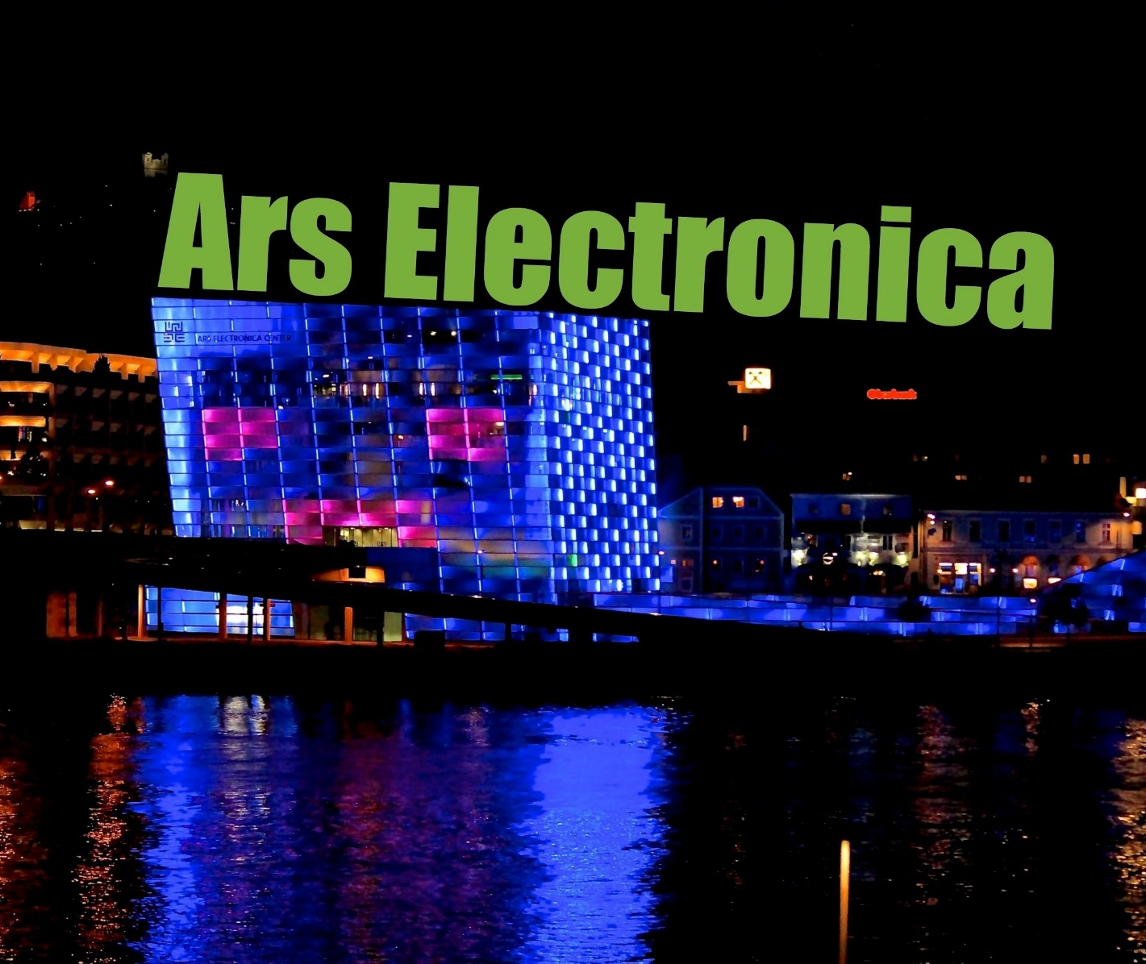

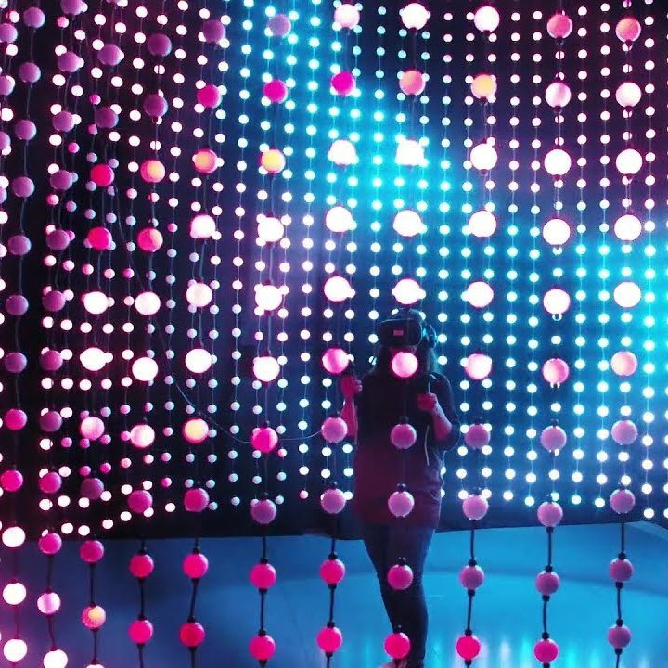
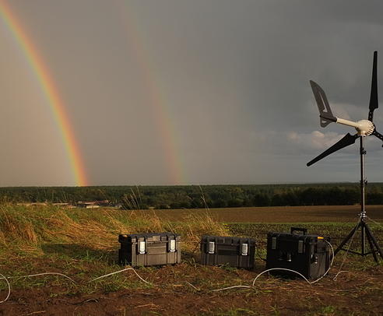
https://julianoliver.com/output/harvest
Notes:
The Linux operating system (developed by Linus Thorvald in 1991) received an art prize at Ars Electronica in 1994. Google is established as a company in 1998.
In my group we have studies specifically interactive installations for which software play a special role.
Around 2010, the new Ars Electronica Center opens in Linz. The core of the center is a 1,000 m2 space in which artists and scientists, school kids and college students, parents and children can experiment, work and play. The question artists and spectactors are all invited to address is this: “what is the impact of the technological development on me and my life?”
In the second generation web, called Web 2.0, the users themselves become the producers. In 2010, there were 150 millions users on Facebook sharing their pictures and videos, 100 millions pictures on Flickr, and 130 million works with a Creative Commons license. 1.574 billion people were using the Internet. Around year 2010 there were around six billion people in this world, and more than three billion mobile phones. Even very cheap mobile phones since 10 years ago come with a camera able to capture both pictures and video, giving everyone the possibility to become artists.
In this decade, Artificial intelligence, machine learning, and increased computational power has opened up to a new wave of discoveries and innovations, like for example cryptocurrency, e-health, smart energy. Artists, are developing projects like harvest, which connects art to energy and cryptocurrency and makes us reflect on the impact of blockchain on the environment.

Slide 20
Menti – three questions about art

Slide 21
Social

Slide 22
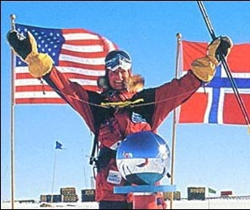
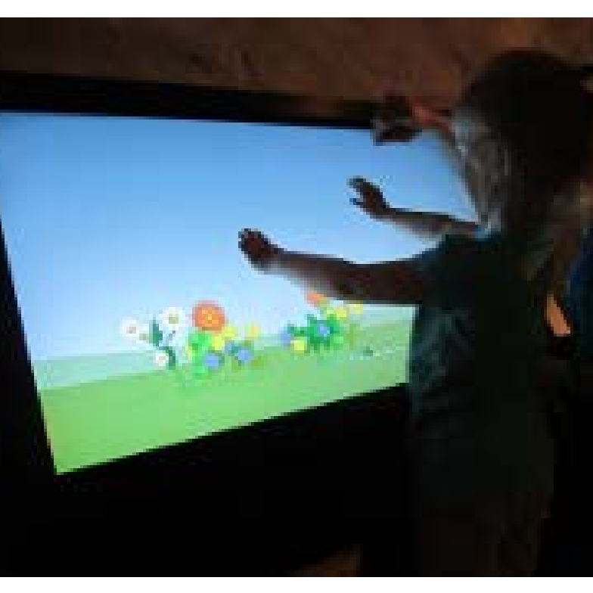
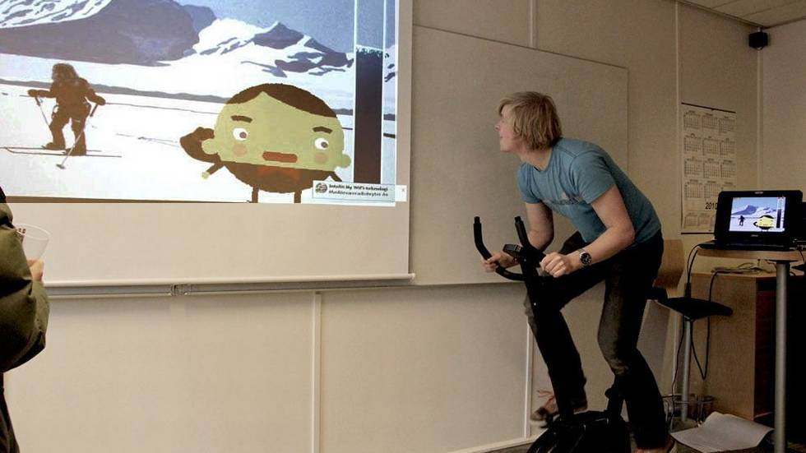
Liv Arnesen
How can we design and evaluate software
that becomes a medium
to engage and inform the user?
Notes:
I started with EiT in 2002 and had customers like museums in town, software companies and social innovators like Liv Arnesen.
Liv Arnesen has been the first woman in the world to ski solo and unsupported to the South pole in 1994
A team created an Art instalaltion to increase awareness of the water cycle in nature among children. Make them aware of the balance of water in nature
-Its interesting that the students did social innovation without knowing it, as most did not know about it since it is not as popular as it is today. And they did it succesfully without a specific SI process or without tools designed for SI.
-Now we have defined the Social Innovation process, we have experience and we have tools that can help us to fulfil our goals.
It was thanks to these processes that we understood that we were approaching social innovation

Slide 23
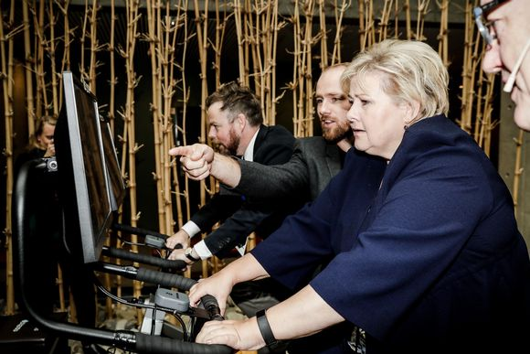
Hagen, Kristoffer et. al. Pedal tanks, A Multiplayer Exergame Based on Teamwork and Competition
Notes:
The master thesis has resulted in a company cofounded by one of the students and professor Alf Inge Wang. The bikes are now installed in several centers in Norway and in this picture we see the prime minister of Norway, Erna Solvberg, trying one of these bikes, in her last visit to our university.

Slide 24
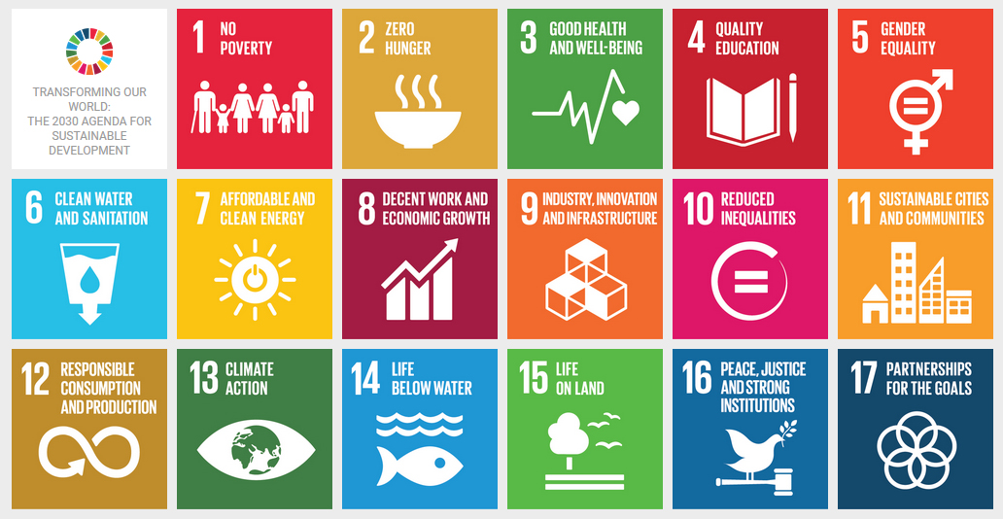

Pappas, Ilias; Jaccheri, Letizia; Mikalef, Patrick;
Giannakos, Michail; Social Innovation and Social Entrepreneurship through Big Data, 2017
Notes:
In the Socratic Horizon 2020 project, we learned how to shape projects driven by the challenges posed by United Nations.
We established an experts in village with 30 students who aimed to identify and propose specific innovative solutions for achieving GOOD HEALTH AND WELL BEING, also is directly related with NTNU 2011-2020 strategic goals regarding health and sustainability.
We used the Socratic Platform and social innovation process to help users to: propose new challenges oriented to solve specific sustainability issues; invite individuals and organizations to participate with innovative ideas that solve these issues; collectively select and implement the most promising ideas. We work concretely with the Autism association.

Slide 25
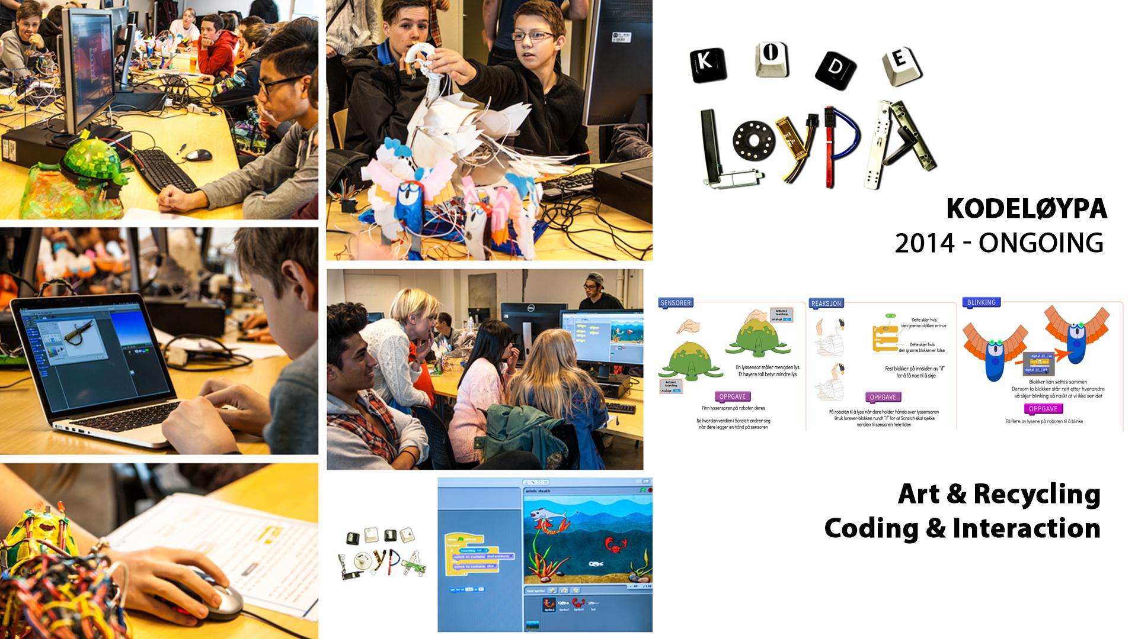
Exploring children’s learning experience in constructionism-based coding activities through design-based research
S Papavlasopoulou, MN Giannakos, L Jaccheri
Computers in Human Behavior 2019
From players to makers: An empirical examination of factors that affect creative game development
MN Giannakos, L Jaccheri
International Journal of Child-Computer Interaction 18, 27-36
Notes:
Kodeløypa is a project that we started in 2014 that build on computing and art to address the goal 4 and 5. We invite each Friday to our department a new class from the ground school. Children come to experience artistic robot programming. We collect rich data to be able to improve knowledge and tools for programming for children. In this specific investigation, we have collected data by eye tracking and analyzed it using ML.

Slide 26
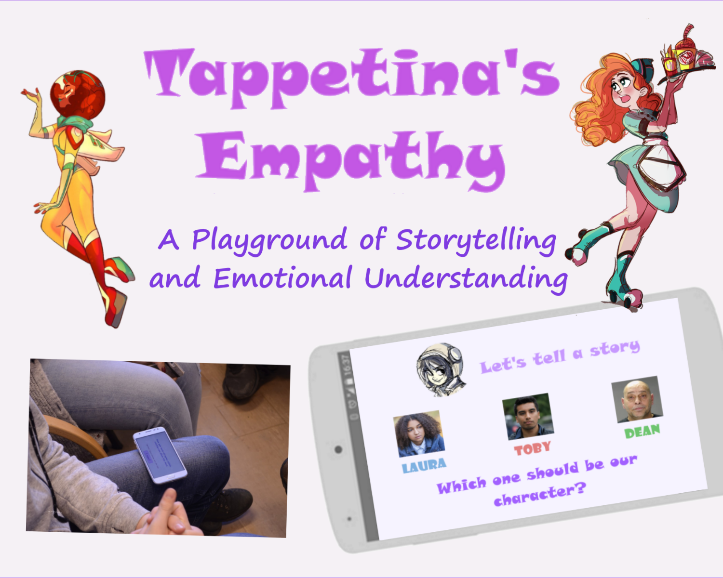
RQ: How to Analyze Digital Stories for Social Good?
  Goal: predict empathy quotient from storytelling features
RQ: How to facilitate Digital Stories for Social Good?
  Goal: predict stories from Emotions and Roles
Tappetina's empathy game: a playground of storytelling and emotional understanding
SB Skaraas, J Gomez, L Jaccheri 2018
Proceedings of the 17th ACM Conference on Interaction Design and Children …
Notes:
Tappetina is a story about algorithms and social innovation. One of her friends has developed an precise description of a set of steps to be performed by machines, an algorithm that is capable of eliminating all of the garbage from Earth.
Sissi, the friend, caring mother, great intelligence and also great doormat woman is not aware of the geniality of her invention, so Doory Mentor has to arrive in time to save her friend and the algorithm before someone steals it and invades the world with garbage.
This is ongoing work about how to facilitate story telling, and analyze stories, like capture sentiments from the texts and the sounds.

Slide 27
Menti – three questions about SI and everything

Slide 28

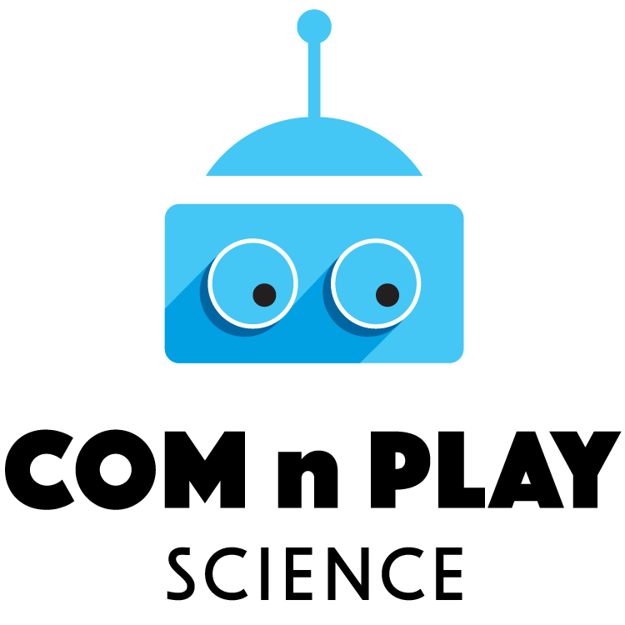

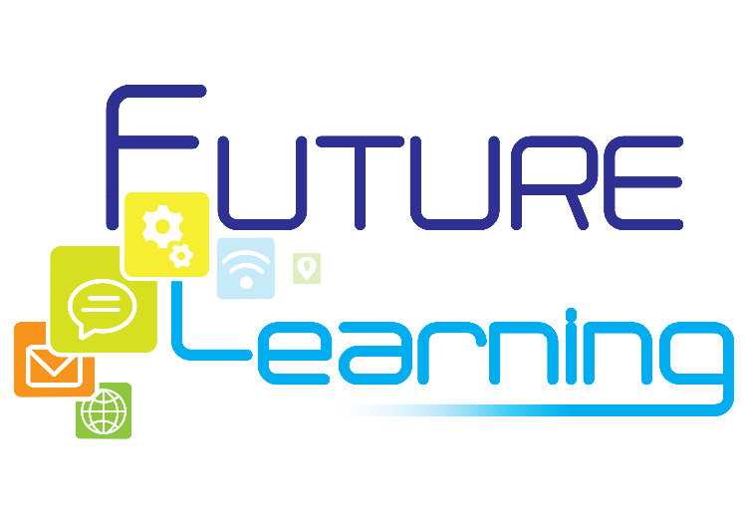

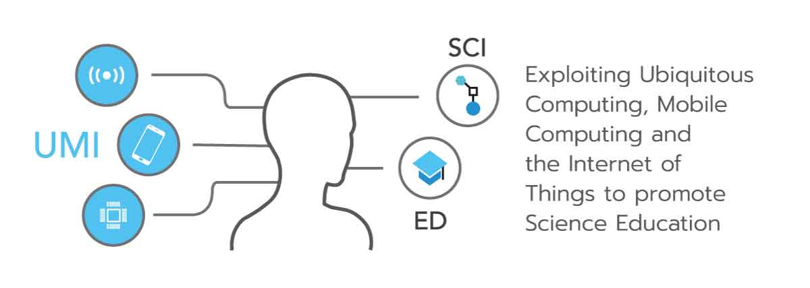
Projects
Education University & Soft Eng.
Center Excited https://www.ntnu.edu/excited Sindre (L.), Divitini, Krogstie B., Madeleine Lorås ++
NFR INTPART IPIT https://ipit.network/ Jaccheri (L.) Jingyue Li, Giannakos, Cico (PhD), Fufen
IT – STEM & Children
Kodeløypa https://www.ntnu.no/kodeloypa + Security Jaccheri (L), Papavlasopoulou, Karlsen, Farzana (PhD)
Tappetina https://tappetina.com/ Jaccheri (L.), Gomez, Sharma, Cico, Rubegni
NFR KreTek 2022 Creativity Schools Bungum (L.) ++
EU Horizon 2020 CoM_n_Play-Science https://comnplayscience.eu/ Giannakos (L.) ++
Social Innovation
EU Horizon 2020 Initiate http://initiate2020.eu/ Jaccheri (L.), Pappas, Opland (PhD)
NFR IDUN 2022 From PhD to Professor ntnu.edu/idun Jaccheri (L.), S. Fast
NFR? Physical activity for individuals with intellectual disability Anke (L.), Michalsen, Hartvigsen ++
Notes:
I want to conclude by giving pointers to the projects I am involved. I would like to Thank my university, the Research Council of Norway and the Horizon program of the European Commission. I would like to thank all my students, without them I would not not learn anything. I thank my colleagues, those whom I mention here and the other ones, I thank expecially Ilias Pappas who is here in the conference, with him we work on social innovation and big data project.
I hope you have enjoyed the interaction and you want to ask me questions or just give me feedback. Thanks again for the attention and for inviting me here.

Slide 29
Other activities
Evaluation and Assessment in Software Engineering (EASE) Trondheim
ease2020.org
All female keynotes
15-17 april 2019
Lead Wire from 2020 COST ACTION Gender - Monica Landoni
IFIP ICEC 2015
IDC 2017
Informatics Europe ECSS 2018
I3E 2019

Slide 30
About this lecture
Distinguished Speaker Association for Computing Machinery (ACM).
https://speakers.acm.org/speakers/
ACM 100,000 members
ACM Speakers: IBM, Microsoft, Stanford University, Carnegie Mellon, University of British Columbia, Tsinghua University
Two ACM Distinguished Speakers in Norway
Letizia with her lecture From Software through Art to Social Entrepreneurship.
There are a total of 130 distinguished speakers world wide.

Slide 31
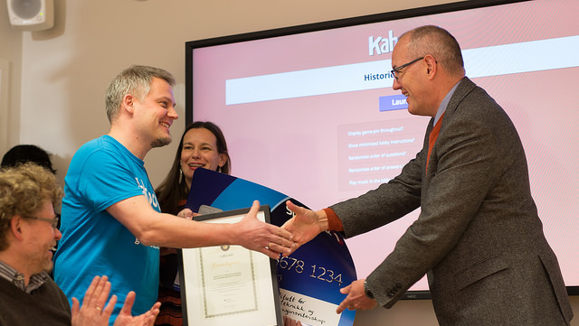
WANG, Alf Inge. The wear out effect of a game-based student response system
Notes:
Has anybody heard about kahoot? Kahoot is social learning quiz system that has been developed by my colleague professor Alf Inge Wang.
Kahoot! You can run kahoot! either by an app or browser.
Kahoot! is a game-based learning platform, used as educational technology in schools and other educational institutions. The company was launched in August 2013 in Norway.^{[2]} Its learning games, "kahoots", are multiple-choice quizzes that allow user generation and can be accessed via web browser.
In March 2017, Kahoot reached the billion cumulative participating players milestone and in the month of May, the company was reported to have 50 million monthly active unique users.

Slide 32
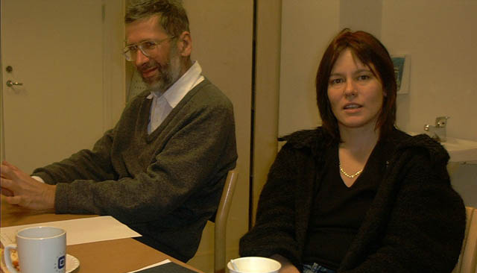
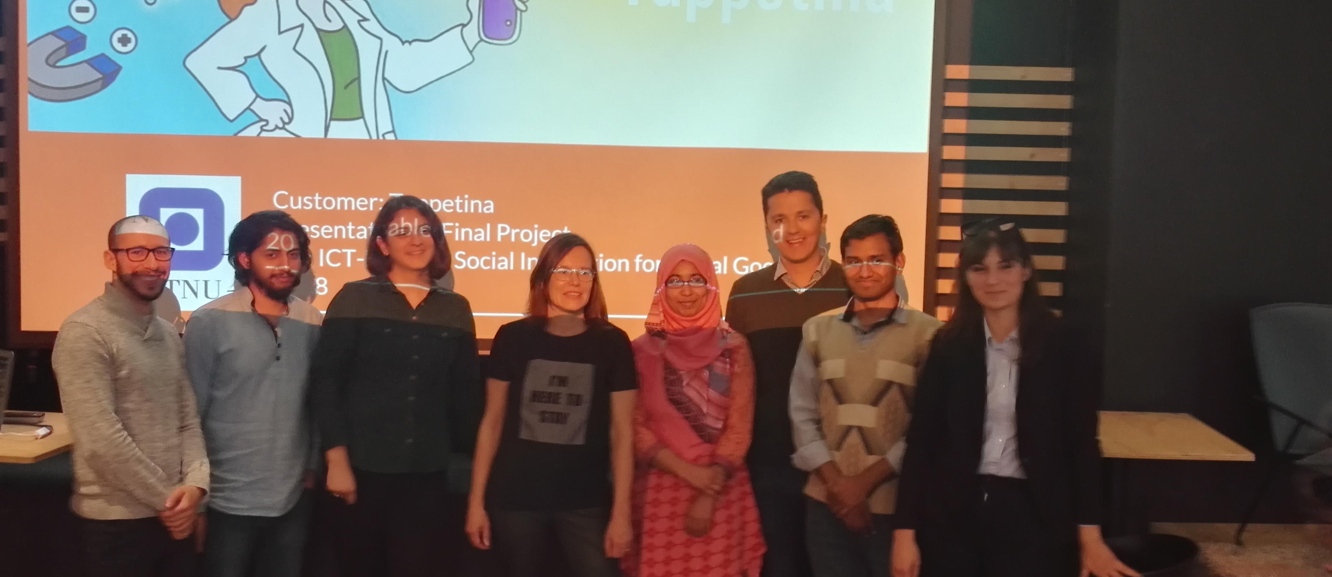
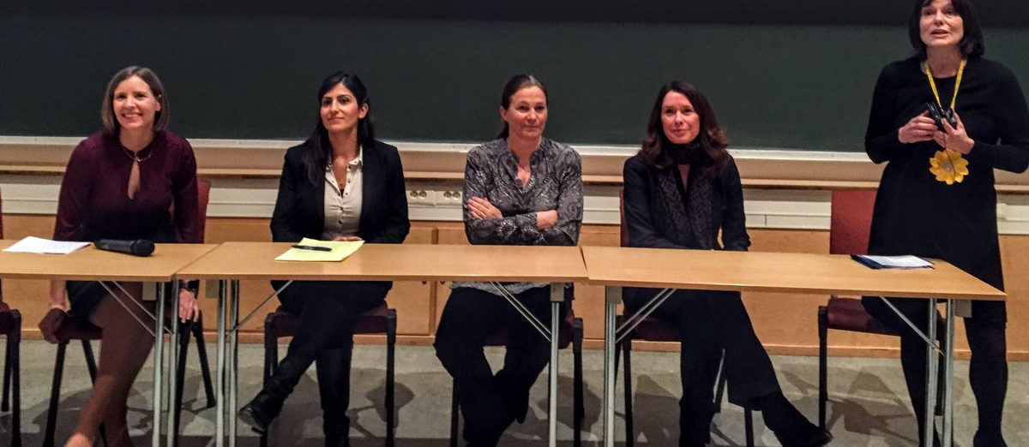
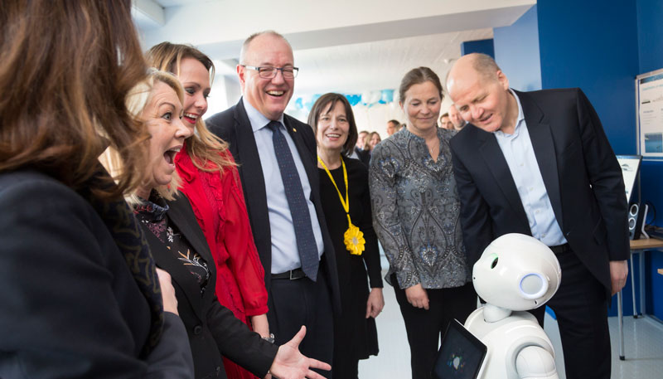

Slide 33
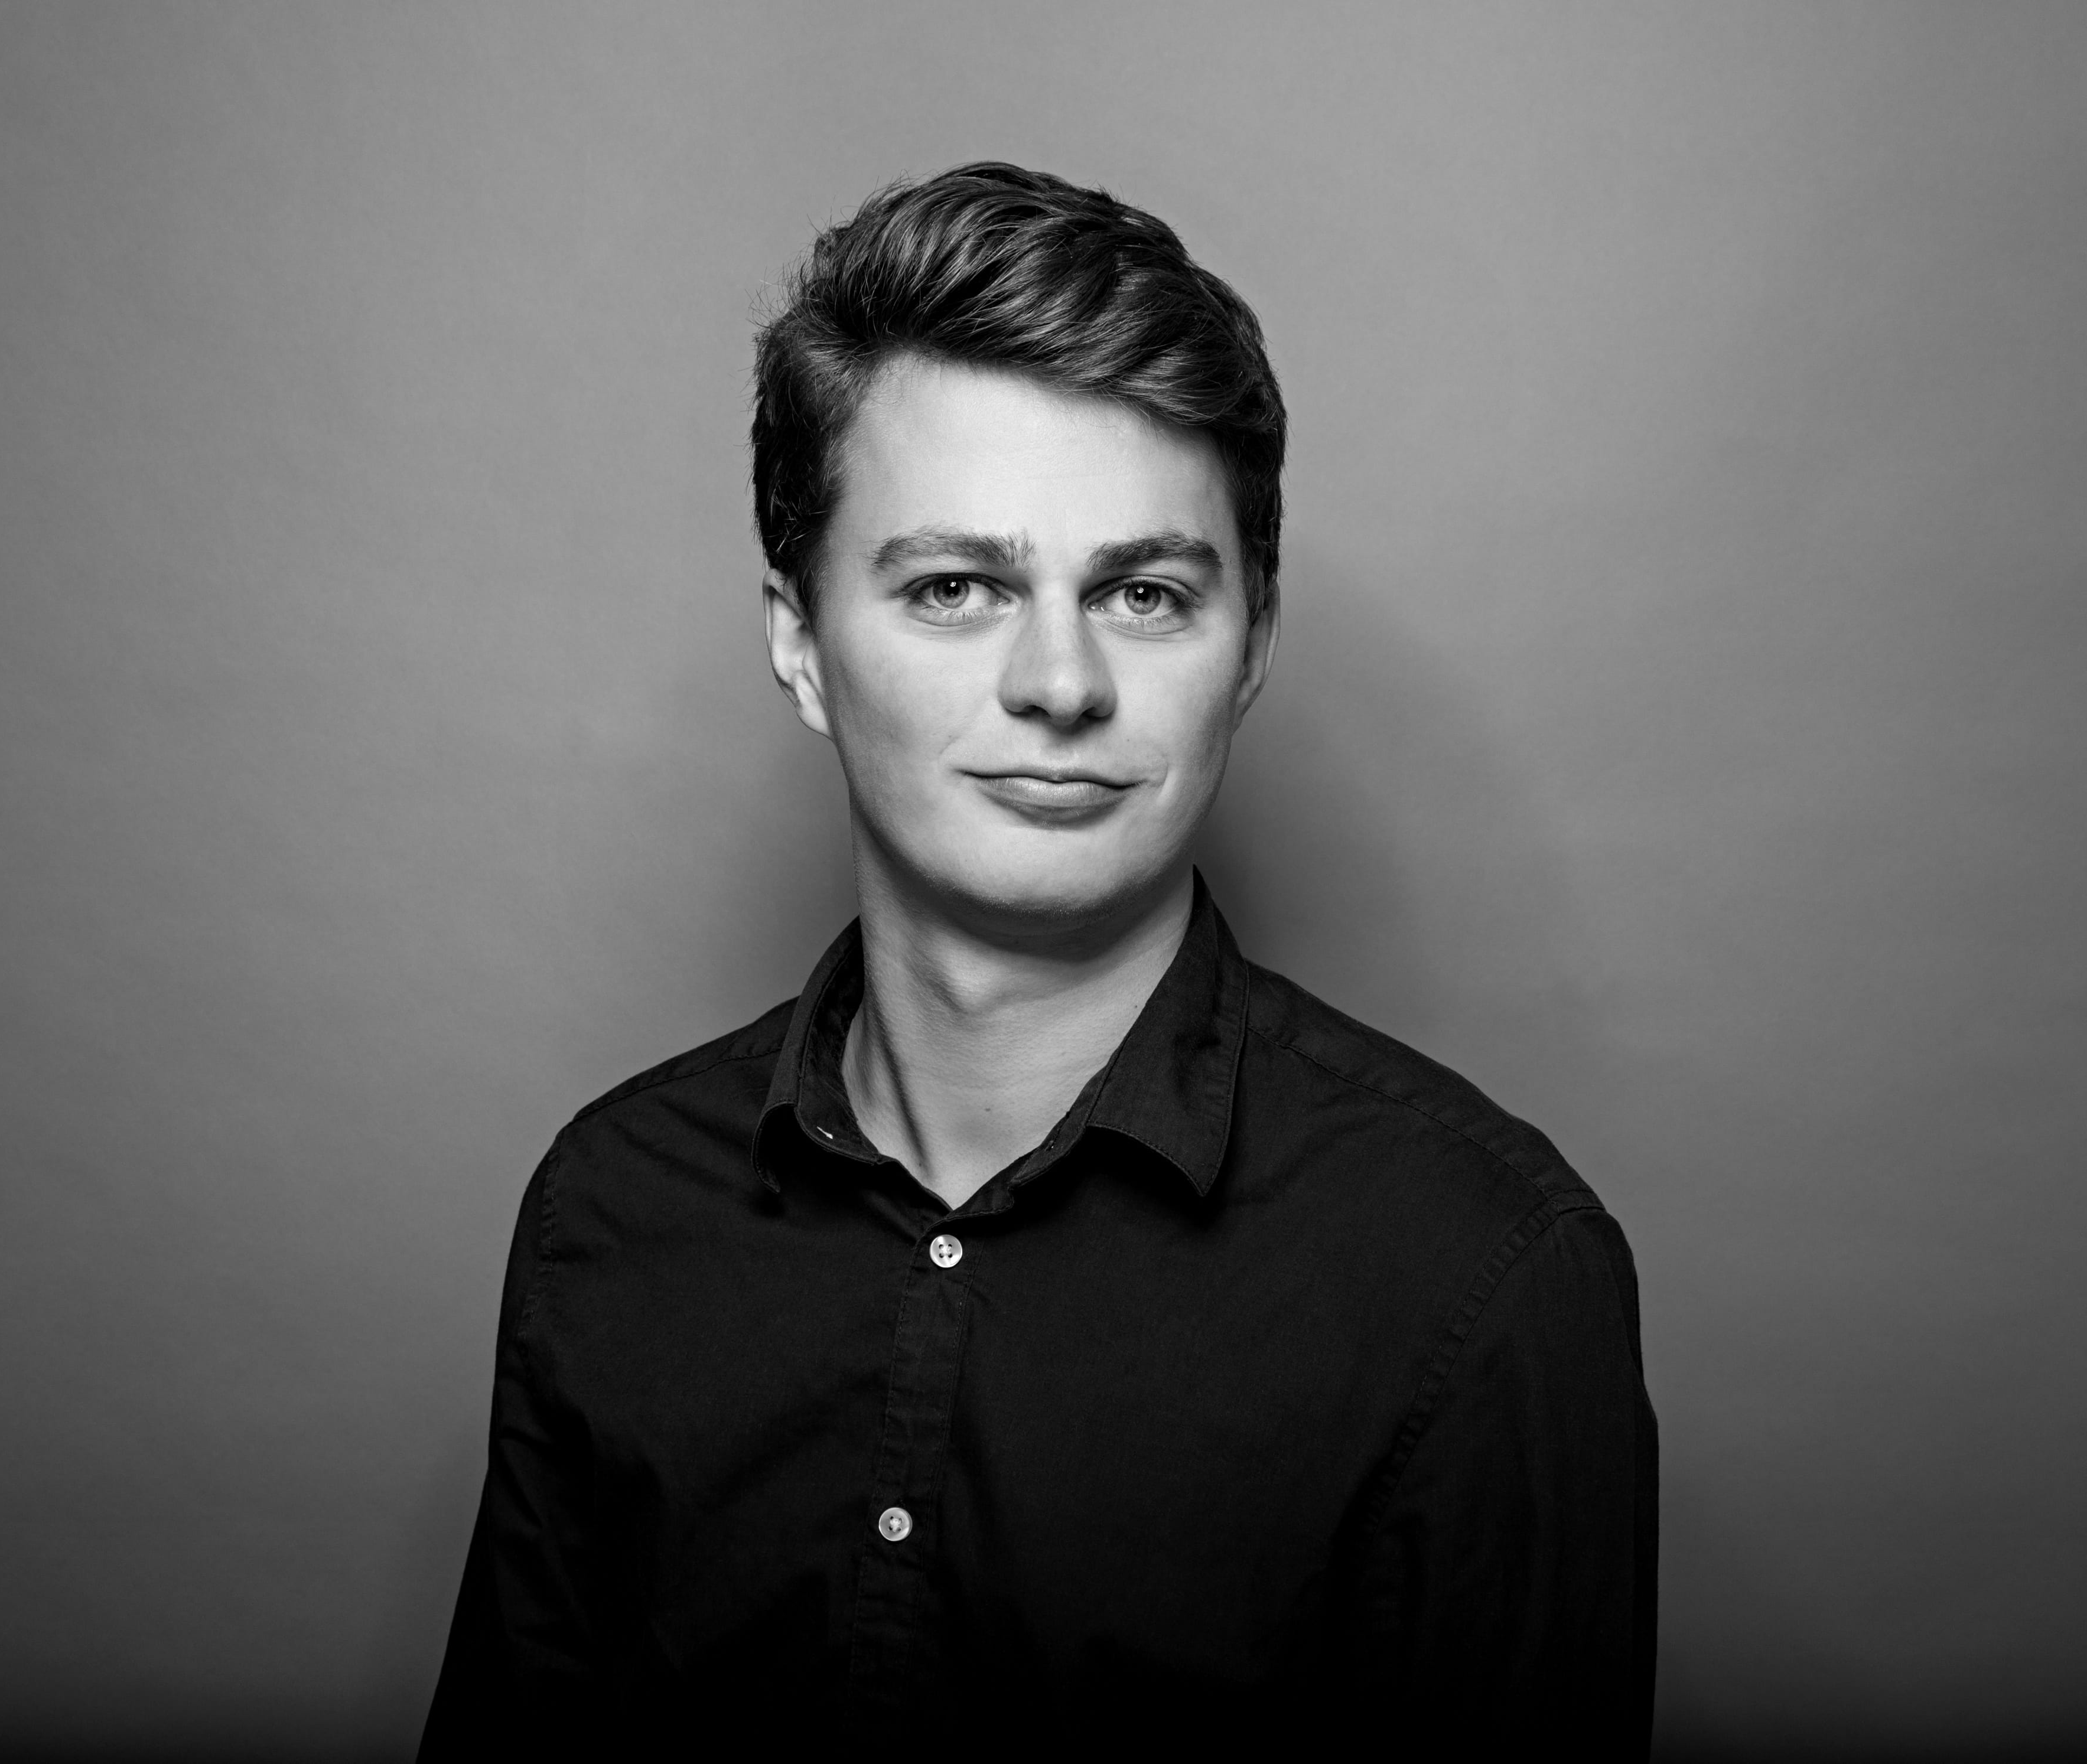
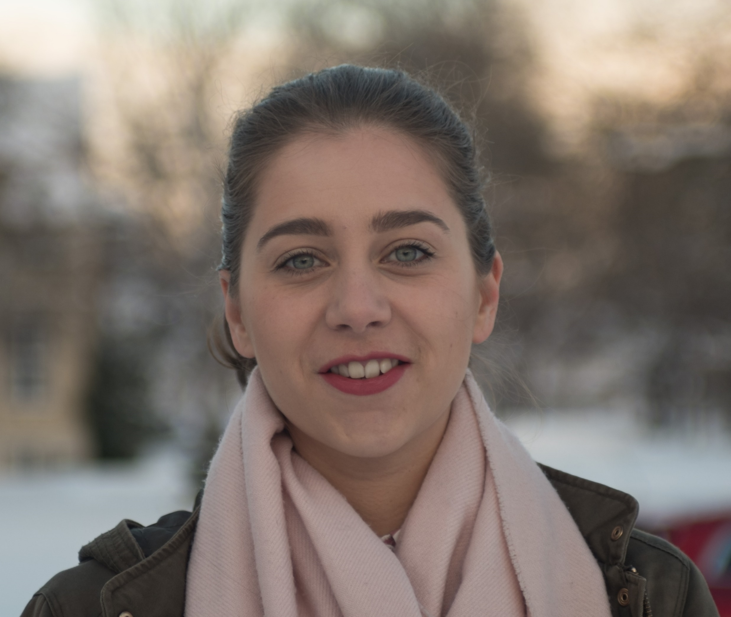

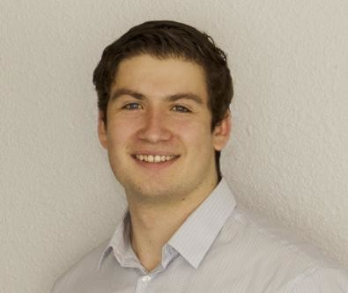
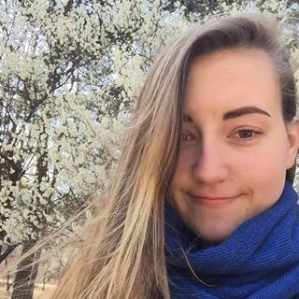
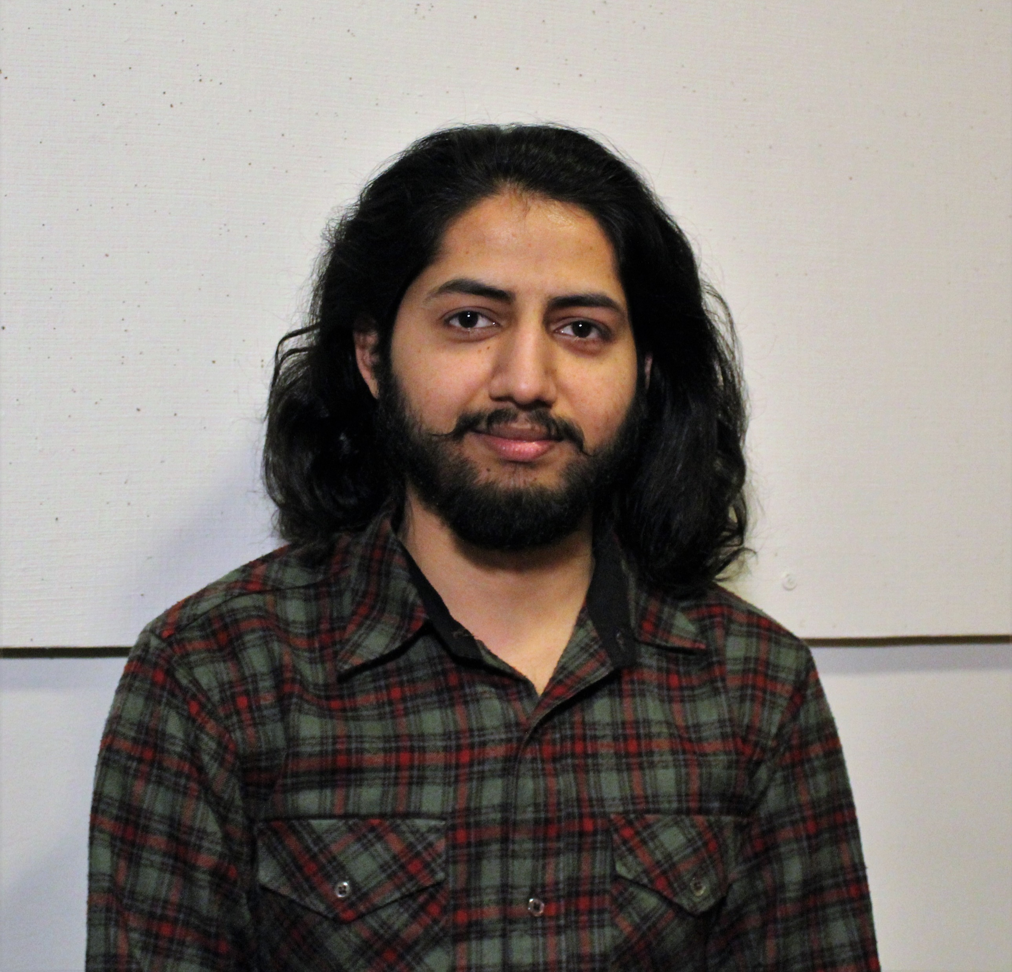
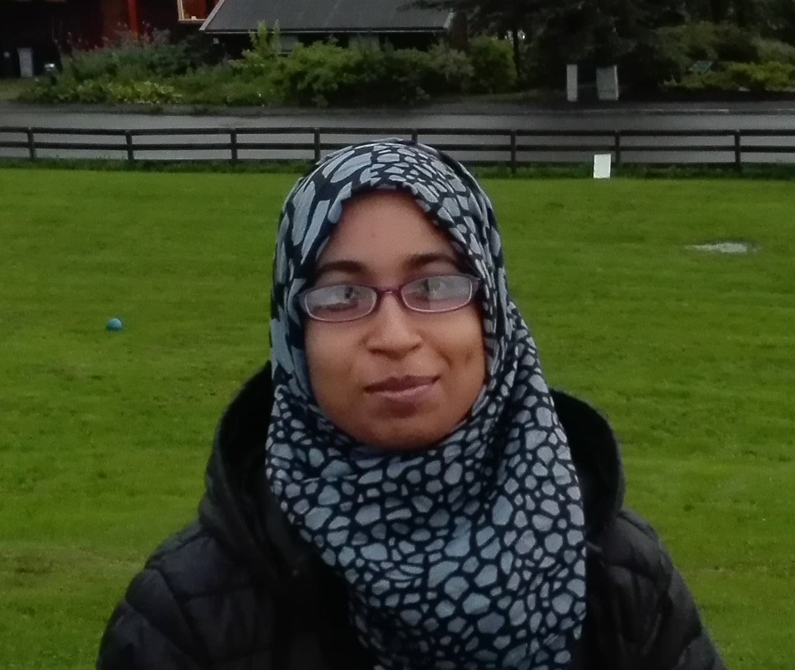

Jostein
Child Marriage
Ida, Ingrid, Jens - Adolescents with Mental Disabilities
Farzana
Big Data SI
Eirik
Blockchain & Sustainability
Kshitiz
Girls and CS
Ina-Marie
Empathy

