Slide 1

Computer science, ethics and gender
Letizia Jaccheri
Lecture for students at Università della Svizzera italiana | USI
Notes:
In this 45 minutes lecture I will interact with the students to share my own story as a computer science researcher, teachers, and academic leader and focus on the ethical and gender issues I have been facing and I am facing.
Some questions I will address:
- Which is the role of students in research experiment?
- How can design processes include toddlers?
- Why and how should we make actions to include female into CS education and top research positions?
- How do female and male perceive CS differently?
The students will be invited into a discussion.
References
Rubegni, E., Landoni, M., De Angeli, A., & Jaccheri, M. L. (2019). Detecting Gender Stereotypes in Children Digital StoryTelling. In Proceedings of the 18th ACM International Conference on Interaction Design and Children. Association for Computing Machinery, ACM.
Carver, Jeffrey C; Jaccheri, Letizia; Morasca, Sandro; Shull, Forrest; A checklist for integrating student empirical studies with research and teaching goals Empirical Software Engineering 15 1 35-59 2010 Springer US
Trifonova, Anna; Jaccheri, Letizia; Bergaust, Kristin; Software engineering issues in interactive installation art International Journal of Arts and Technology 1 1 43-65 2008 Inderscience Publishers
Giannakos, Michail N; Chorianopoulos, Konstantinos; Jaccheri, Letizia; Chrisochoides, Nikos; “This game is girly!” Perceived enjoyment and student acceptance of edutainment E-Learning and Games for Training, Education, Health and Sports 89-98 2012 Springer, Berlin, Heidelberg
Høiseth, Marikken; Giannakos, Michail N; Alsos, Ole A; Jaccheri, Letizia; Asheim, Jonas; Designing healthcare games and applications for toddlers Proceedings of the 12th International Conference on Interaction Design and Children 137-146 2013 ACM
Giannakos, Michail N; Jaccheri, Letizia; Leftheriotis, Ioannis; Happy girls engaging with technology: Assessing emotions and engagement related to programming activities International Conference on Learning and Collaboration Technologies 398-409 2014 Springer, Cham
Papavlasopoulou, Sofia; Giannakos, Michail N; Jaccheri, Letizia; Creative programming experiences for teenagers: attitudes, performance and gender differences Proceedings of the The 15th International Conference on Interaction Design and Children 565-570 2016 ACM
Gomez, Javier; Jaccheri, Letizia; Torrado, Juan Carlos; Montoro, Germán; Leo con lula, introducing global reading methods to children with ASD Proceedings of the 17th ACM Conference on Interaction Design and Children 420-426 2018 ACM
Pappas, Ilias O., Trond Aalberg, Michail N. Giannakos, Letizia Jaccheri, Patrick Mikalef, and Guttorm Sindre. "Gender Differences in Computer Science Education: Lessons Learnt from an Empirical Study at NTNU." In NIK. 2016.
Pappas, Ilias O., Simone Mora, Letizia Jaccheri, and Patrick Mikalef. "Empowering social innovators through collaborative and experiential learning." In 2018 IEEE Global Engineering Education Conference (EDUCON), pp. 1080-1088. IEEE, 2018.

Slide 2
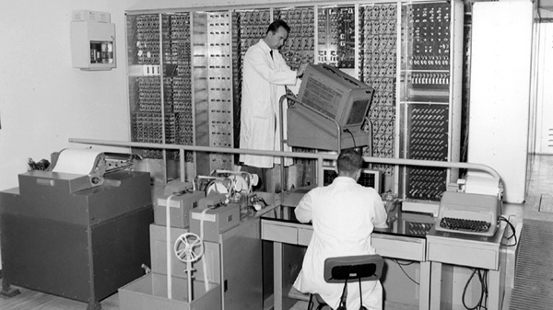
Pisa, Italia, 1960
The first Italian computer
Notes:
I grew up in Pisa, the first italian computer was built, olivetti, enrico fermi.

Slide 3
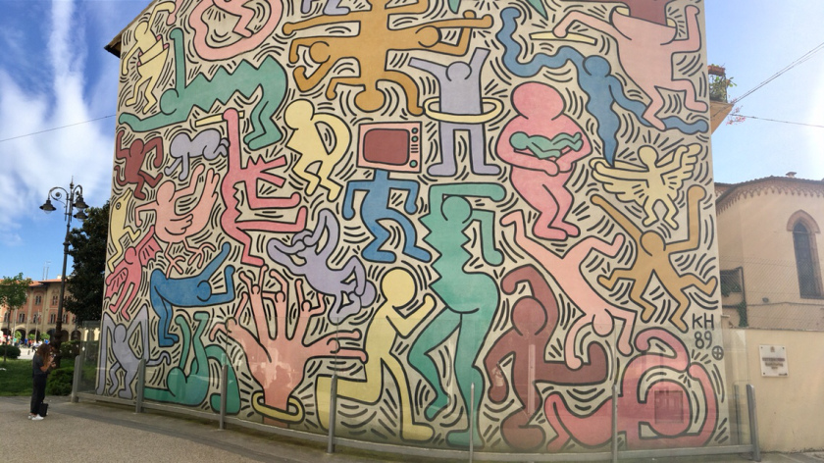
Pisa, Italia, 1989
Keith Herring
Notes:
Jeg gikk først på latinskolen fordi min far hadde bestemt at jeg skulle bli advokat som han. Jeg studerte latin, gresk og filosofi. Men data ble min Ungdomsoppgjøret
Jeg kjøpte min første datamaskin in 1982, jeg begynte på informatikk i 1983 og var ferdig med en master i programvaresystemer i 1988. jeg begynte som programmerer i en bedrift. Det var i den perioden av Keith Herring laget en murales på veggen av en kirke, la chiesa di san antonio, og jeg hadde en følelse at datamaskiner og programvare ville nå endre verden og samfunnet til noe bedre.

Slide 4


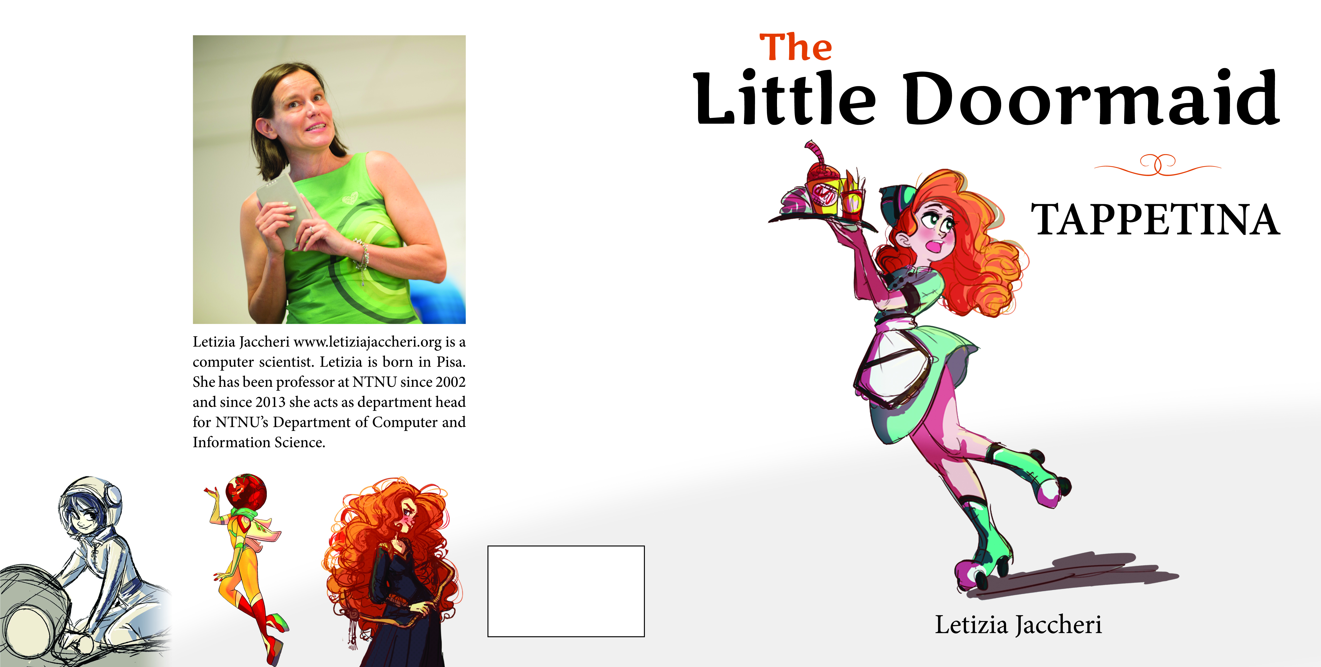
letiziajaccheri.com
2004
2006
2009
Notes:
Det som motiverer meg er å forstå samspill mellom liv og programvare. Kunst er selve livet og kunst hjelper å stille spørsmål og å forstå.
Kjarlighet og computer som jeg skrev i 2003 kan ikke kjøpes nå men dere kan laste ned gratis både på italiensk og norsk fra letiziajaccheri.org

Slide 5
Menti.com
270826

Slide 6
computer system
people
data
Notes:
I like simple messages

Slide 7
Ethics?
Branch of philosophy relating to the decisions and comprehension of “right” and “wrong”.
A system of moral principles.
The rules of conduct recognised by a given group.
Professional Ethics
  Power and responsibility
  Codes of conduct (of professional bodies, ACM, IEEE, …)
Ethics in Research
  Principles for ethically acceptable research

Slide 8


Gender
UN Goal 5: Achieve gender equality and empower all women and girls. Ending all discrimination against women and girls is not only a basic human right, it's crucial for sustainable future; it's proven that empowering women and girls helps economic growth and development.

Slide 9
Linux (operativ system)
  Loc 4,142,481
Apache (web server)
  Web Sites hosted 179,720,332
  60.31%
  Loc 89,967
PhD Software Engineering 1995
Politecnico di Torino

Slide 10
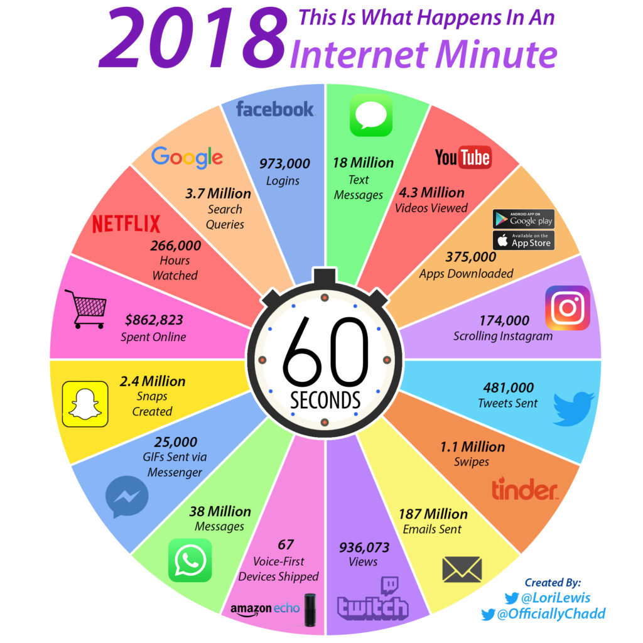

Software engineering and AI
people
Decide requirements
Develop solutions
Interact with systems
Computer system
learns
腾讯
Tencent
big data
Question: who decides how the system will learn?
Notes:
Software engineering handler om mennesker om programvare: mennesker som bestemmer krav, lager løsninger, interagerer med programvare. Programvare kan være. Du har mer programvare på din mobil enn man hadde på de mest avansert programvare senteret når jeg var ferdig utdannet.

Slide 11
Q1 Which is the role of students in research experiment?
Notes:
The students will be invited into a discussion.

Slide 12
Q2 How can we design processes that include toddlers?

Slide 13
Q3 Why and how should we make actions to include female into CS education and top research positions?

Slide 14
Q4 How do female and male perceive CS differently?

Slide 15
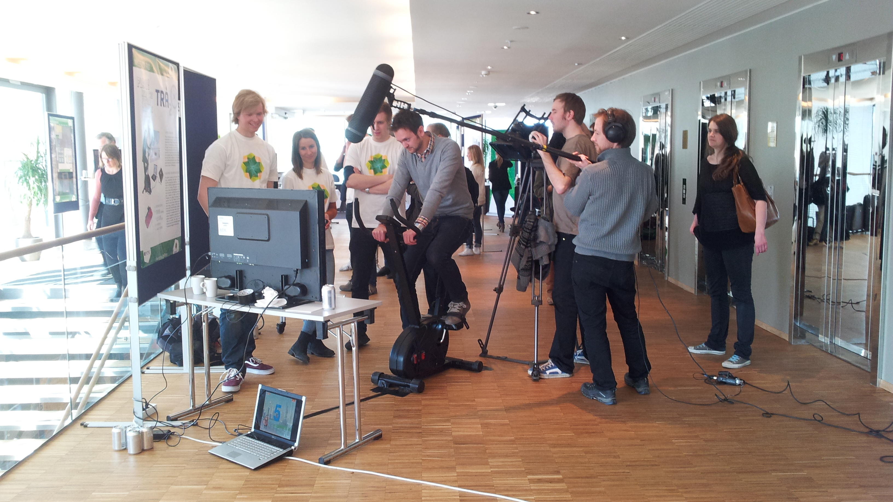
Carver, Jeffrey C; Jaccheri, Letizia; Morasca, Sandro; Shull, Forrest; ,
A checklist for integrating student empirical studies with research
and teaching goals, 2010 Q1
Notes:
Mine prosjekter siden 2000 er sentrert rundt en enkel ide.
Studenter er i midten og de er innovatorer, forskere og brukere. Jeg har gjenom årene veiledet nesten 20 esperter i team landsbyer og studenter fra forkjellige disipliner har lært og har inspirert meg å stille spørsmål om hva er god programvare for et godt samfunn?

Slide 16
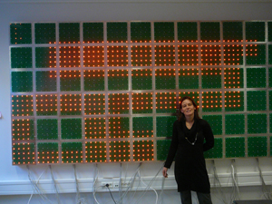
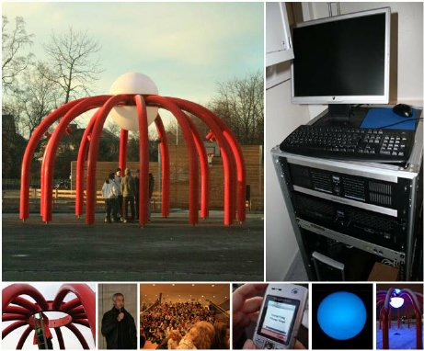
Trifonova, Anna; Jaccheri, Letizia; Bergaust, Kristin; Software engineering issues in interactive installation art 2008 Ethics

Slide 17
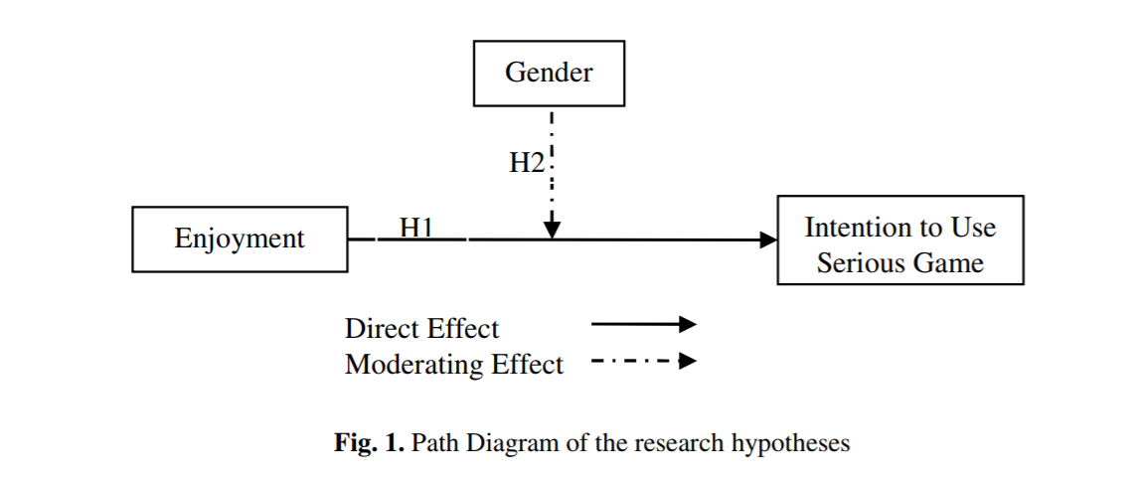
Giannakos, Michail N; Chorianopoulos, Konstantinos; Jaccheri, Letizia; Chrisochoides, Nikos; “This game is girly!” Perceived enjoyment and student acceptance of edutainment 2012 Question 4
The empirical study is a controlled experiment to which 46 Gymnasium (middle school) students participated. Results confirmed the positive effects of the enjoyment on students' intention to use storytelling serious games. Notably, we found that gender has a moderating effect on the relationships between enjoyment and intention to use the game. The results of this study suggest that games with a storytelling component might be attractive to girls.

Slide 18
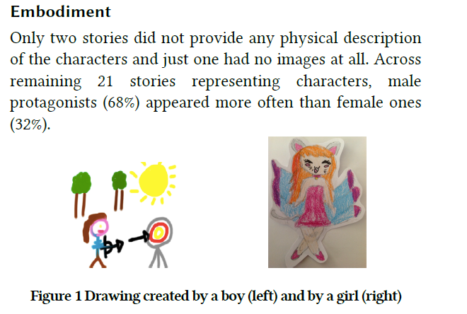
Rubegni, E., Landoni, M., De Angeli, A., & Jaccheri, M. L. Detecting Gender Stereotypes in Children Digital StoryTelling 2019 Question 3 and Question 4

Slide 19
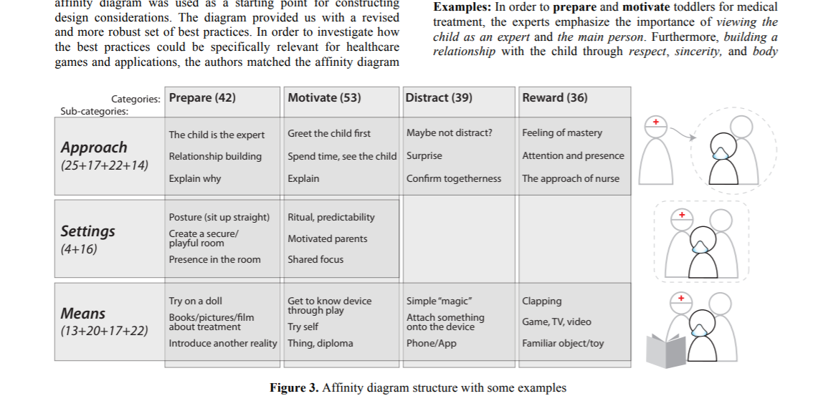
Høiseth, Marikken; Giannakos, Michail N; Alsos, Ole A; Jaccheri, Letizia; Asheim, Jonas; Designing healthcare games and applications for toddlers 2013 Question 2

Slide 20
References
Trifonova, Anna; Jaccheri, Letizia; Bergaust, Kristin; Software engineering issues in interactive installation art 2008 Ethics
Carver, Jeffrey C; Jaccheri, Letizia; Morasca, Sandro; Shull, Forrest A checklist for integrating student empirical studies with research and teaching goals 2010 Question 1
Giannakos, Michail N; Chorianopoulos, Konstantinos; Jaccheri, Letizia; Chrisochoides, Nikos; “This game is girly!” Perceived enjoyment and student acceptance of edutainment 2012 Question 4
Høiseth, Marikken; Giannakos, Michail N; Alsos, Ole A; Jaccheri, Letizia; Asheim, Jonas; Designing healthcare games and applications for toddlers 2013 Question 2
Giannakos, Michail N; Jaccheri, Letizia; Leftheriotis, Ioannis; Happy girls engaging with technology: Assessing emotions and engagement related to programming activities 2014 Question 4
Papavlasopoulou, Sofia; Giannakos, Michail N; Jaccheri, Letizia; Creative programming experiences for teenagers: attitudes, performance and gender differences 2016 Question 4
Pappas, Ilias O., Trond Aalberg, Michail N. Giannakos, Letizia Jaccheri, Patrick Mikalef, and Guttorm Sindre. "Gender Differences in Computer Science Education: Lessons Learnt from an Empirical Study at NTNU 2016. Question 3
Pappas, Ilias O., Simone Mora, Letizia Jaccheri, and Patrick Mikalef. "Empowering social innovators through collaborative and experiential learning 2018. Ethics
Gomez, Javier; Jaccheri, Letizia; Torrado, Juan Carlos; Montoro, Germán; Leo con lula, introducing global reading methods to children with ASD Proceedings of the 17th ACM Conference on Interaction Design and Children 2018 Question 2 ++
Rubegni, E., Landoni, M., De Angeli, A., & Jaccheri, M. L. Detecting Gender Stereotypes in Children Digital StoryTelling 2019 Question 3 and Question 4

Slide 21
Girl project ADA https://www.ntnu.edu/girls
2004 | 2019
7% | 36%
Average %-share 5-year integrated Master
Computer Sciences
Communication Technologies
Cybernetics and Robotics
Electronics System design and innovation

Slide 22
Technologyweek
Invite girls from high school from all over the country
3 days
Presentations and workshops
Personal meeting with rolemodels
Meeting students
Break down stereotypes
Hands-on experiences

Slide 23

Other events through the semester
Calling the applicants
Welcome day
8th March - Women´s Day
Networking lunches
Programming courses
Mountain hiking
CodeHubs
PhD-party

Slide 24
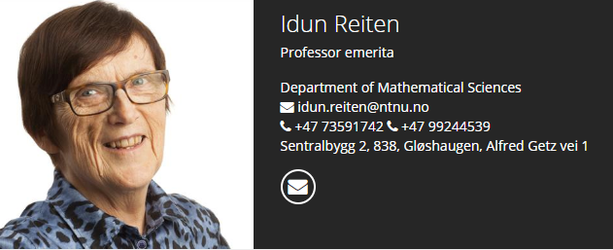
IDUN 1 M Euro 2019 – 2022 https://www.ntnu.edu/idun
background:
581 employees in scientific positions– 20% female
125 professors – 13,8% female
Problemet:
Too few women at master level
Dropout from phd to professor
Idun Reiten, first female professor at the Faculty of Information Technology and Electrical Engineering, NTNU
Notes:
Hvorfor IDUN?
IE er et av åtte NTNU fakulteter og har sju institutter fordelt på tre byer. IE er det største fakultet i Norge på de fagområdene IE forvalter (Informasjonsteknologi, Matematikk, Elektroteknikk). IE har – i likhet med de fleste nordvestlige land- utfordringer knyttet til rekruttering av kvinner generelt, og spesielt til ledende vitenskapelige stillinger innenfor Science, Technology, Engineering, Mathematics (STEM).
Ved NTNUs Fakultet for informasjonsteknologi og elektroteknikk er knapt 14 % av professorene kvinner. Dette skyldes dels at det utdannes for få kvinner på masternivå i STEM og dels at mange kvinner stopper opp i karrierestigen.
Hvorfor heter prosjektet IDUN?
Prosjektet IDUN har fått navnet etter Idun Reiten, Professor Emerita, den første kvinnelige professoren ved nåværende IE-fakultetet. Navnet Idun kommer fra norrønt og betyr «den fornyende».

