Slide 1
Video Telenor-NTNU AI-Lab on Vimeo
Norwegian Open Ai Lab
https://vimeo.com/tydelig/review/290972766/392840506c
Notes:
https://vimeo.com/tydelig/review/290972766/392840506c
The Norwegian Open Ai Lab
In our AI lab at NTNU, several social innovation projects are carried out.

Slide 2


Artificial Intelligence and innovation why and how develop research and innovation collaborations
Letizia Jaccheri
Notes:
Welcome to my lecture, my name is letizia jaccheri, I work at the Norwegian university of science and technology in Norway and I am honored to give this speech. The speech is titled AI and innovation and I get also a subtitle why and how develop research and innovation collaborations

Slide 3
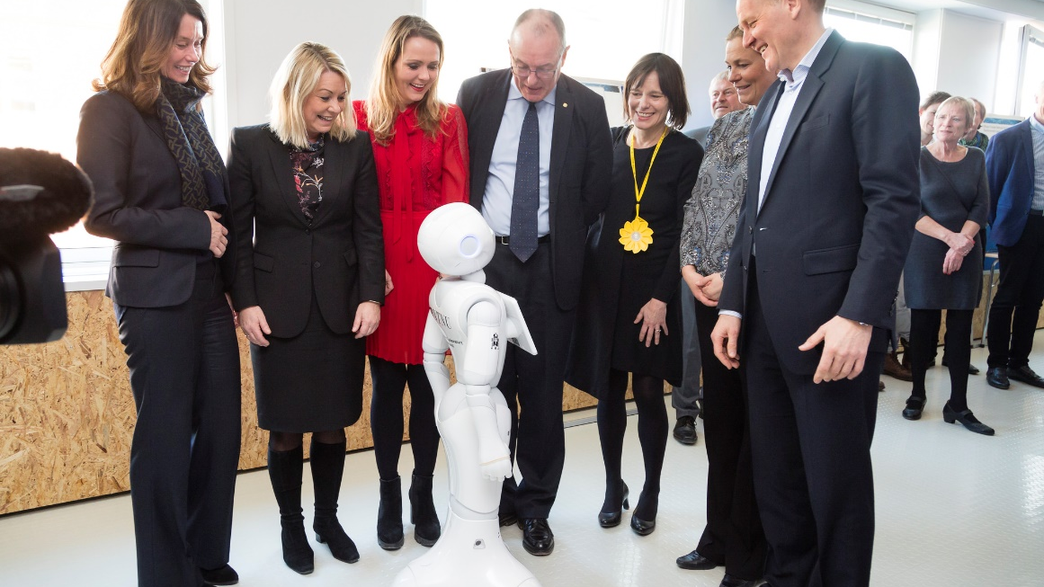
8.3.2017 Opening
Notes:
I am a bit proud and a bit incredulous that we have managed this.
The 8th of March 2017, Telenor-NTNU AI-Lab was opened with t he goal is to conduct research and innovation in artificial intelligence and big data. The press releases sounded like this:
The laboratory will investigate how machines can develop new services, based on data derived from Internet of things.
Artificial intelligence is an area where Norwegian companies can take an international role, and Telenor-NTNU AI-Lab will therefore work in close cooperation with industry, research institutions, academia and entrepreneurs.
Telenor contributes 40 million in financial support. With the 40 million, we will hire a Professorship in AI and Machine Learning, 1 postdoc, 1 doctoral student, and assistants.
AI LAB is an Important Confirmation, which means Increased Attention, New Resource, New Researchers and Students. This means that employees in Telenor and NTNU are obliged to work at the lab and for lab.
And we organize events and hacking. And it will attract policy makes and industry

Slide 4
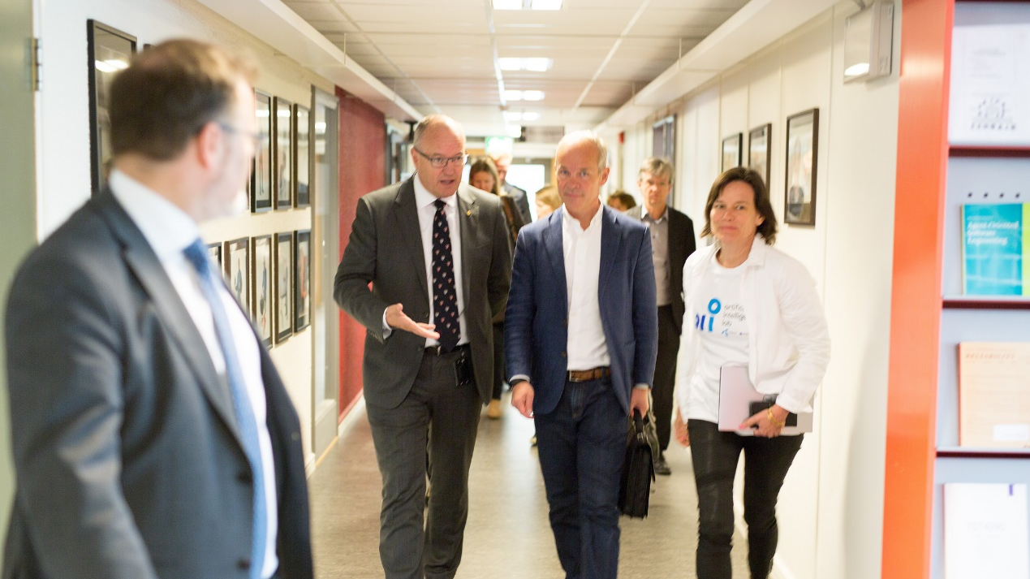
The AI Lab soon became a catalysator for Industry actors, and policy makers
Notes:
- SINTEF no
The agreement between NTNU and DNB is worth 25MNOK over 5 years
- DNV GL pays for a present professorship worth 10MNOK
Equinor and Kongsberg finances several professor and researchers positions under the AI umbrella

Slide 5
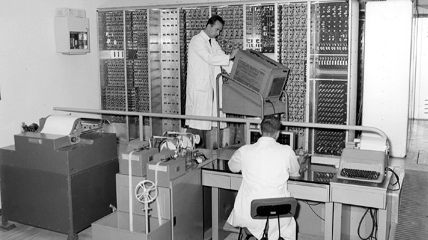
Pisa, Italy, 1960’s
The first Italian computer is build
Notes:
Who am I and why am I here? I wish to start from the time oof the Viking.
I was born in the 1960’s in Pisa Tuscany Ital. At that time in Pisa a group of researchers supported by the Italian Company Olivetti were developing the first Italian computer, called CEP. CEP was developed 500 meters from my house and that project attracted to Pisa many intelligent talents from all over Italy and the rest of the world. Not least that project inspired many people to start studying computer science. Personally I wrote my first program on a spectrum in 1982 and started computer science in 1983 we were 1300 students who started all together from many different places in Italy. It was the beginning of a big adventure.

Slide 6

Structure
research
software
art
social
Notes:
I work with three areas: software, art, social good
Software is the ground for your and my research and innovation projects.
Each of you has one or several definitions of art in your mind. For me art is about life, communication between human beings, it is like research an attempt to achieve something higher than we have achieved before.
Social innovations are new ideas that meet social needs, create social relationships and form new collaborations. These innovations can be products, services or models addressing unmet needs more effectively.
The project we have seen in the video at the beginning is clearly a social innovation project.

Slide 7
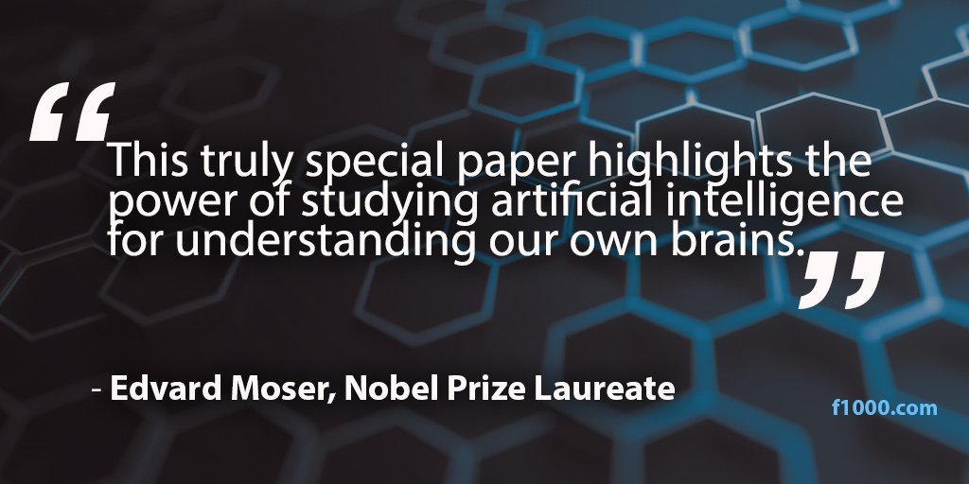
On the importance of good research goals
Notes:
To be able to imagine innovation and research cooperation we must stop and reflect about the importance of good research and good research goals. Studying artificial intelligence for understanding our own brains.
The notion of Artificial Intelligence was invented in 1956, even before software engineering. Deep learning was introduced as a rebranding of AI in 2006 and AI started its new wave with Big Data Powerful computing

Slide 8
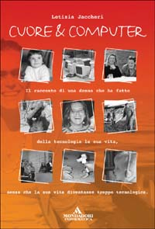
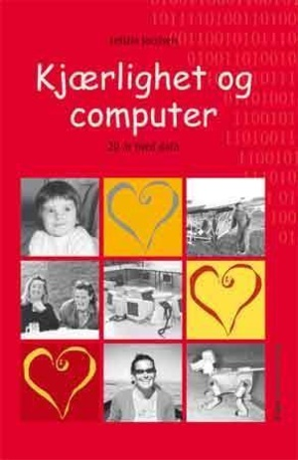
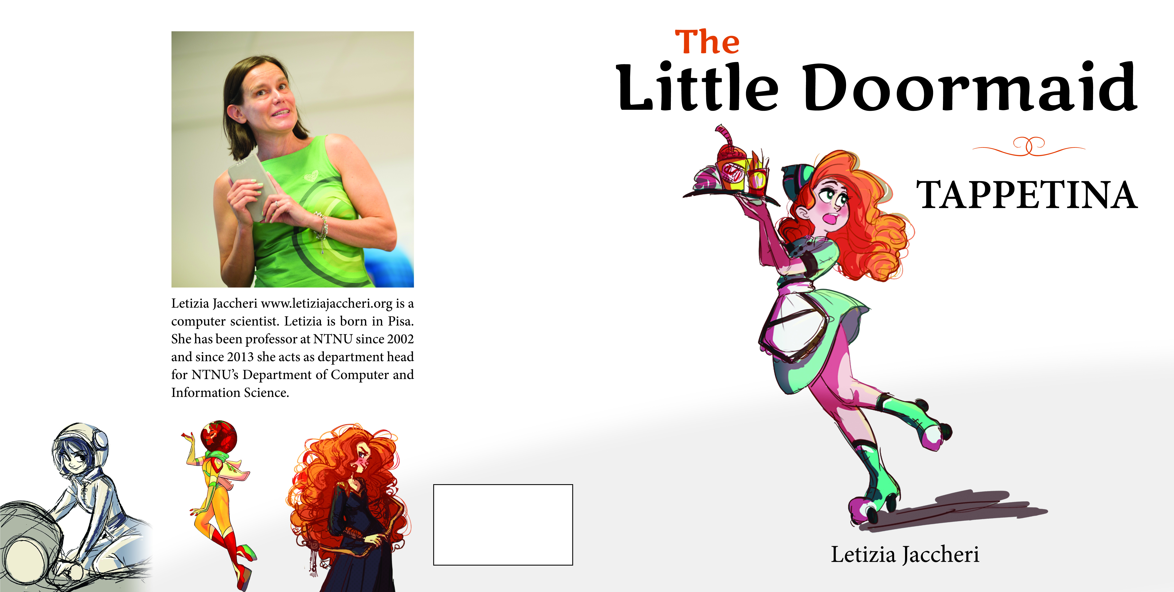
tappetina.com
Understand the relationship between art and software
Notes:
the goal that has motivated my research is the will to understand the relation between art and software. Art is the same as life, and communication between human beings. Software is the language to communicate between human beings and computers.
Art and science have in common a goal of trying to do something newer and unexplored with respect of what we have done before.
Art and science are very different in that the subject is science should be as distint as possible from the researcher while the artist uses herself and her feelings as a medium and as a message
I am not sure if I am an artist or a scientist but I do not care to be defined.
During the years I have being writing several scientific papers, teaching several courses, supervising students. I also love to write for the popular dissemination, expecially for children and young ones. You find most of what I have written on my blog. Most of the information is in English, something in Italian, or Norwegian. The Doormaid books is also translated to other languages, like Chinese.

Slide 9
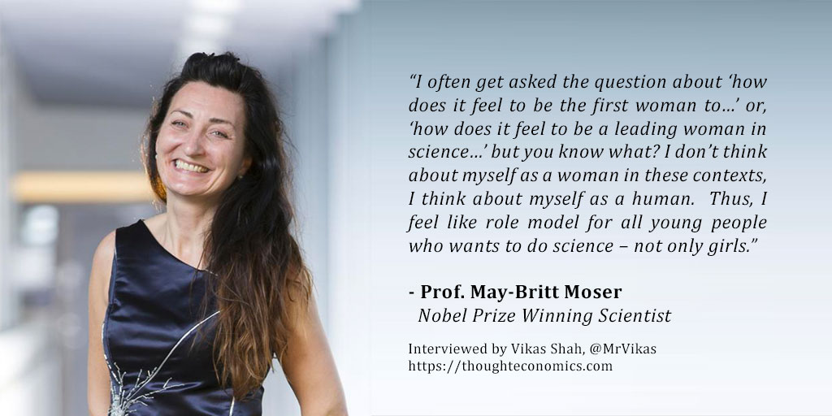
On the importance of good role models
Notes:
They soon became role models for all of us at NTNU who want to establish research projects guided by meaningful and powerful research goals.
Before I go ahead I would like to stop and ask you to reflect one minute about what I have said until now. My slides are available. Do you have questions?

Slide 10
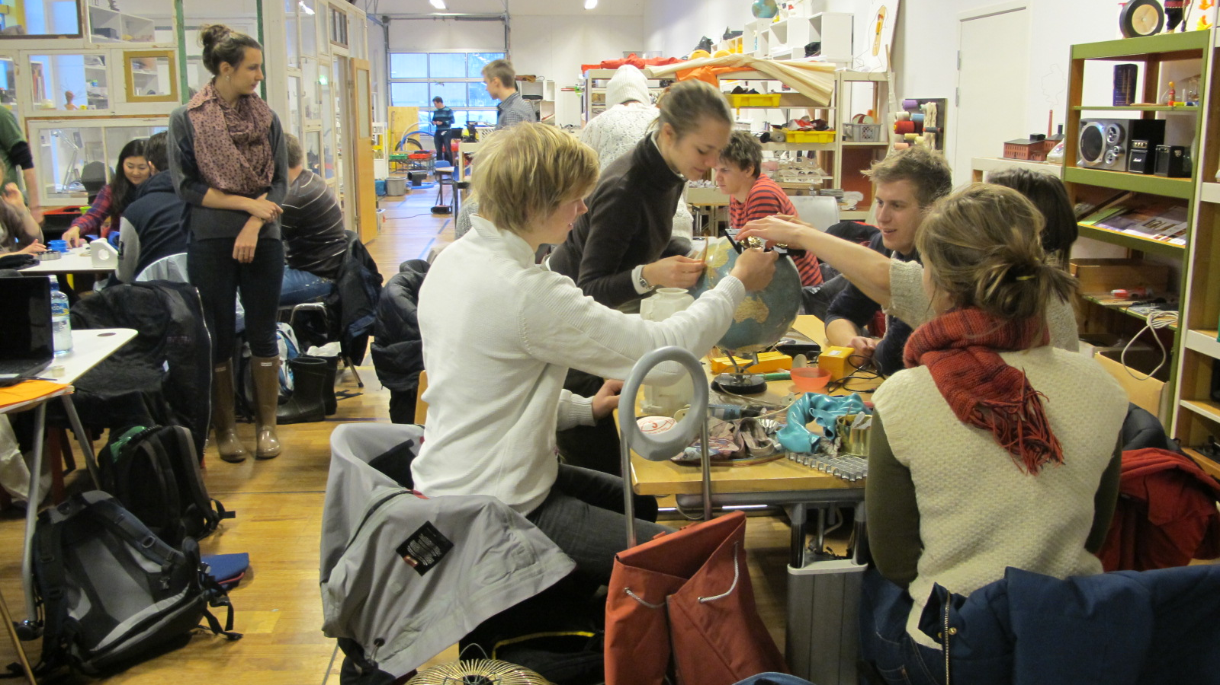
Design Science
Build
Reflect
Contribute to theory
  Empirical
  Literature review
  Experiment (Hypothesis, experimental design, statistical analysis)
  Case study (Follow one or several groups in depth)
Notes:
What I learned in my 30 years in software engineering research, I learned to see research possibilities and to apreciate different research methods. While I hear colleagues saying «this is not research» or looking for candidates who are experts in the very specific research method they have been always working with, I try to be open to different methods. On the one hand, we assist to design science research projects that are basically centered around the construction of an artefact, reflection about the process and the product, and then contribution to theory. On the other hand, empirical research relies on literature reviews, experiments with hypothesis testing by statistical methods, case studies in which several groups are followed in depth over time, and the collected data is usually qualitative and analyzed according to qualitative methods.

Slide 11
software
Notes:
As I was writing this presentation, I realized that I have been working with software research for more than 30 years and that software engineering is 49 years old. The name ‘software engineering’ was proposed in 1969 at a NATO conference to discuss software development problems—large software systems were late , did not deliver the functionality needed by their users, cost more than expected, and were unreliable.
Software engineering research has focused on understanding software and how humans can develop good software.

Slide 12
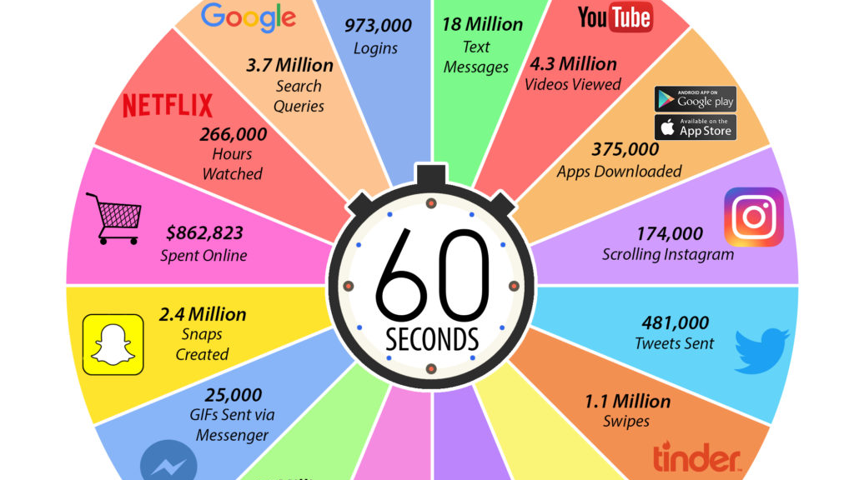
Notes:
It does not make sense to talk about software without talking about data. In order to say something about the most popular software applications (facebook, google, youtube, twitter, netflix) we can say something about the data they generate. It has been estimated that for each minute 375.000 apps are downloaded from app store and google store, that almost half millions twits are sent, 36 millions of whatsup messages, a quarter of millions of hours are watched, and 3,7 millions of queries are run. We also note that all the apps in this figure are made in US. I wonder which is the most popular app in Norway in your opinion.

Slide 13
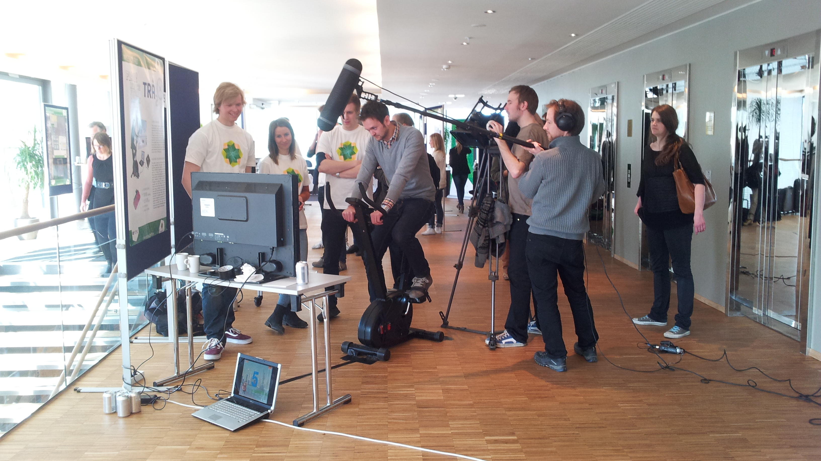
Carver, Jeffrey C; Jaccheri, Letizia; Morasca, Sandro; Shull, Forrest; ,
A checklist for integrating student empirical studies with research
and teaching goals, 2010
Jaccheri, Letizia; Sindre, Guttorm;
Software engineering students meet interdisciplinary project work and art,
2007
Notes:
Central to my research projects has been the idea to put students in the center. Students are innovators, researchers, and subjects. It has been challenging to defend this idea. However it is thanks to students, and the interdisciplinary courses Experts in Team that I learned how to work at the intersection between software and other disciplines, starting from art. Experts in Team is a mandatory course that each year all master students at NTNU participate to.
Important to researchers is to publish in high quality conferences and journals-

Slide 14
art
Notes:
I wonder now if you have any questions about the software part of my presentation.

Slide 15
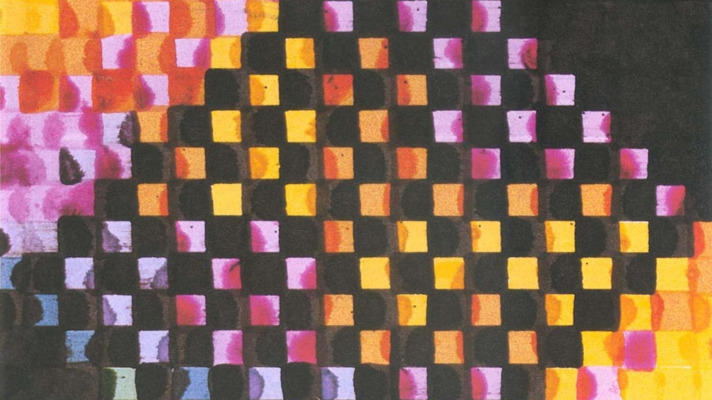
1965 First Computer Art Exhibition
Trifonova, Anna; Jaccheri, Letizia; Bergaust, Kristin;
Software engineering issues in interactive installation art,
2008
Notes:
ENIAC (Electronic Numerical Integrator and Computer) was introduced at the University of Pennsylvania in 1946. In 1951 the first UNIVAC became commercially available. In 1965 American A. Michael Noll and German Frieder Nake experiment with computer art and in the same year the first computer art exhibition is held.
In 1974 Vinton G. Cerf developed the TCP/ Internet Protocol. The Free Software Foundation published a single license usable for all software in 1989, called the GNU General Public License (GPL). This formalized the concept of copy left as opposite to copy right. Artists began to exploit the new technology offered by the web (Internet art) from the very beginning, developing new forms of interaction with the audience and shared authorship.
Photoshop 1.0 was released in 1990 as a tool for digital photography. In the following years, digital cameras appeared on the market. Pictures could now be uploaded to computers and then manipulated. The first multimedia PC was released in 1991, its defining components being the CD-ROM drive and the sound card. The performance of micro processor-based computers reached the point that real-time generation of computer music using more general programs and algorithms became possible. In 1991, the first Web server was installed at the Stanford Linear Accelerator Center in California. In 1992, the portable browser was released by CERN as freeware, and the world had approximately 50 Web servers.

Slide 16
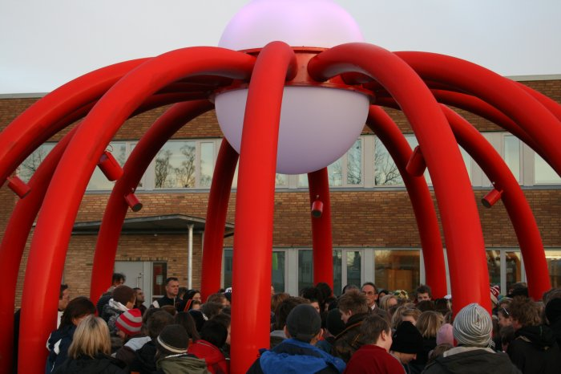
How can we improve the development process
of software
dependent artworks?
Ahmed, Salah Uddin; Jaccheri, Letizia; M’kadmi, Samir; Sonic onyx: Case study of an interactive artwork, 2009
Notes:
In this project that we carried out in Trondheim from 2007 to 2011, the research questions explore the interplay between artwork, technology, artist, and audience
How can we improve the development process of software dependent artworks and projects, in terms of software development, maintenance, upgrade and usability of the artwork? This permanent installation in the school yard of a school in Trondheim, enables the pupils to play with technology and music, while being outside and together.

Slide 17
Social

Slide 18
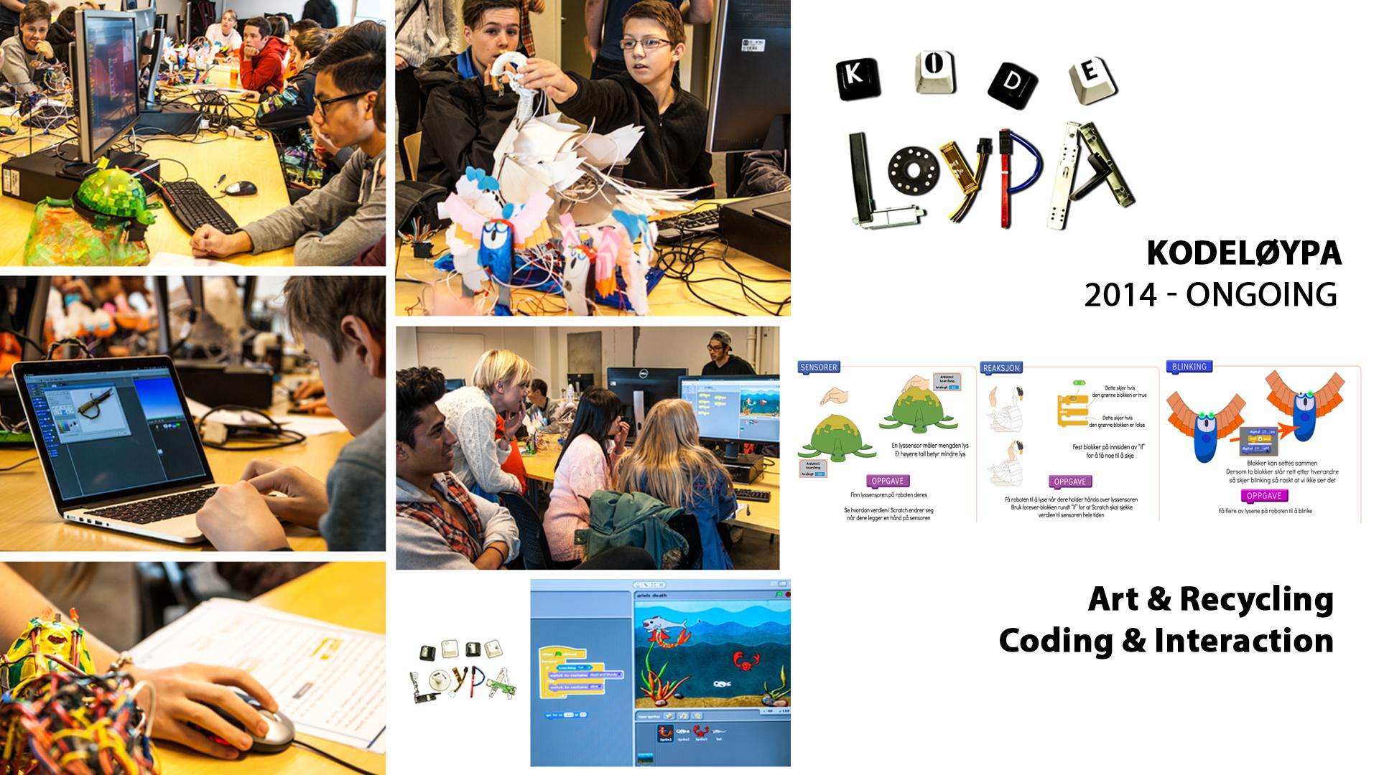
Using Eye-Tracking to Unveil Differences Between
Kids and Teens in Coding Activities
S Papavlasopoulou,
K Sharma, M Giannakos, L Jaccheri
2017
Notes:
Kodeløypa is a project that we started in 2014 that build on computing and art to address the goal 4 and 5. We invite each Friday to our department a new class from the ground school. Children come to experience artistic robot programming. We collect rich data to be able to improve knowledge and tools for programming for children. In this specific investigation, we have collected data by eye tracking and analyzed it using ML.

Slide 19

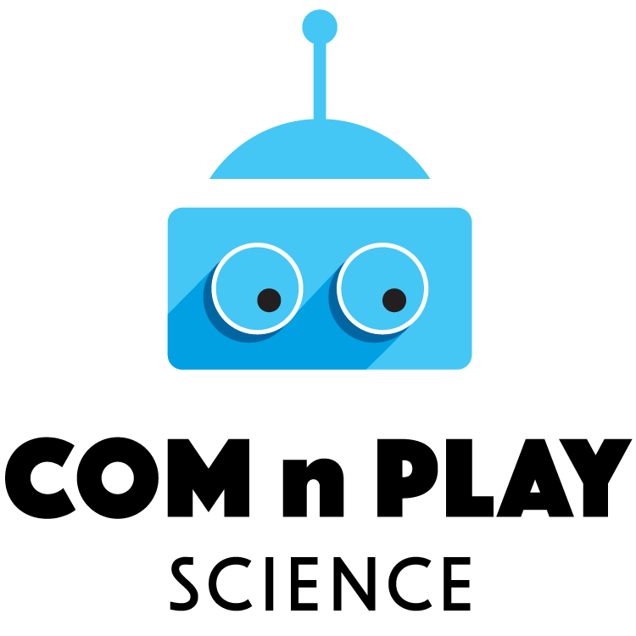


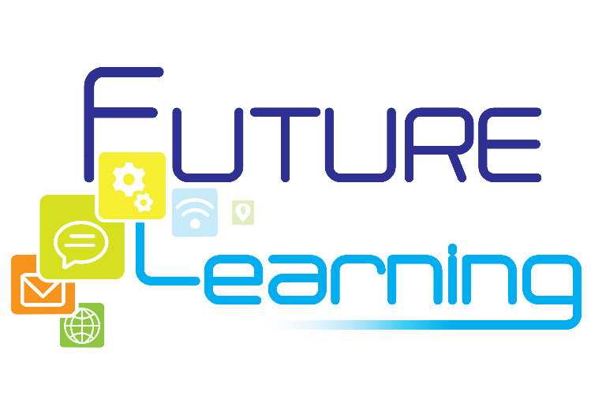
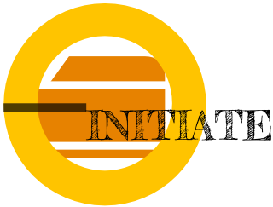
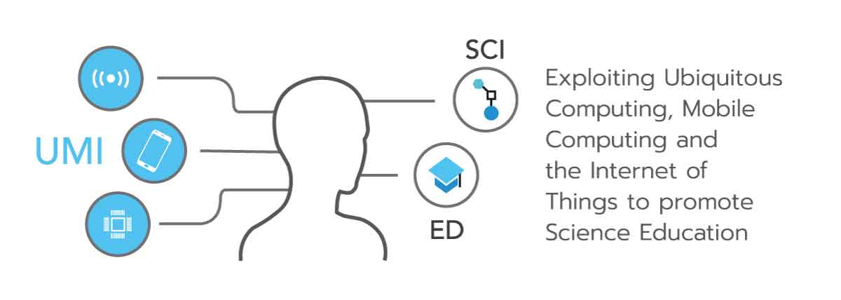
Projects
EU Horizon 2020 Socratic http://www.socratic.eu/ - Pappas, Mora
EU Horizon 2020 UMI http://umi-sci-ed.eu/ - Divitini
Center Excited https://www.ntnu.edu/excited - Sindre
NFR INTPART IPIT https://ipit.network/ - Jingyue Li, Giannakos
NTNU ARTEC https://www.ntnu.edu/artec - Perkis
Kodeløypa https://www.ntnu.no/kodeloypa - Papavlasopoulou
Tappetina https://tappetina.com/ - Gomez, Sharma
EU Horizon 2020 CoM_n_Play-Science https://comnplayscience.eu/ - Giannakos
EU Horizon 2020 Initiate http://initiate2020.eu/ - Pappas
Notes:
I want to conclude by giving pointers to the projects I am involved. I would like to Thank my university, the Research Council of Norway and the Horizon program of the European Commission. I would like to thank all my students, without them I would not not learn anything. I thank my colleagues, those whom I mention here and the other ones, I thank expecially Ilias Pappas who is here in the conference, with him we work on social innovation and big data project.
I hope you have enjoyed the interaction and you want to ask me questions or just give me feedback. Thanks again for the attention and for inviting me here.

Slide 20

AI-Lab
Heri Ramampiaro
Head of the Data and Artificial Intelligence Group
Deputy Head of Computer Science Department
www.ntnu.edu/ailab
heri@ntnu.no
Telenor, SINTEF, DNB, DNV GL, Equinor and Kongsberg

