Slide 1

Letizia Jaccheri
Art and Software for All
HiOA 20.12.2017
Notes:
My name is Letizia Jaccheri,
I am a professor of computer science at the Department of Computer Science at ntnu
I have been asked to give a lecture about AI and smarter media but I have gone my own ways and made a lecture in my style about life (or art that is the same) and computing.

Slide 2
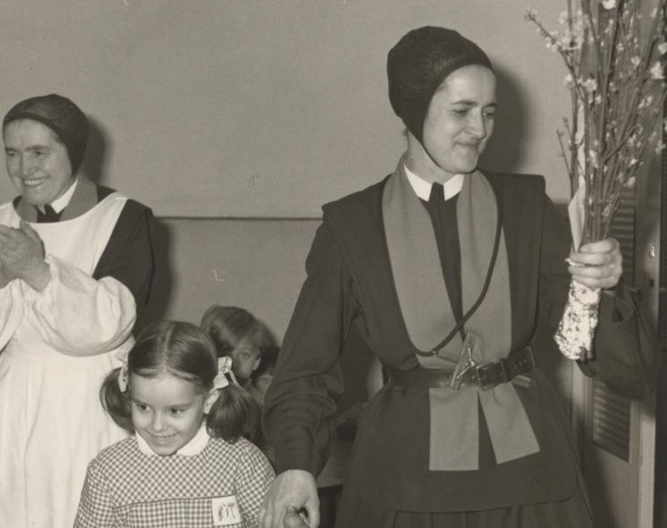
1960’s Pisa Tuscany Italy
1st Italian computer CEP
Me Kindergarden
Notes:
When I grew up in Pisa and I attended the Nun kindergarden, in Pisa there was the first Italian computer that has been developed 500 meters from my house and was attracting to Pisa many intelligent talents from all over Italy and the rest of the world.

Slide 3
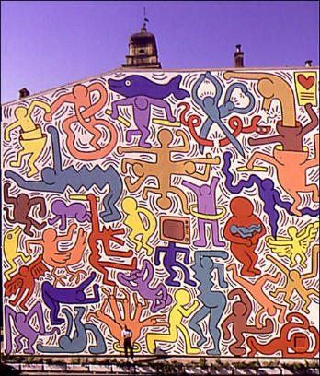
Master in Computer Science 1988
Keith Haring Pisa 1989 Chiesa San Antonio
Notes:
I graduated in CS in 1988 at the university of pisa. During that time, Keith Haring painted a wall to a church in Pisa, chiesa di san antonio, and I felt that everything would be possible - if it was possible to paint such pictures At a church that also contained the contents of a computer, just 5 years before, when I started data, few people knew what it was.
Computer technology has never flop in the 34 years I've been using data. The studies in computer technology have never been as popular as now and this year the institute has recorded 500 new data students distributed on several programs. This year, the Institute has a center for outstanding education and Telenor NTNU AI Lab.
Artificial Intelligence 1956
Deep learning was introduced as a kind of rebranding of AI in 2006 and AI started its new wave with Big Data + Powerful computing

Slide 4
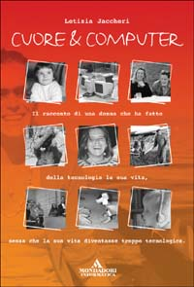
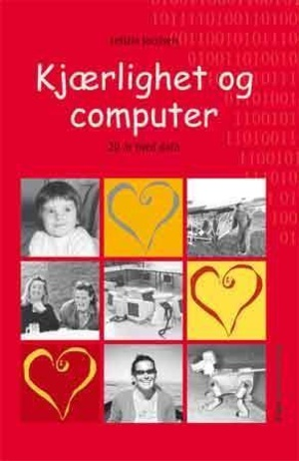
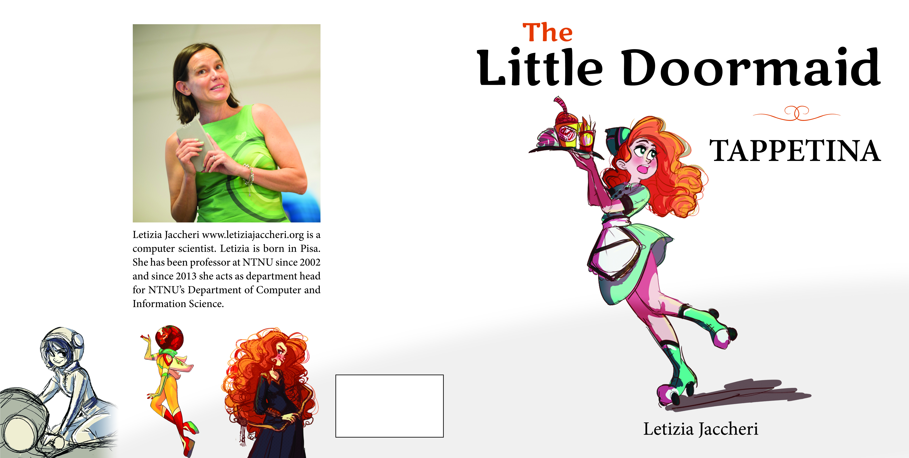
My Research (1988 – 2017)
Understand the relationship between art and software
Notes:
Art and science have in common a goal of trying to do something newer and unexplored with respect of what we have done before.
Art and science are very different in that the subject is science should be as distint as possible from the researcher while the artist uses herself and her feelings as a medium and as a message
I am not sure if I am an artist or a scientist but I do not care to be defined.

Slide 5
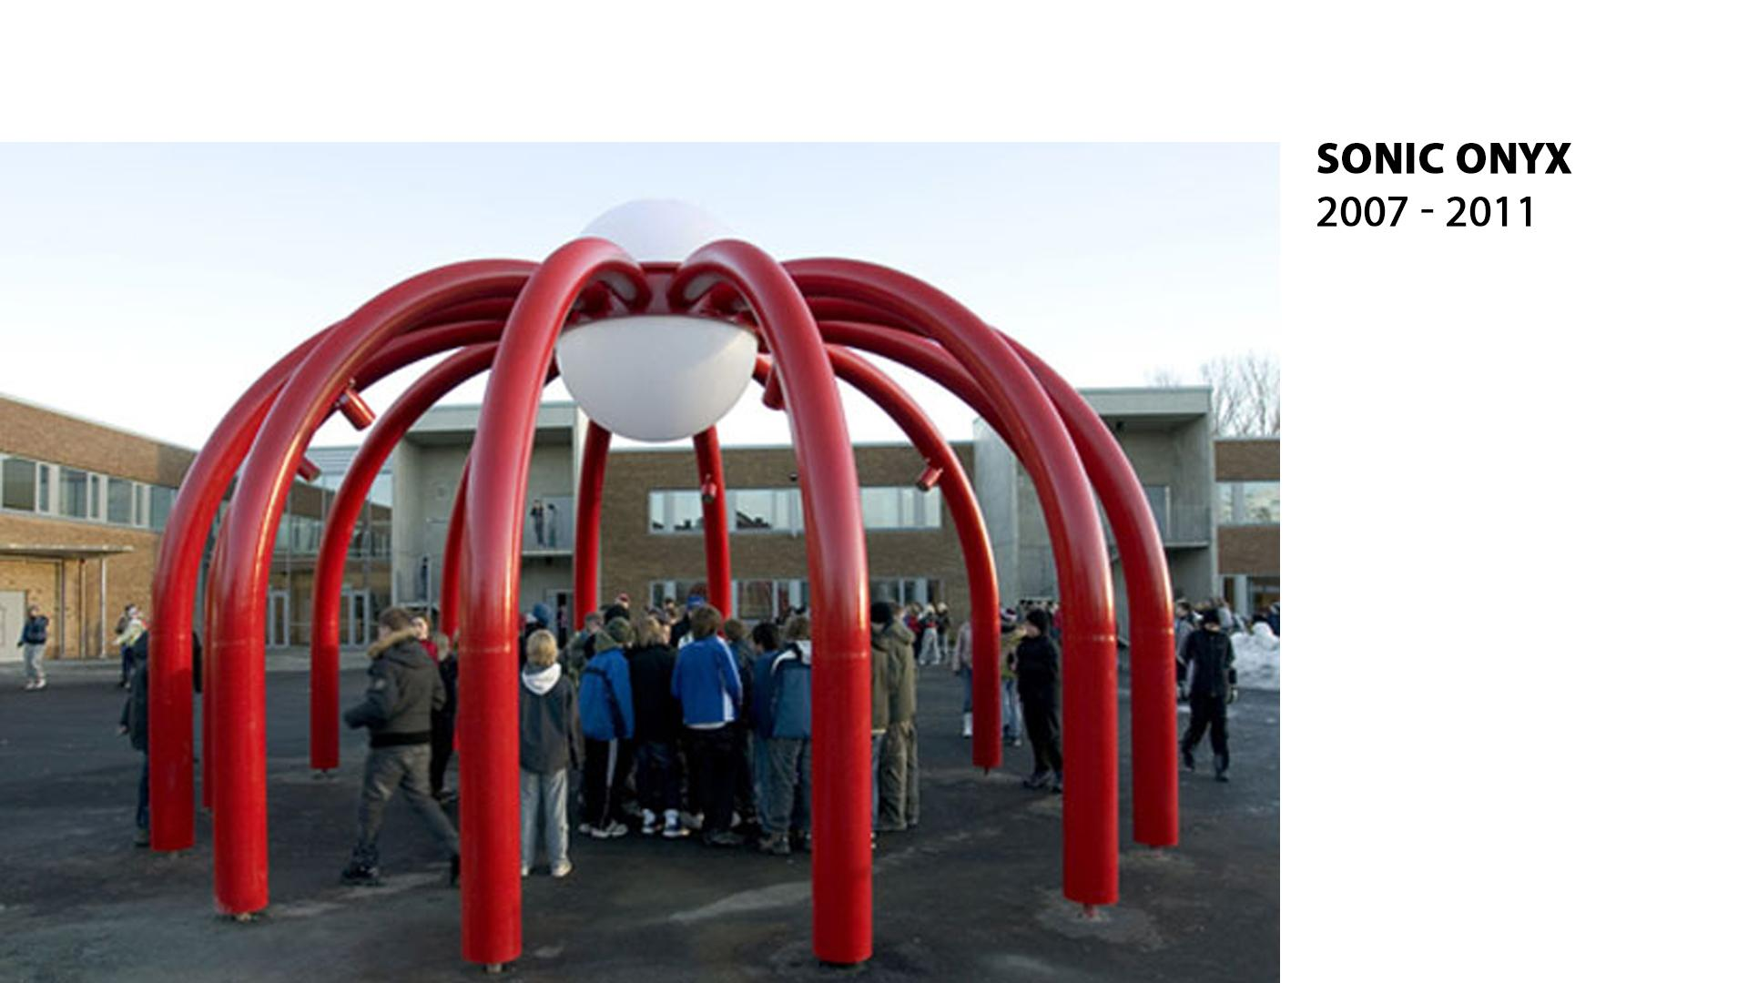
Salah Ahmed PhD work
Notes:
The research questions explore the interplay between artwork, technology, artist, and audience
How can we improve the development process of software dependent artworks and projects, in terms of software development, maintenance, upgrade and usability of the artwork?

Slide 6
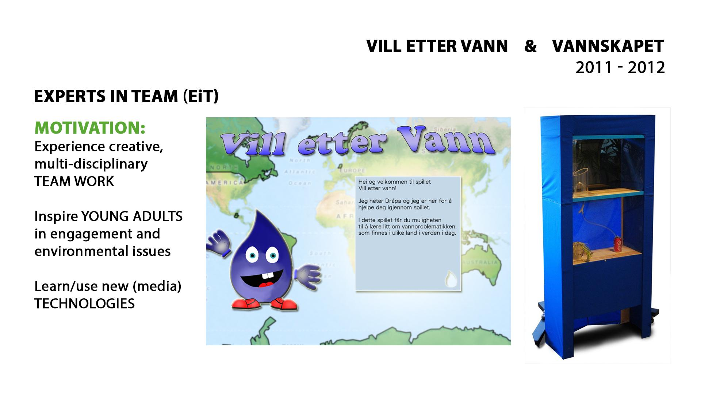
Notes:
Idea = education + empirical + interdisciplinarity

Slide 7
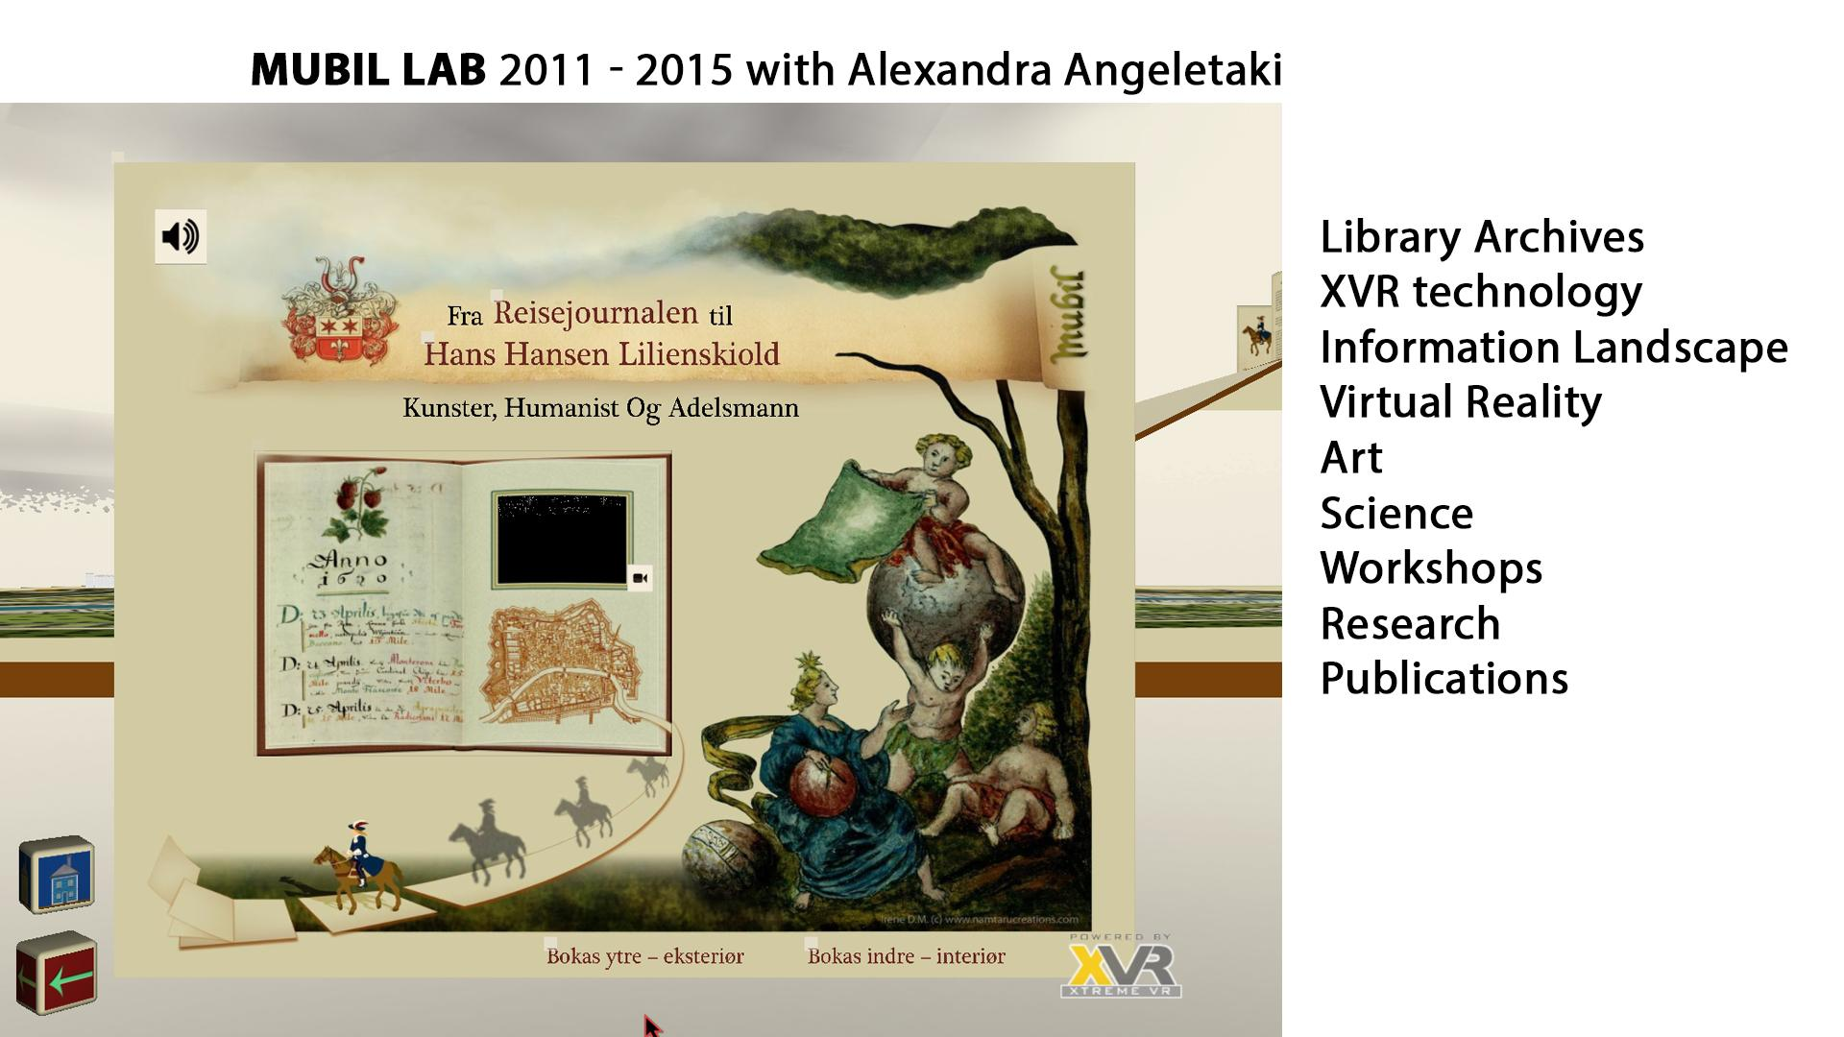
Notes:
Working with friends

Slide 8
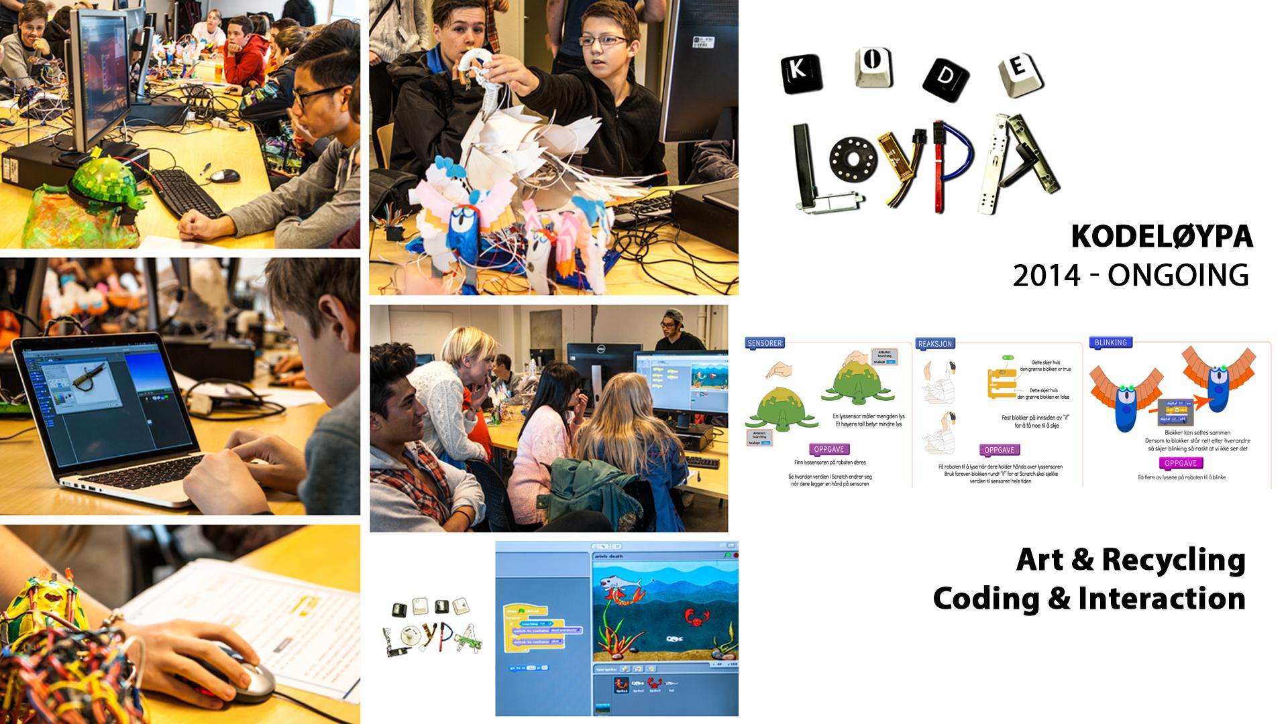
Notes:
Most of the papers and the projects are built on top of this

Slide 9
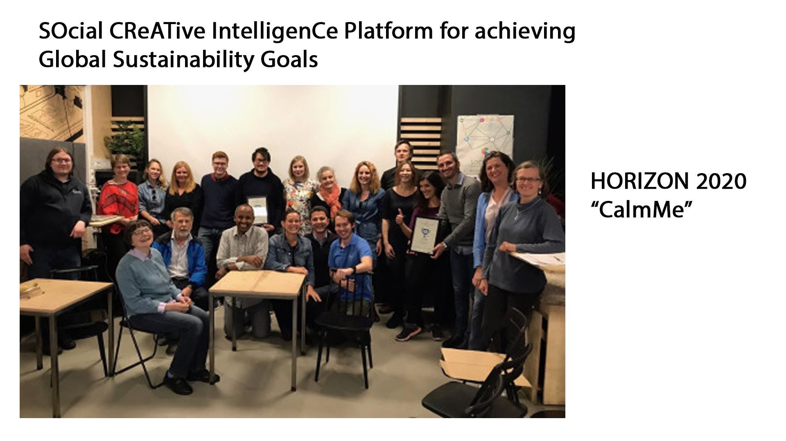

Slide 10
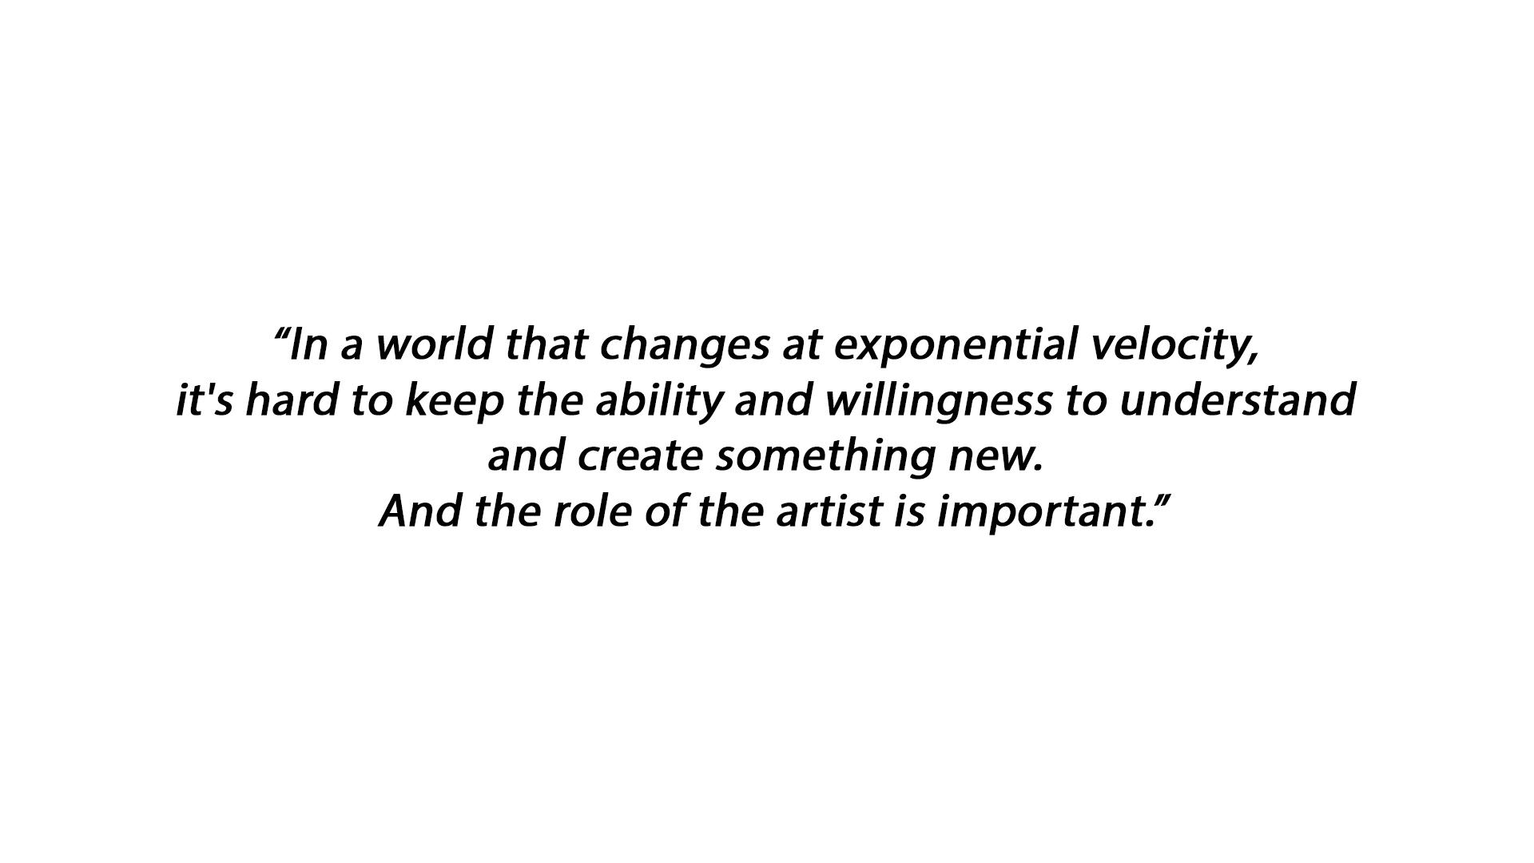

Slide 11
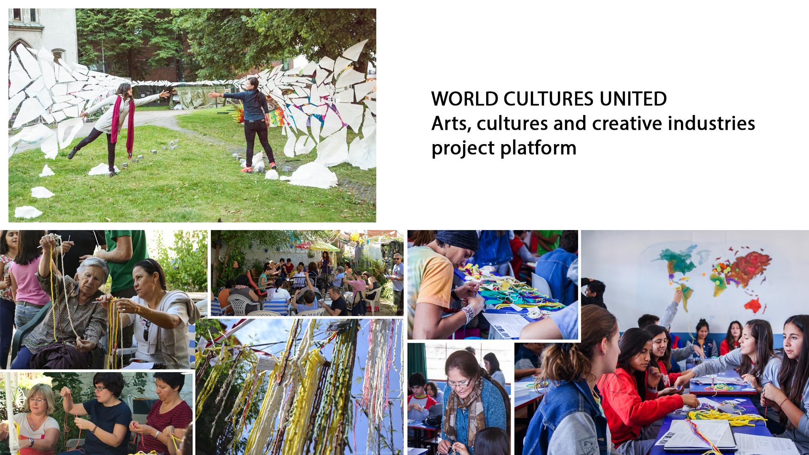
Notes:
One of the customer for eit 2018

Slide 12


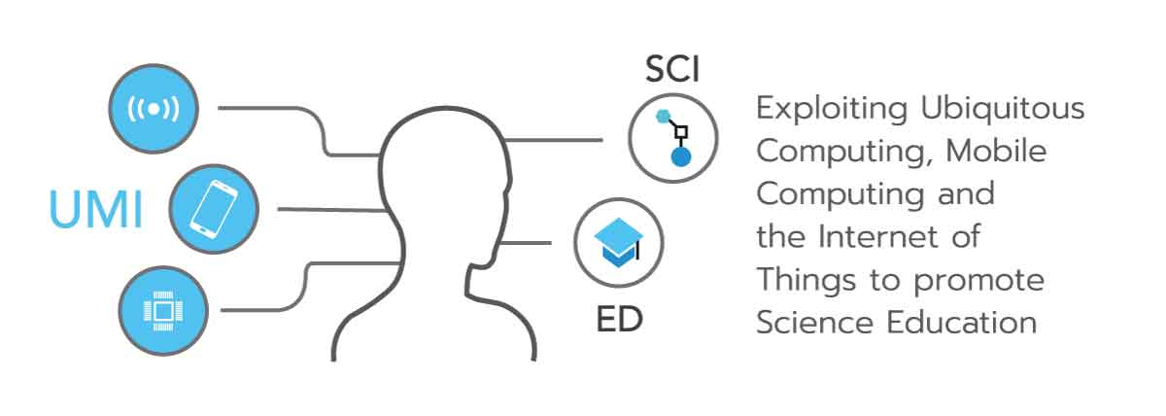

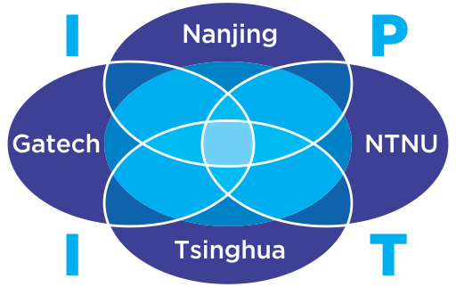
EU Horizon 2020 Socratic http://www.socratic.eu/ Jaccheri, Pappas, Mora
NFR Future Learning https://www.ntnu.edu/idi/future-learning Giannakos ++
EU Horizon 2020 UMI http://umi-sci-ed.eu/ Divitini, Jaccheri
Center Excited https://www.ntnu.edu/excited Sindre ++
NFR INTPART IPIT Jaccheri, Jingyue Li, Giannakos
NTNU ARTEC https://www.ntnu.edu/artec Perkis ++
Kodeløypa and Tappetina https://tappetina.com/ Papavlasopoulou, Karlsen, Jaccheri

