Slide 1
Informatics – Informatikk
Letizia Jaccheri
Friday 18.08.2017 Kl. 10.15
Software Engineering Programvaresystemer
http://www.ntnu.no/idi
https://www.ntnu.edu/studies/mit

Slide 2
Studieretningsmøtet
Hva forventer dere som veiledere av studentene, hva kan de forvente av dere
Hvordan skal studentene gå fram når de velger masteroppgave, holder det at de velger på nett eller burde de komme innom for å vise sin interesse, foretrekker dere spørsmål på e-post eller at de kommer innom osv.
Fortell litt (nøkkelord) om emnene som tilhører gruppen
Hvilke emner passer godt sammen om man er interessert i spesifikke områder (kom med noen eksempler) innen studieretning
Hva må de tenke på når de ser etter emner. F.eks. bruk et konkret masteroppgaveforslag som ligger ute, hva ser du etter for å finne emner som vil være nyttige for arbeidet med oppgaven
Hvilke faglærere tilbyr masteroppgaver 2018/2019
Hvilke faglærere sine masteroppgaveforslag burde de se på om de f.eks. er interessert i helseinformatikk osv.

Slide 3
MIT master programme
4 semesters, with a mix of
  theory and practice
  individual and group work
  exercises and projects
  mandatory and elective courses

Slide 4
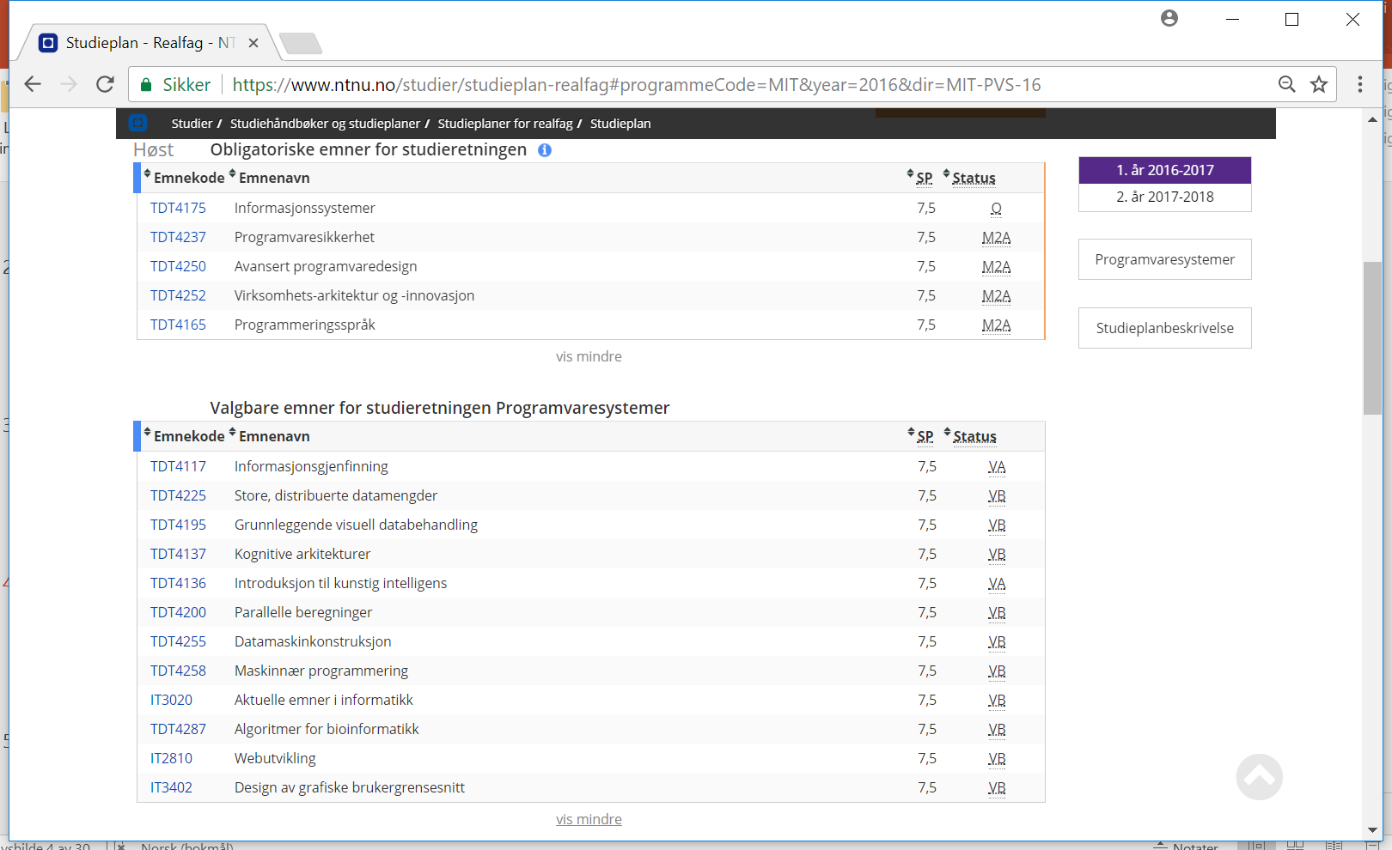

Slide 5
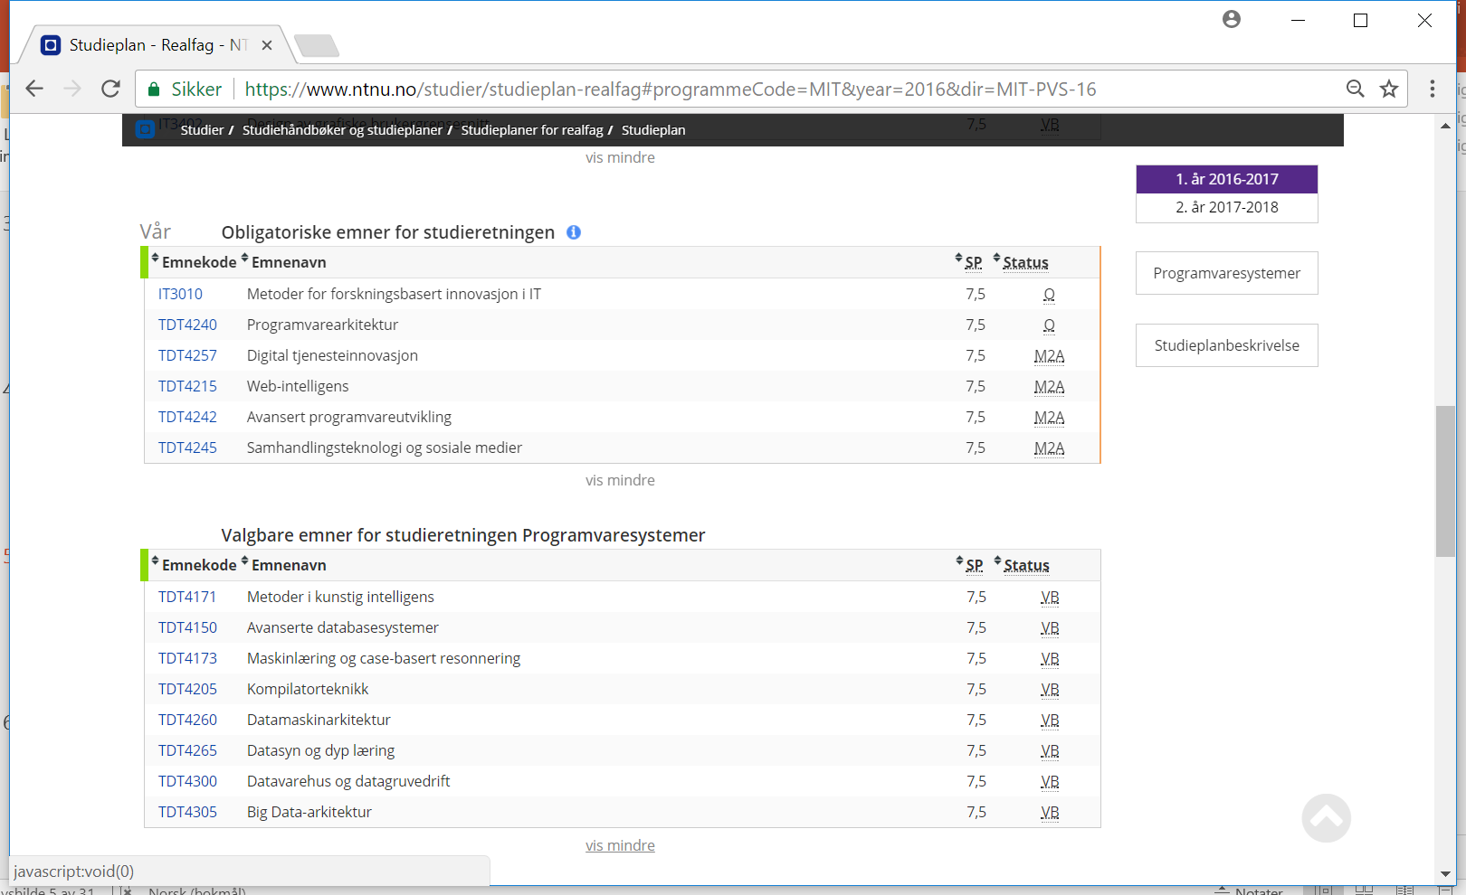

Slide 6
Experts in Team (EiT)
Dominates the 2nd semester
  practical, group, project, mandatory
  multi-disciplinary project with objectives defined by group
  two-level organisation: topics (“villages”) and groups
  must prioritize topics during October 2017!
See https://innsida.ntnu.no/wiki/-/wiki/English/
Experts+in+Teamwork+-+for+students

Slide 7
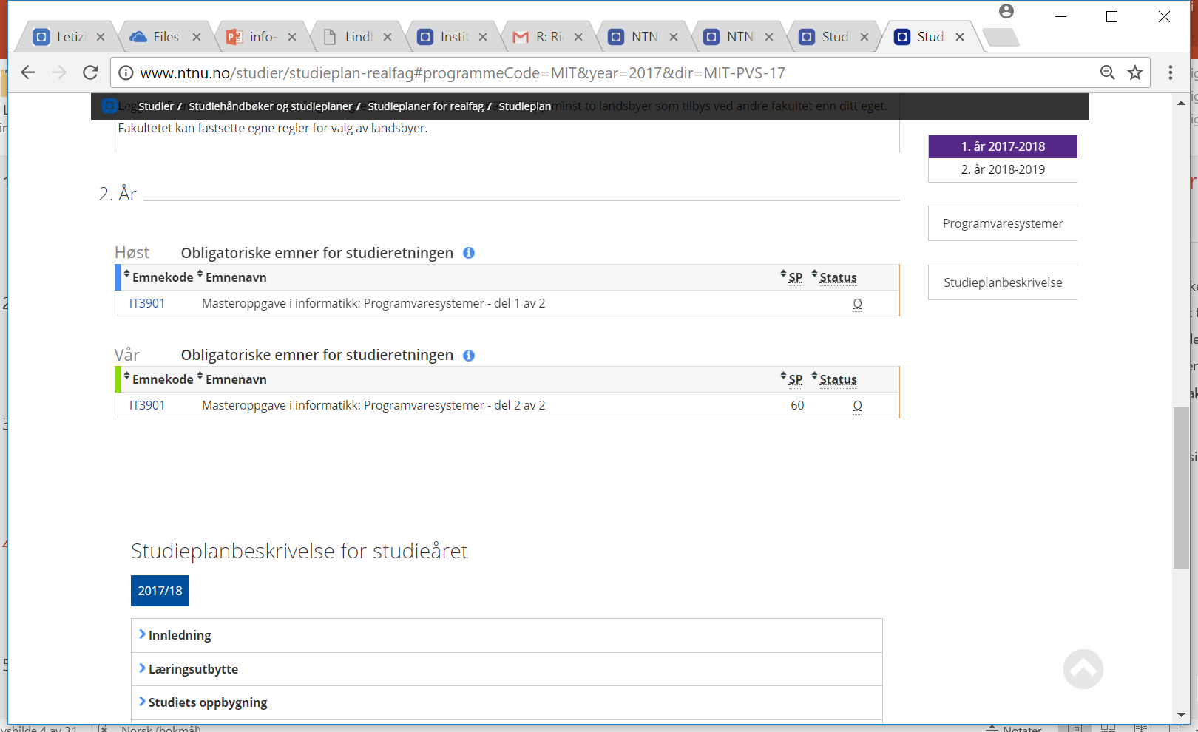

Slide 8
Relevante ressurser
Gruppe
https://www.ntnu.no/idi/people/isse
Oversikt over mulige masteroppgaver: https://www.idi.ntnu.no/education/masteroppgaver.php
Tidligere masteroppgave ved instituttet: https://brage.bibsys.no/xmlui/handle/11250/227491/browse?value=Master+thesis&type=type
Studieplan på nett
http://www.ntnu.no/studier/studieplan-realfag#programmeCode=MIT&year=2017&dir=MIT-PVS-17
Daim –master contract and more:
http://daim.idi.ntnu.no/

Slide 9
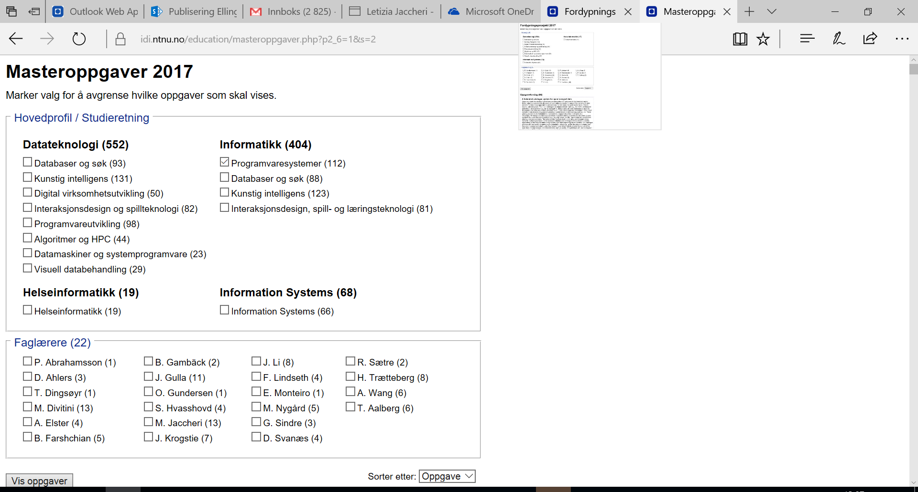

Slide 10
Work spaces /Computer labs
Computer labs and reading rooms:
Høyskoleringen 3 (P15), 4. floor: Computer labs 411, 414, 421, 424
Elektrobygget: B118, B122, G208
Realfagsbygget: Library (Computers, group rooms, reading spaces)
To find rooms, use MazeMap at https://innsida.ntnu.no/kart
  select Location > NTNU i Trondheim > Gløshaugen
  search for room

Slide 11
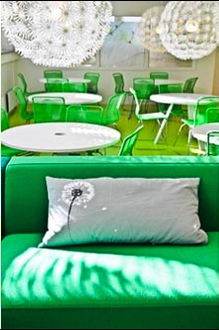
Work spaces /Computer labs
Drivhuset, where you can
study, work in groups or relax.
(IT-building, 1. floor, see
MazeMap http://bit.ly/2i5rTct)
Your own master’s work space
for 2. year (IT-building)
NB! Alf Høiseth is responsible for room administration. Contact him if you have questions: alfh@ntnu.no

Slide 12
Do you need help?
When and how to contact the adviser
When?
- Questions about the programme/courses
- Problems with your programme/courses
- Social questions / problems
How:
- drop in: IT-building, 1. floor, reception area (room 162)
- email: studier@idi.ntnu.no

Slide 13
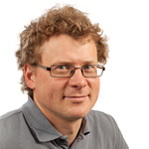

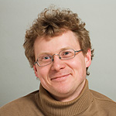
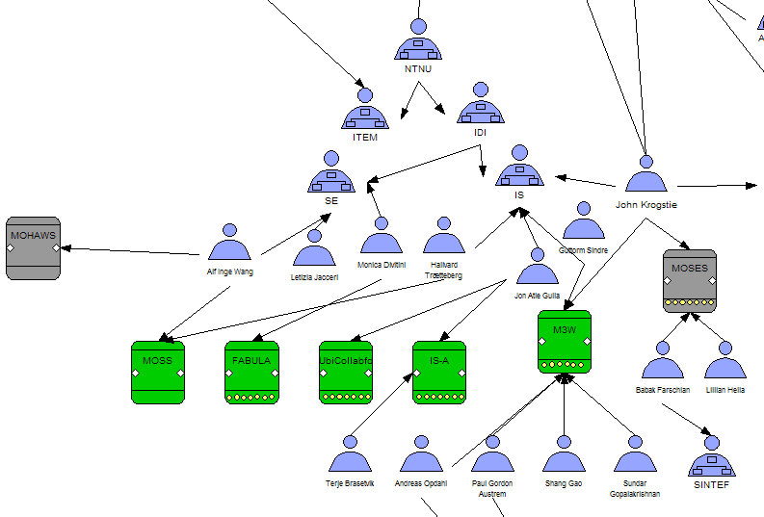


Professor John Krogstie krogstie@idi.ntnu.no
Research areas:
Model-based ICT-systems
  Enterprise and Process modeling
  Active Knowledge Modelling (AKM)
  Quality of models -SEQUAL
Mobile information systems
  Wireless Trondheim Living Lab
Main courses:
TDT4252 Enterprise architecture for enterprise innovation
TDT49: Mobile information systems
Examples of project/master thesis topics (some in co-operation with private organizations or public institutions)
Location-based services in Wireless Trondheim – e.g. Work related to MazeMap –Indoor human mobility patterns
Holistic modelling language
Application of Active Knowledge Modelling with Commitment, Aker Solutions, Statoil and others
Quality of models and modelling approaches e.g. at Statoil

Slide 14
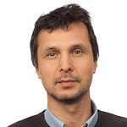
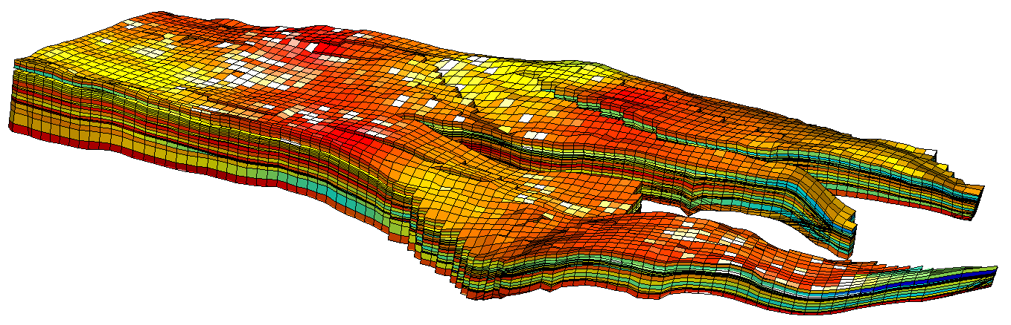
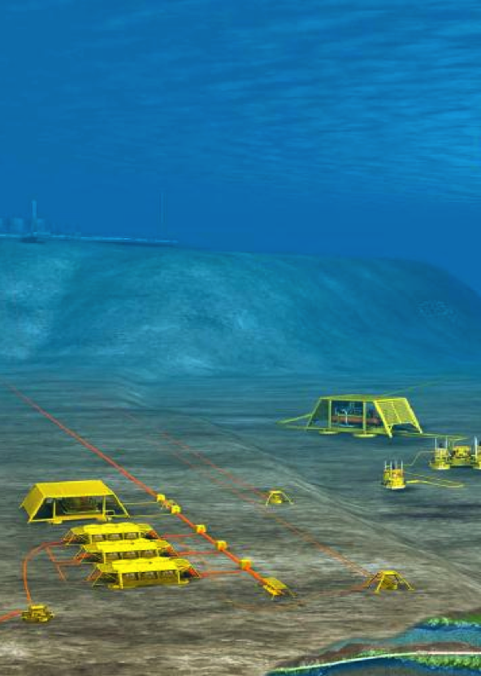
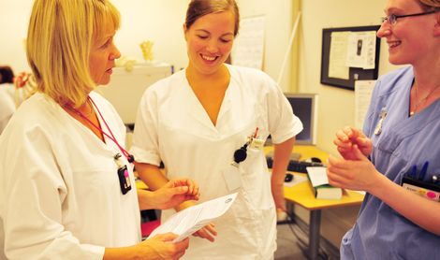
Professor Eric Monteiro ericm@idi.ntnu.no
Project/master thesis topics
Digital oil
  When do you trust your data?
  Coping with faulty sensors?
Health collaboration reform
  Continuity of care
  Interdisciplinary work, ICT
Research method:
  Observations, interviews, prototype

Slide 15
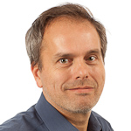
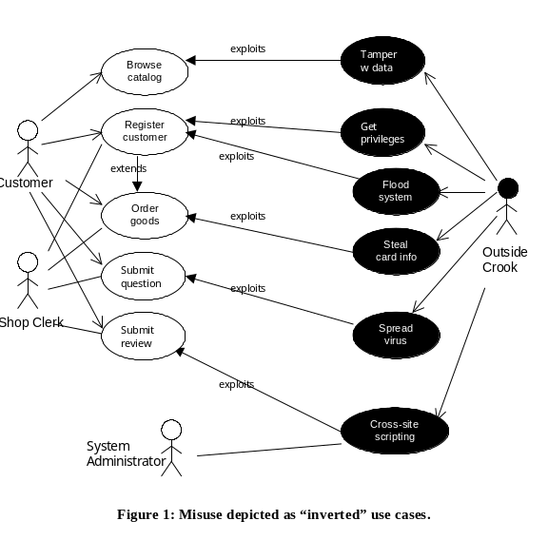
Professor Guttorm Sindre guttors@idi.ntnu.no
Requirements and security / safety:
  Early techniques for elicitation of requirements
    E.g., misuse cases
Usage of boilerplates (textual templates) for requirements
  Both for security and other requirement types, e.g. interoperability
Comparative evaluation of diagram notations in conceptual modelling

Slide 16
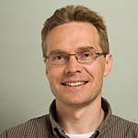
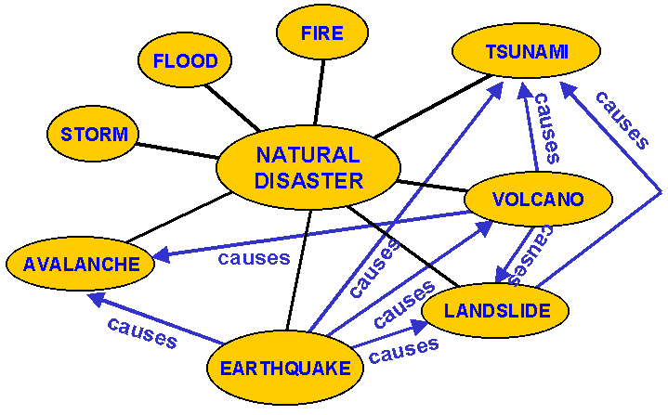

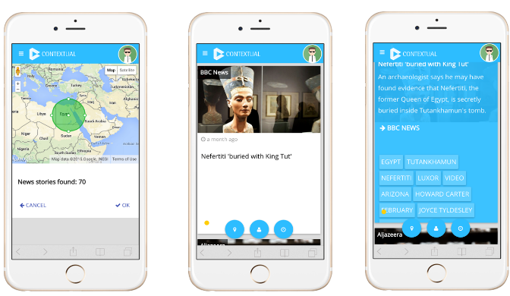
Professor Jon Atle Gulla jag@idi.ntnu.no
Research areas:
Semantic web & open data
Text mining & computational linguistics
Web search & recommender systems
Innovation & entrepreneurship
Project/master thesis topics:
Mobile news recommender systems
Social media analysis
Ontology engineering & analysis
User intelligence
Personalized mobile services
Sentiment analysis
Web mining and process mining

Slide 17
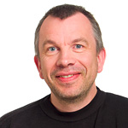
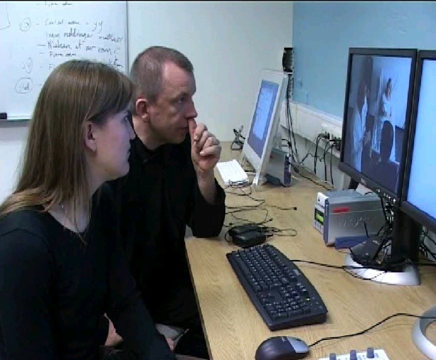
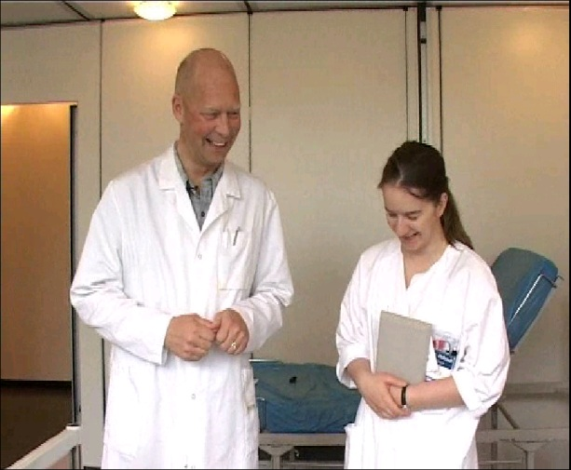
Professor Dag Svanæs dags@idi.ntnu.no
Research areas:
HCI
Interaction Design
Health informatics
Project/master thesis topics
Usability testing methodology
User-centred design methods
Sensor-based systems
User-interface design
Mobile computing (apps)
Prototyping techniques

Slide 18
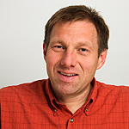
Øystein Nytrø
Evicare: Lean clinical decision support architecture for evidence-based healthcare in hospitals
Keeping patients out of hospital: Harvesting and mapping individual patient trajectories between specialist and primary care.
Master thesis topics within knowledge representation, search/information extraction & machine learning. Collaboration with researchers, clinicians, IT-industry and government.

Slide 19
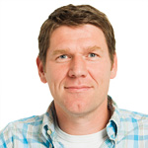
Professor Pieter Toussaint
Research areas:
  Work process support
  Computer-mediated communication
Important application domain:
  Health
Projects: COSTT and CoCoCo

Slide 20
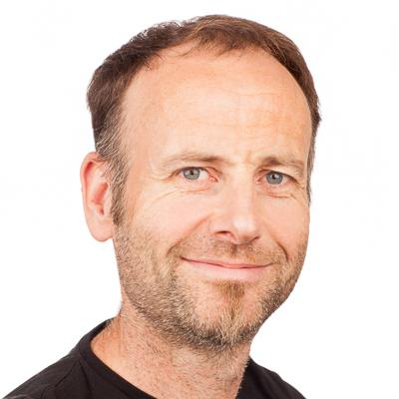
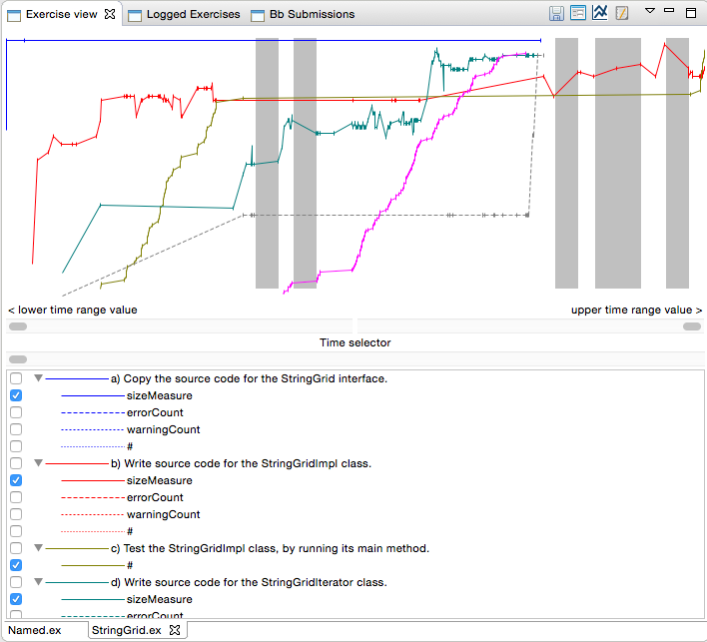
Associate professor Hallvard Trætteberg hal@ntnu.no
Research areas:
Tools for prototyping user interfaces
Learning to program
  Tools for supporting object-oriented programming course
  Learning Analytics
Project/master thesis topics
Prototyping user interfaces – web, mobile and desktop
Tools for ad-hoc code sharing
  Teacher – students during lecture
  Among students – pair programming
Learning resources for programming
  Customizing Eclipse IDE for learners
  Integrating coding and learning
  Structuring learning material
Coding for kids

Slide 21
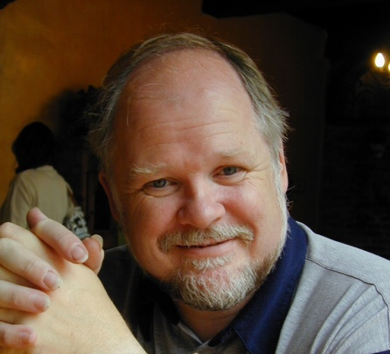
Assistant. Prof. Terje Rydland, terjery@idi.ntnu.no
Research interests
  User interfaces/Interaction design
  ICT in learning environments
  Use of mobile devices in learning
  Netbased learning - HTML/CSS/JS
Master thesis topics
  Exploring different ways to present pedagogical material in digital formats
  Interactive presentation of media rich content as a supplement to video
  Editor for producing web magazines on a tablet computer.
  Implementation of tablets and smartphones in a learning environment
  …

Slide 22
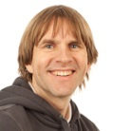
Assistant. Prof. Rune Sætre, satre@idi.ntnu.no
Research areas:
Keeping patients out of hospital, also known as PAsTAs:
Harvesting and mapping individual patient trajectories between specialist and primary care.
Mobile Computing and Service Composition: UbiCompForAll
Natural Language Processing and Information Services
  BussTUC
Courses:
TDT4105, TDT4110: ITGK and OO-Programming
TDT38: Clinic Support Systems
TDT44: Semantic Web
Project/master thesis topics:
FastlegeVakten, BussTUC, TeleBuster, PAsTAs, TextureCraft

Slide 23
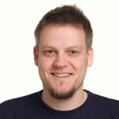
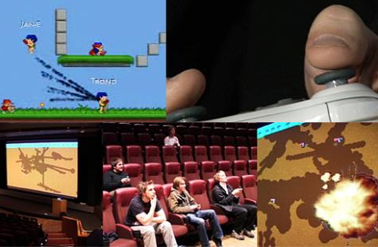
Professor Alf Inge Wang alfw@idi.ntnu.no
Research areas:
Game-based learning,
game technology,
game innovation,
software architecture,
game development
Courses:
TDT4105/TDT4110 IT Grunnkurs
TDT4240 Software Architecture
TDT71 Game Development
Examples of projects:
Kinect-based learning games, location-aware games, classroom games, multi-modal games, software architectures in game development.

Slide 24
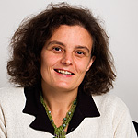
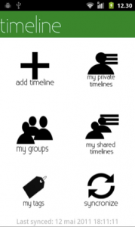
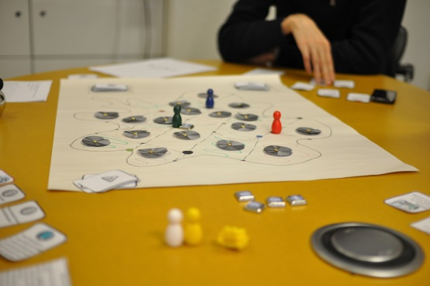
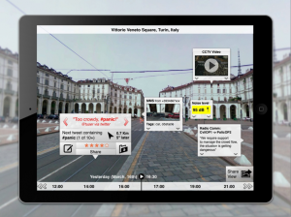

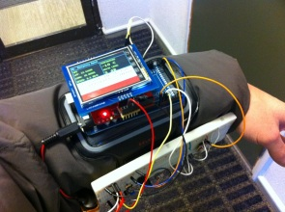
Prof. Monica Divitini, divitini@idi.ntnu.no
Research areas:
Cooperation Technologies
Mobile and ubiquitous computing
Pervasive Social media
Collaborative Serious games
Courses:
TDT4245, TDT29, IT2901
Check: teseolab.org
Project/master thesis available
MIRROR: Reflective learning@work
FABULA: learning in the city
CoCreat: Creativity in learning
Games and storytelling in museums
Games for emergency work
Embodied social interaction
A service-centric, user-driven view
Supporting cooperation among mobile users
A device-centric, technology-driven view

Slide 25
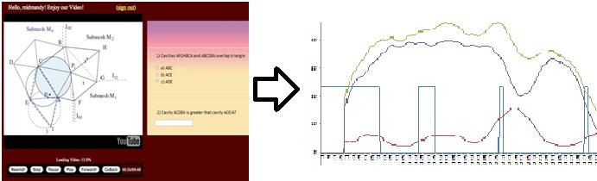
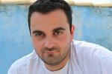
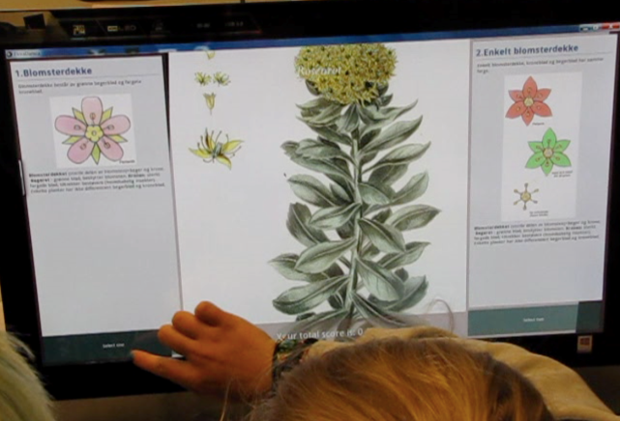
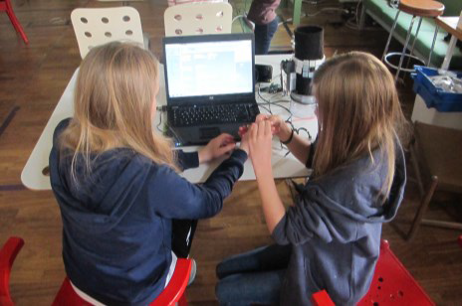
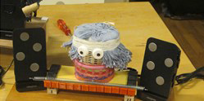
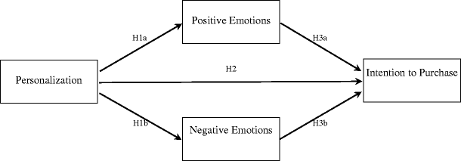
Associate prof Michail Giannakos,
michailg@idi.ntnu.no
Research areas:
Learning Analytics
  Video Learning Analytics
  Analytics from multi-touch screens and other ubi-devises
  Analytics from web appplications
Computing Education in K-12 Schools
  Programming using tangible environments
  Visual programming languages
User Experience
  Impact of Social Media @work,learning
Examples of project/master thesis topics
Collecting and making sense of video learning analytics
Usability design for video lectures
Learning programming through tangible playful environments
Design and development of playful digital games for STEM education
Investigating the impact of social media usage at work

Slide 26
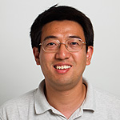

Assoc. Prof. Jingyue Li, jingyue.li@idi.ntnu.no
Research areas:
Security of web and mobile applications
Safety and security of autonomous systems
IoT and smart city
Empirical software engineering
Courses:
TDT4242: Advanced software engineering
TDT4237: Software security
Examples of project/master thesis topics
Software testing as services
Security and safety of autonomous systems
Security of IoT application and smart city
Software security and DevOps
Automatic security vulnerability detection tools

Slide 27
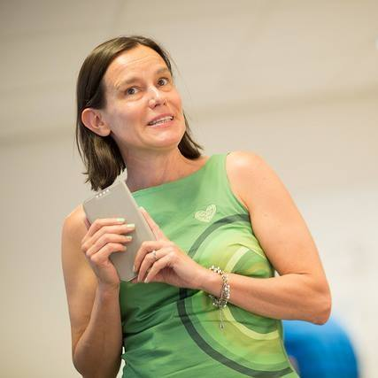
Prof. Letizia Jaccheri, letizia.jaccheri@ntnu.no
Project/master thesis topics:
Big data for social good and social innovation (with Ilias Pappas) http://www.socratic.eu/
Computational thinking and coding for K-12 education (with Sofia Papavlasopoulou) https://youtu.be/Wbzg2-T9G7k
Social Innovation platforms https://socratic-eit.org/
The Little Doormaid - an interactive a fairy tale about social innovation https://letiziajaccheri.org/the-little-doormaid/
Courses:
TDT4850 ICT-Enabled Social Innovation for Social Good
TDT4290 Kundestyrt prosjekt

Slide 28
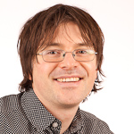
Adj. Prof. Torgeir Dingsøyr, dingsoyr@idi.ntnu.no
Research areas:
Empirical software engineering
Software process improvement
Agile software development
Knowledge management in software engineering
Teamwork in software development
Courses:
IT1901 Informatics, Project I
Project/master thesis topics
Large-scale agile software development

Slide 29
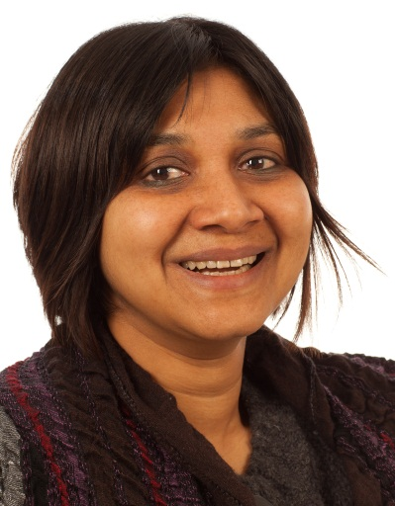
Adj. Assoc. Prof. Sobah Abbas Petersen, sap@idi.ntnu.no
Research areas:
Mobile, Ubiquitous and Mixed Reality Learning (SIMOLA, ALTT)
Serious Games (GALA: http://www.galanoe.eu/)
Gamification
(MyNeighbourhood: http://my-neighbourhood.eu/)
Enterprise Modelling and Proactive Enterprises (http://www.proasense.eu/)
Courses:
TDT4252, DT8802
Project/master thesis topics
Mixed Reality Learning and Decision Making in the workplace
Modelling for Proactive and Sensing Enterprises
Visual Modelling and personalized views
Gamification and engagement

Slide 30
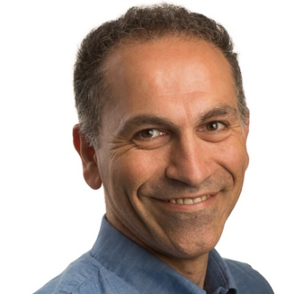
Adj. Assoc. Prof. Babak Farshchian, baf@idi.ntnu.no
Research areas:
Pervasive and ubiquitous computing
Collaborative information systems
Assisted living, elderly and ICT
Social inclusion technologies
Courses:
IT 3010 Research methods in informatics
TDT39 Empirical studies in information technology
Project/master thesis topics
ICT for fall prevention among elderly population
ICT for supporting dementia patients and caregivers
Internet of things infrastructures for healthcare and assisted living.

Slide 31
Questions?

