Slide 1

Being or becoming?
and its influence on motivation for mentoring (in CS?)
Kirsti E. Berntsen
Ass. Prof.
Dept. Informatics and e-Learning

Slide 2



The evidence shows
- CS worse off than STEM
- medicine, nano & IX are ‘hot’
Singling out
Structures
Self image
Common opinion
?

Slide 3
Some issues
Traditions of authorship in scientific publications
  Sociology – ranked authorship => gender indifferent recognition
  E.g. economics - alfabetical order => male recognition
  (Sarsons 2015, unpublished Harvard)
Gender based strategies => single out
To counter balance - we need common stories on why to do ..
What are my capabilities? => qualitative feedback on work, assignments, i.e. – more than grades A-F

Slide 4
Strategies - we need:
- both collective and individual approaches
- shared common opinions that support becoming and being
Being a competent professional
– requires membership in Communities of Practice (COP, Wenger 1998)
Becoming, and staying, part of:
a COP is made through a “mutual engagement” in “shared stories” – “making a joint enterprise that is continually renegotiated by (all) the members”.
Good examples:
  Little Doormaid (Jaccheri 2016)
  Making the diverse history of computing and gender common knowledge (Misa 2010)

Slide 5

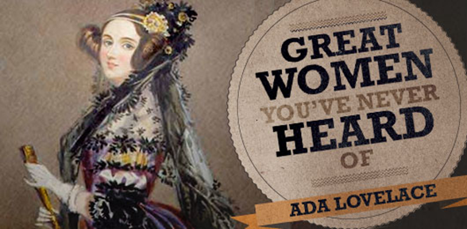
Alan Turing, Joan Clarke, Hugh Alexander, ...
Cracked the Enigma Code Machine, 2.World War
Picture from the movie The Imitation Game (2014)
Ada Byron Lovelace
(1815-1852):
invented the algorithm,
for the first computer – Charles Babbage’s Analytical Machine

