Slide 1
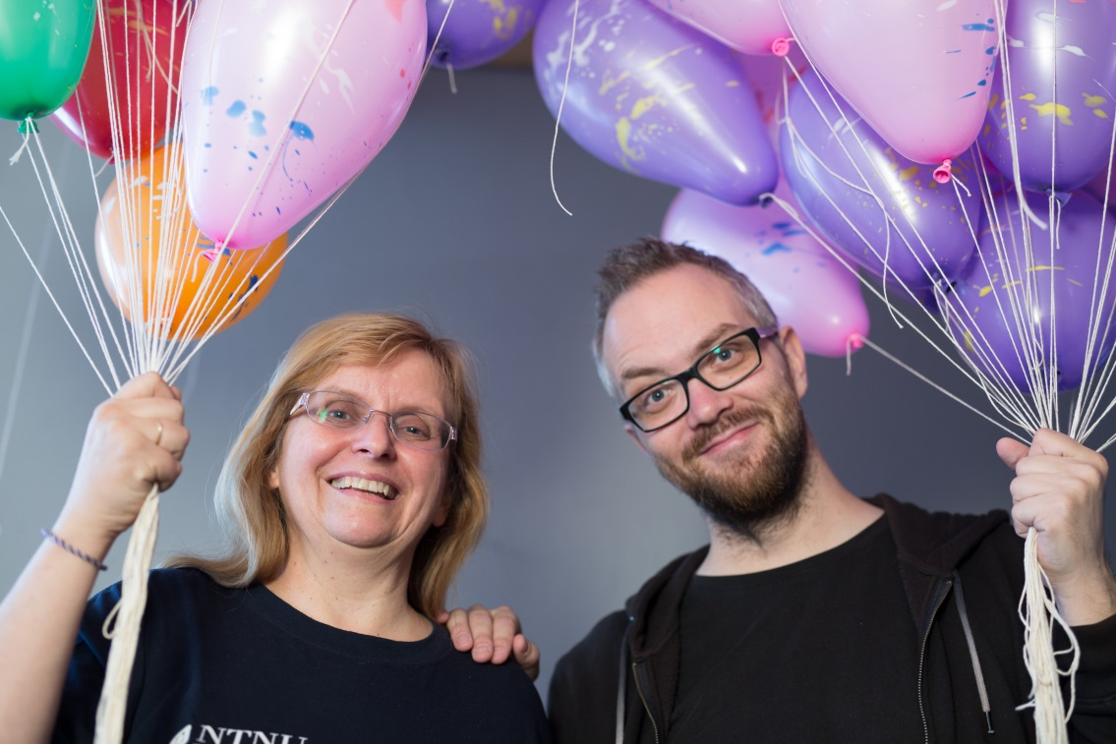
Letizia Jaccheri
热爱IT，乐于和学生一起工作
Kjærlighet til IT
og gleden ved å være sammen
med studenter
Amore per l’informatica
e per gli studenti
Love IT and Students
Department of Computer and Information Science (IDI)
www.letiziajaccheri.org
Notes:
Hva er jeg mest og minst fornøyd med ved mitt eget institutt?

Slide 2
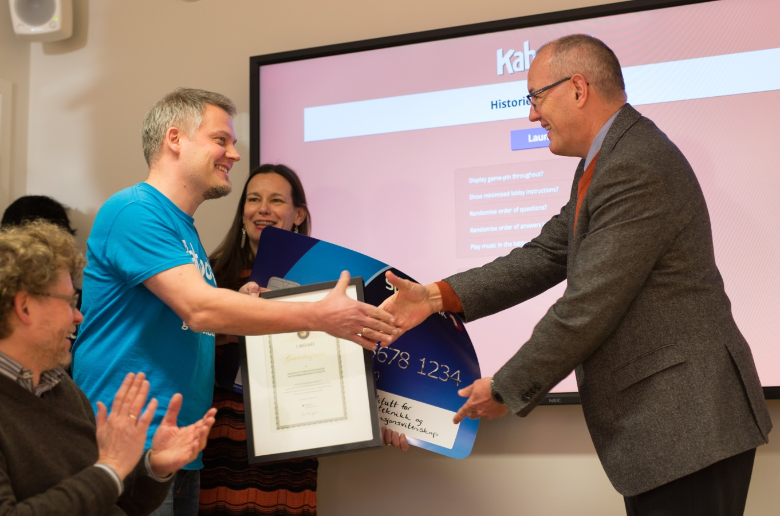
Computer Science (CS) Excellence in education and research
Computer Science
Software engineering
Information Systems
Computer Engineering
Notes:
CS is about a) hardware, software, and stakeholders (users, customers, developers); b) contributing to theory by increased understanding; c) contributing to methods by engineering new systems. Our mission is excellence in education and research. It does not make sense to discuss if education is more important than research or if understanding is more important of engineering and vice versa. We should do all. Not each one should do all but as a department.

Slide 3
Education
Computer Science – sivilingeniør datateknologi
  5 year Master in Computer Science (2015: 108 – 1687 – 368)
  2 year Master in Computer Science
Informatics – Informatikk
  3 year Bachelor in Informatics (2015: 130 – 1300 – 338)
  2 year Master in Informatics
international master Information Systems
  2 year Master in Information Systems
PhD programme Information Technology
  3 year PhD in Information Technology
Available places – applicants – first choice applicants
Notes:
http://www.samordnaopptak.no/tall/2015/mai/so45/

Slide 4




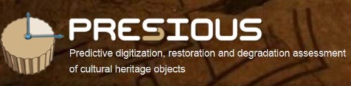

Research - EU / EEA Projects
AMIDST - Analysis of MassIve Data STreams
Cloud Lightning
HaBiT - Harvesting big text data for under-resourced languages
LinkedDesign
NASCENCE - NAnoSCale Engineering for Novel Computation using Evolution
Ocean-Certain
PRESIOUS - Predictive digitization, restoration and degradation assessment of cultural heritage objects (coordinator)
READEX - Energy-efficient high-performance (exascale) computing

Slide 5


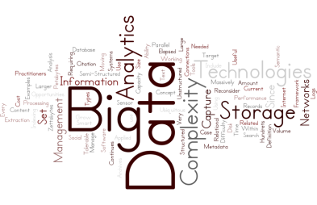

Research - NFR NORAD Projects
Agile 2
Common Language Resources and Technology Infrastructure Norway (CLARINO)
Digital Oil (Doil)
Exploring New Dimensions in Big Data (Exibida)
Join Game 2
NORHED - Linguistic Capacity Building
Programmable epigenetics (Epi++)
Flexible student-driven learning (SIKT)
Agile development of safety-critical software (SUSS)
Content analysis for recommender systems focusing on news stories
Linguistic capacity building for development of Ethiopia

Slide 6



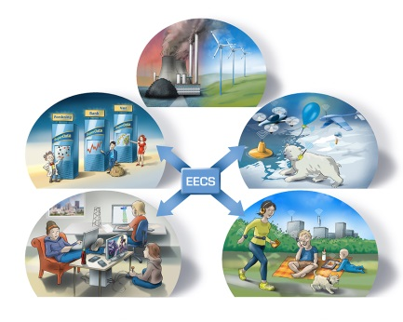


Research ++
Centres for Research-based Innovation (SFI)
EXPOSED
SIRIUS
Our Strategic Research Areas at the IME faculty
Big Data (BigData)
Energy Efficient Computing Systems (EECS)
Open and Autonomous Digital Ecosystems (OADE)
Industry Partners
Norwegian Public Roads Administration / Statens Vegvesen
Schlumberger
Telenor

Slide 7
People and cooperation
Software engineering and Information systems group (P: 14+1N; T: 27)
Algorithms, HPC and Graphics (P: 4+1N; T: 9)
Intelligent systems (P: 7; T:7)
Data and Information Management (P: 7; T:8)
Computer Architecture and Design (P: 3+1N; T: 12)
Administrative group (10)
Technical group (9)

Slide 8
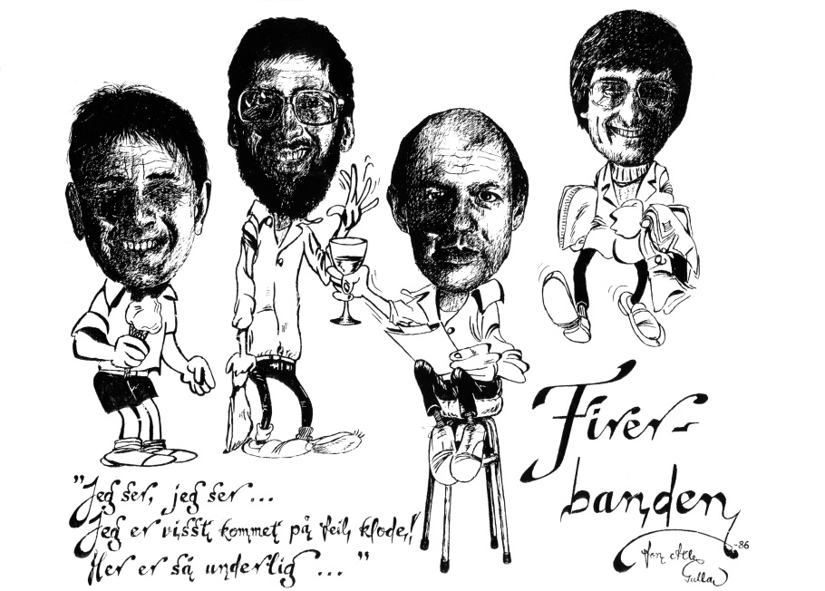
People and cooperation
S: 30 new persons employed since August 2013 of which 2 permanent + 3 Permanent in 2015

Slide 9

Spaces
constant focus on renewing, a lot of light and space in IT building, common labs for the new groups

Slide 10
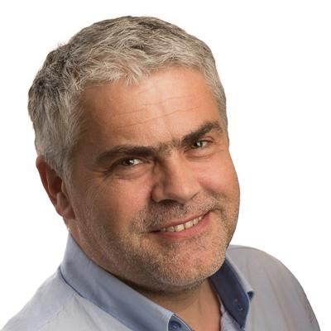
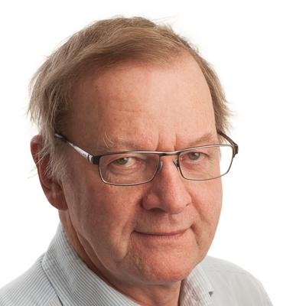
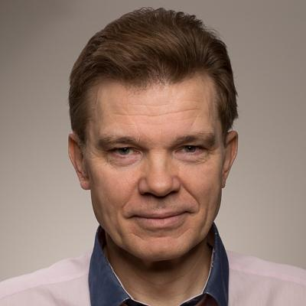
Questions?
Room 454 IT Building
Agnar Aamodt
Trond Aalberg
Mads Nygård

